Slide 1

Expectations for Year 1
What to expect this year….
Learning together, achieving forever.
Notes:
Miss Dillon

Slide 2
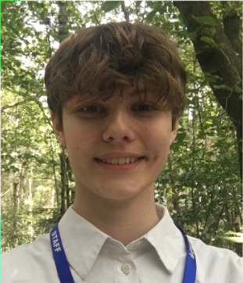
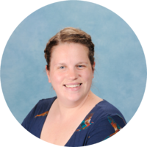
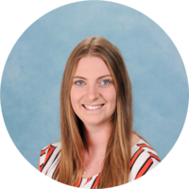
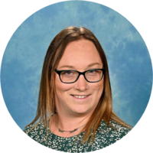
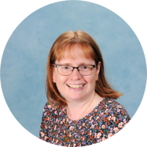
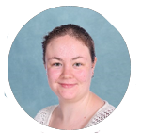
Meet the staff team.
Teachers
LSAs
The team very much work as a cohort unit so your child will work with a range of adults. We pride ourselves on being an approachable and friendly staff team, so please speak to us at the end of the day when you collect your child – at pick up, our door is always open!
Miss Storr- Yew
Mrs Davis- Cedar
Mrs Greehy-
Supporting transition
Mrs G (Gorzynski)
Mrs Wallace
Miss Sharratt
Learning together, achieving forever.
Notes:
Lisa

Slide 3

Continuous Provision in Year 1
Continuous Provision (CP) is a less formal style of teaching, providing opportunities to ‘learn through play’ and is what the children have experienced in their time in Year R. This way of learning encourages children to become active, independent learners who can therefore make their own choices whilst feeding their curiosity and exploration skills.
The aim of this style of teaching is to “build” confident, resilient, positive and reflective children who love to learn, embedding essential skills for lifelong learning.
Similar to the Year R setting, your child will have outdoor learning opportunities available to them as much as possible and freedom across both classrooms for most parts of the day. We ask that all children have wellies kept in school to allow them to get outside and explore whatever the weather. Please ensure your children have waterproof coats on rainy days, and sun hats on sunny days! Just like in Year R- learning can be a messy business, prepare for your children to have very active and sometimes messy days of learning.
How is Continuous Provision different in Year 1 to Early years?
Rainbow Challenges
Implementation of the National Curriculum.
Some whole class teaching for certain subjects.
Learning together, achieving forever.
Notes:
Lisa

Slide 4
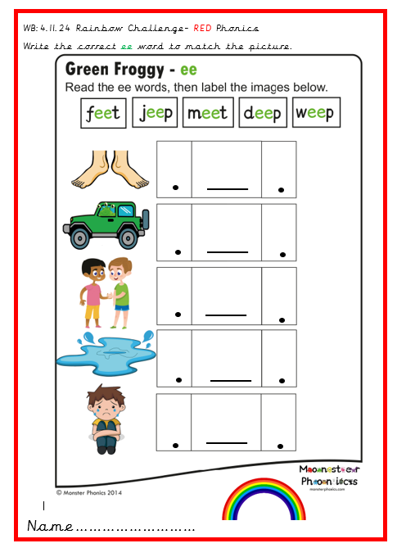
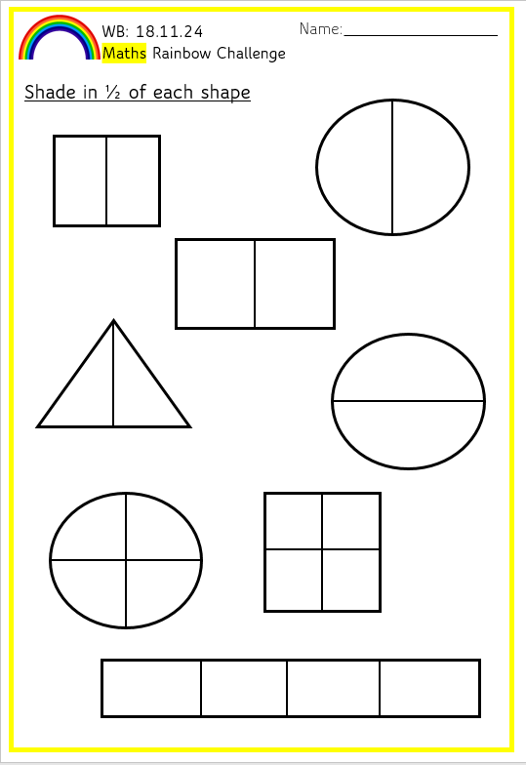
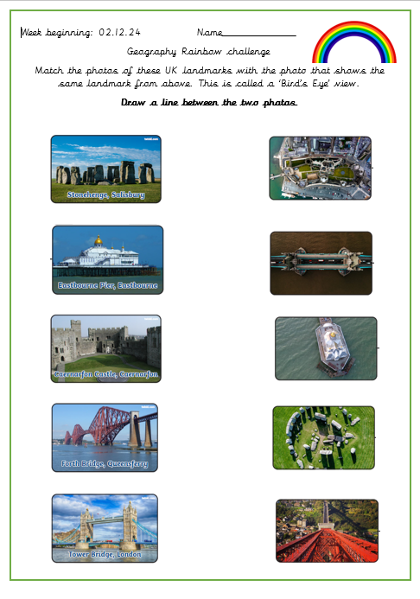
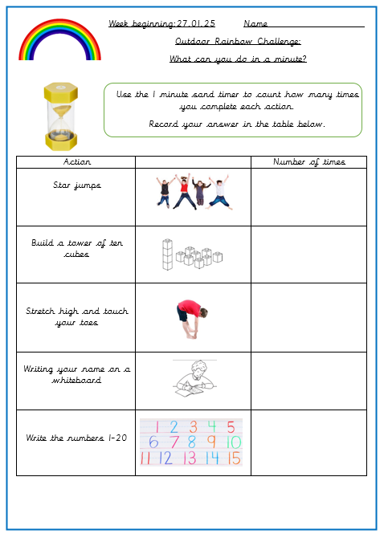
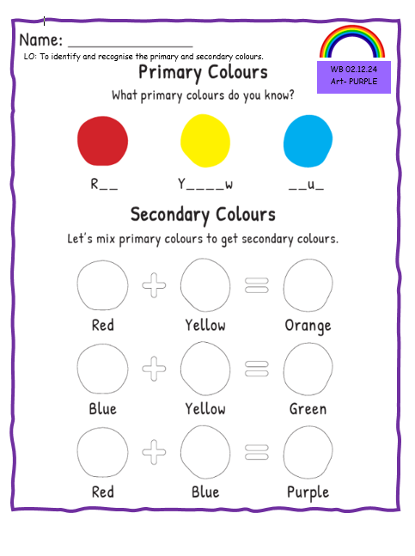
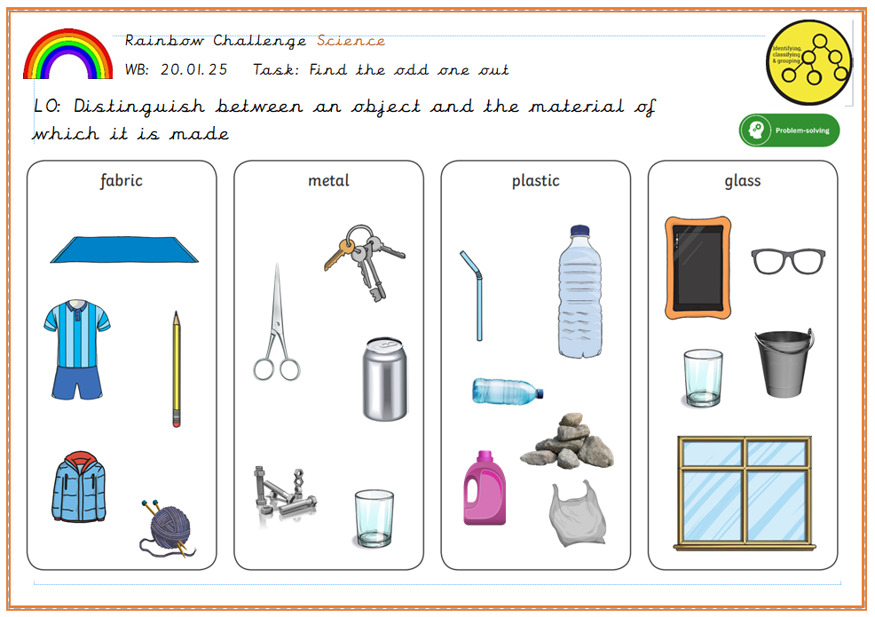
What are Rainbow Challenges?
When we feel the children have settled and are ready we will begin Rainbow Challenges. Rainbow challenges run throughout the week and are linked to the areas of the curriculum. The challenges are sometimes so that we can assess for learning before teaching, so that we can see what the children may know already. Mostly it will be an opportunity for the children to ‘show what they know’.
Activities are a chance to embed and practice their learning from the previous week.
Red- English and Phonics
Orange- Science
Yellow- Maths
Green- History/ Geography
Blue- P.E, French, R.E, Jigsaw, Music
Purple- Art and DT
Notes:
Lisa

Slide 5
Topics in Year 1
Autumn Term– Me and My World
History- How have things changed in my lifetime?
This topic really gives us the chance to get to know the children, talk about different family dynamics. In science we learn about the different animal groups and identify animal body parts. In humans we focus on the senses and naming basic body parts. In Geography we learn about the UK and capital cities.
Spring Term – Toys
A highlight of this topic includes a visit from Mr Cushing, toy expert extraordinaire and ‘The Grandparents Toy Party’! In science we learn about materials which links well with our toys topic as the children learn about the different materials and their properties. In Geography we learn to read and draw maps, continents and oceans and human and physical features.
Summer Term 1 – Kings, Queens and Castles
The highlight of this topic includes a trip to Portchester Castle, learning about the monarchy and significant events of their reign. Hot and cold areas of the world, the Sahara and Antarctica. In science we learn about evergreen and deciduous trees and naming and identifying wild and garden plants. In DT we make castles with a working drawbridge.
Whilst we will send out reminders of key events, please do refer to our termly dates letter that is emailed to you before every new term.
Learning together, achieving forever.
Notes:
Natalie

Slide 6
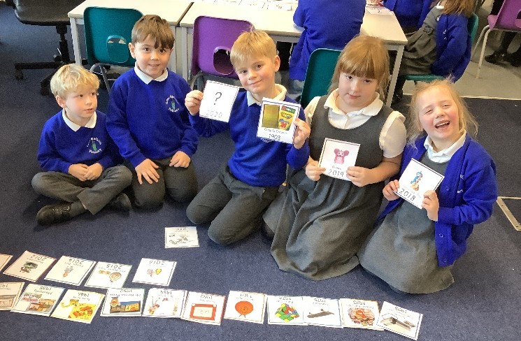
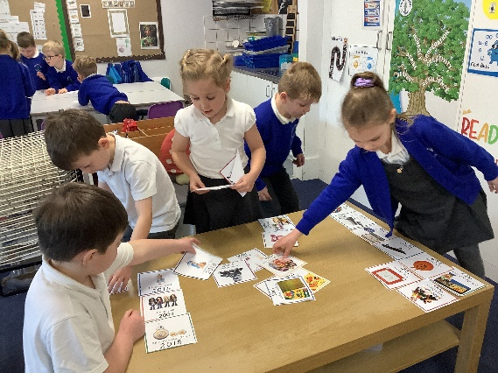
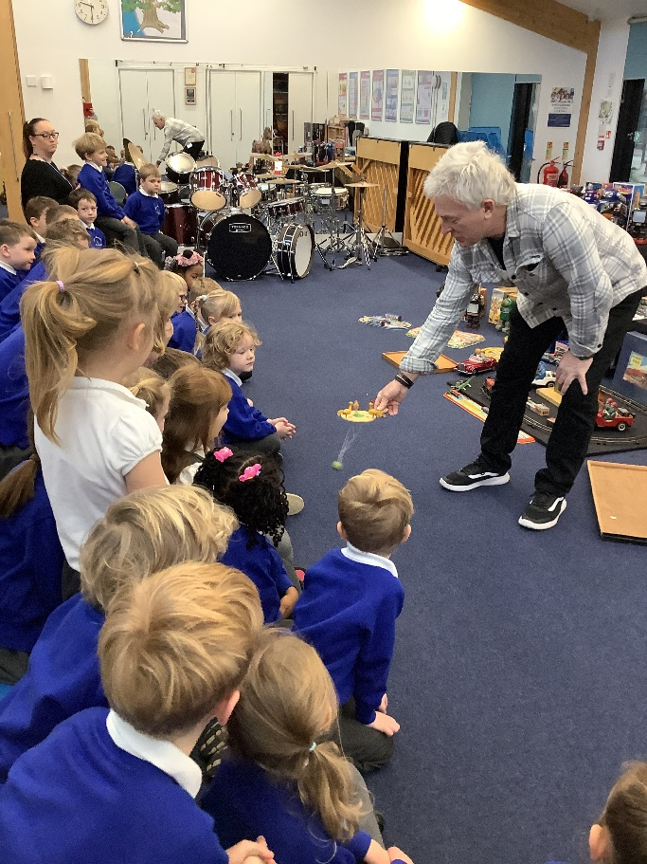
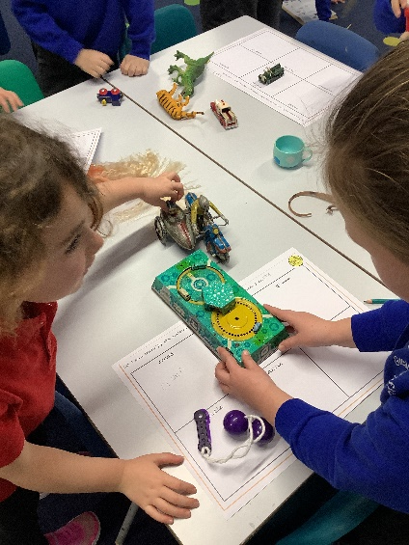
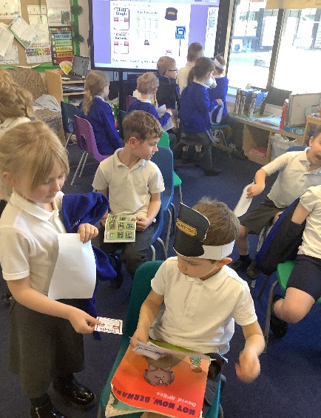
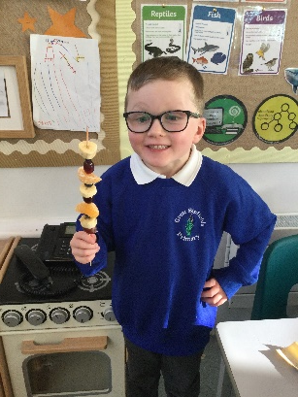
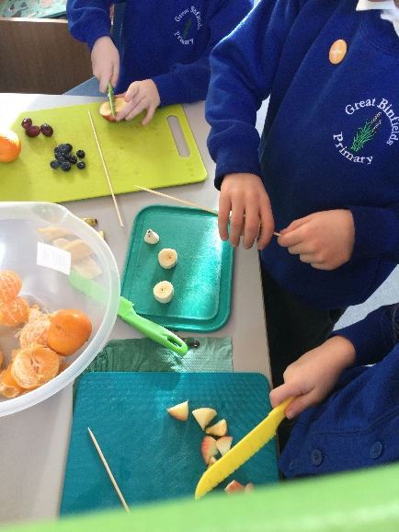
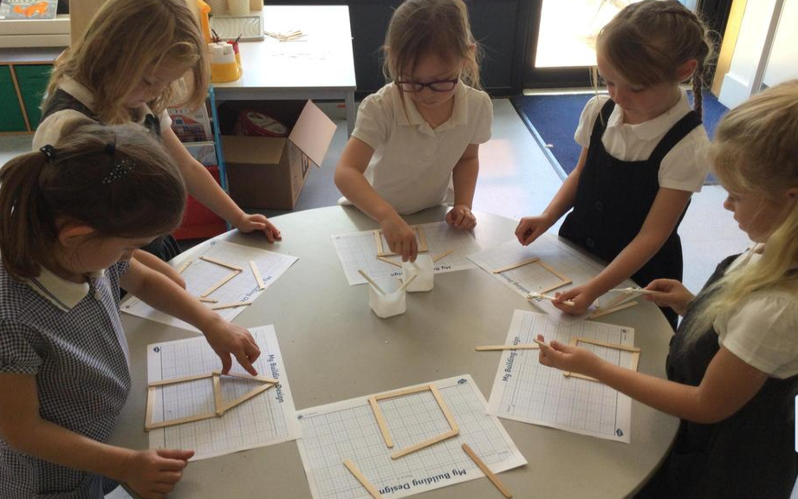
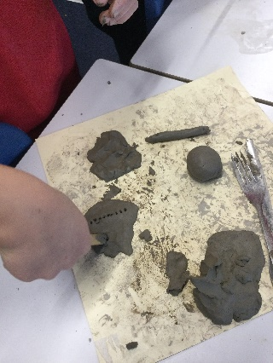
We are not sat at tables all day.
Our learning in Year 1 is very hands on and practical. Learning happens everywhere!
Notes:
Lisa

Slide 7
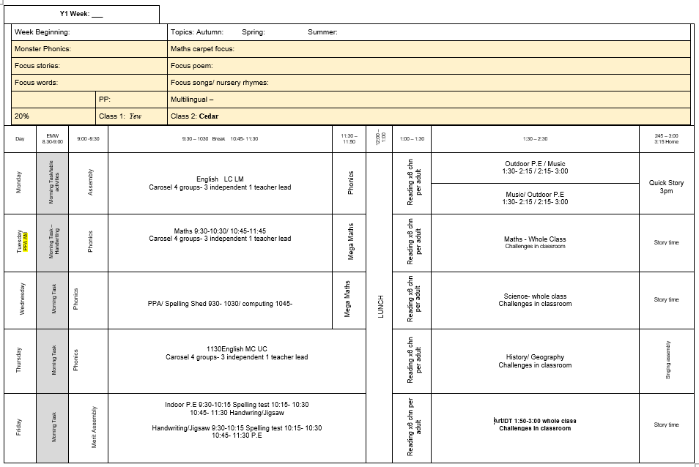
A typical week in Year 1
This can change dependent on other school events happening
PE: Monday - Outdoor PE
Friday– Indoor PE (Dance/Gymnastics)
Library: Day to be confirmed
Notes:
Lisa

Slide 8
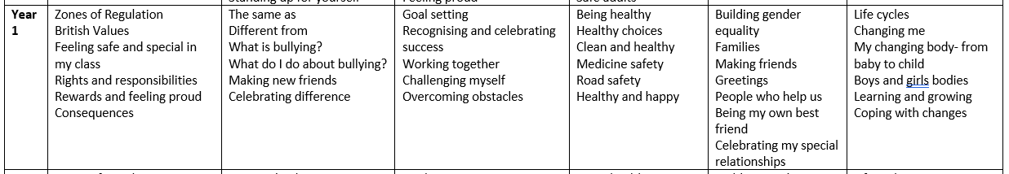

PSHE
Our PSHE lessons are supported by the Jigsaw scheme but we also use other schemes and websites to ensure full coverage and variety, by teaching a combination of PSHE, emotional literacy, mindfulness and social skills. Each term we also have jigsaw days across the school..
https://www.greatbinfields.co.uk/pshe-including-rse-and-citizenship
Please visit our website for our PSHE and RSE policies and more information on how each are taught.
Notes:
Natalie first then Lisa

Slide 9
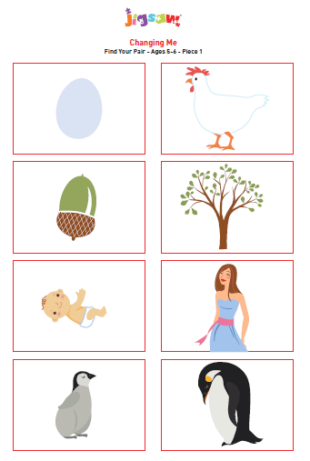
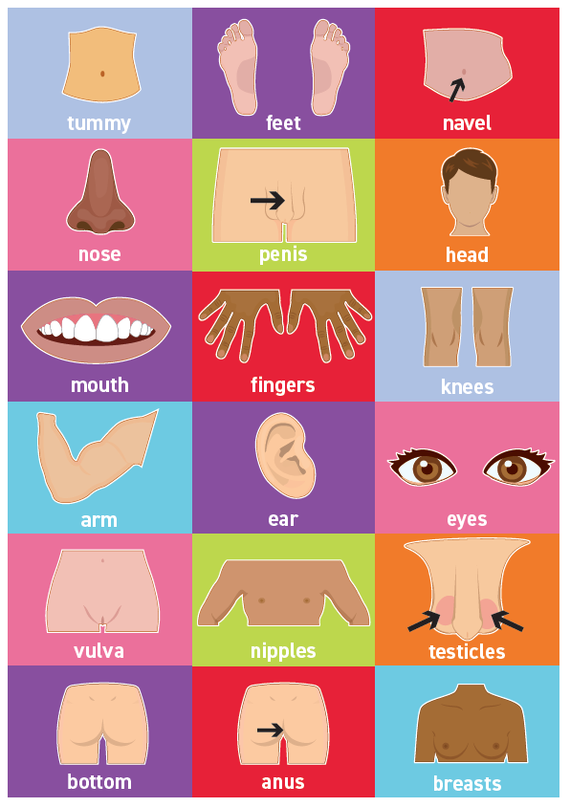
PSHE
The government has updated RSE guidance for September 2026 onwards and our curriculum has been adapted to be in line with this.
Here is an example of an RSE lesson resource used within our year group:
We also have an RSE parent consultation survey which can be found on our Key Information page. The survey is available to complete at any point, with no end date – responses will be reviewed periodically, and taken into account when the policy is reviewed each year.
We teach the children the correct vocabulary for different body parts such as penis, vulva and anus.
Notes:
Lisa

Slide 10

https://www.greatbinfields.co.uk/
School Website
We will regularly post updates on the latest news page (front page) as the year group enjoys special events.
Each half term, we will post a round up of the topic including pictures of your children learning in action! This will be also be on the ‘class page’ section of the website (under the ‘children’ tab then ‘class pages’)
The monthly school newsletter is also published on the ‘latest news’ section. This will keep you up to date with school events.
Notes:
Natalie

Slide 11
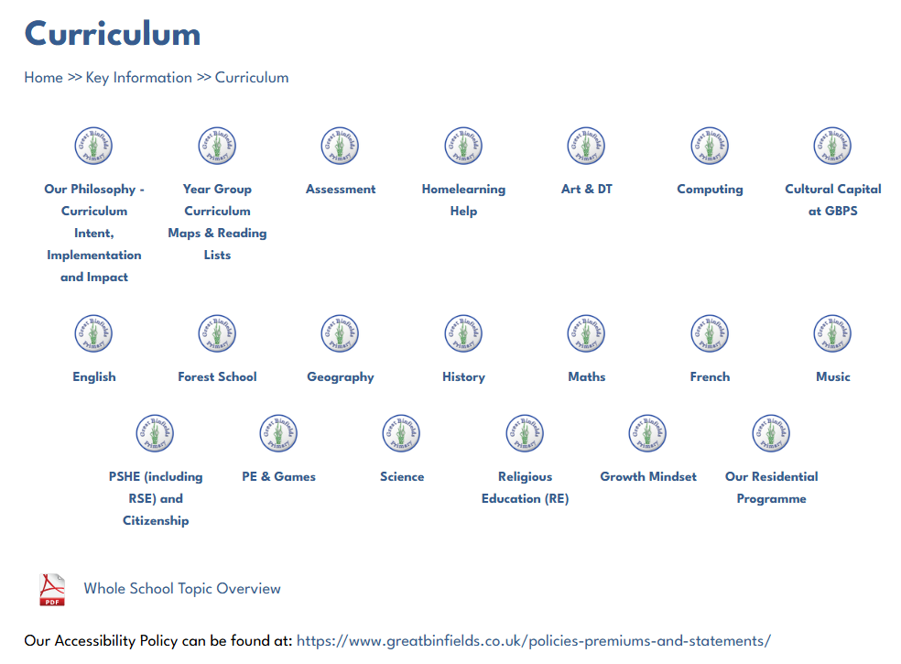
Curriculum pages on our website
https://www.greatbinfields.co.uk/curriculum/
Each area of the curriculum has a dedicated information page on our school website. These pages are kept up to date by our Subject Leads. These pages outline the long term plan for that area across the school. For example, you can see what your child will be learning in Science during their school year, how this progresses from KS1 to KS2 and which objectives we are assessing your children against.
Notes:
Natalie

Slide 12

https://www.greatbinfields.co.uk/
We will regularly post updates on the latest news page (front page) as the year group enjoys special events.
Each half term, we will post a round up of the topic including pictures of your children learning in action! This will be n the ‘class page’ section of the website (under red ‘children’ tab then ‘class pages’)
The monthly school newsletter is also published on the ‘latest news’ section. This will keep you up to date with school events.
Notes:
Natalie

Slide 13
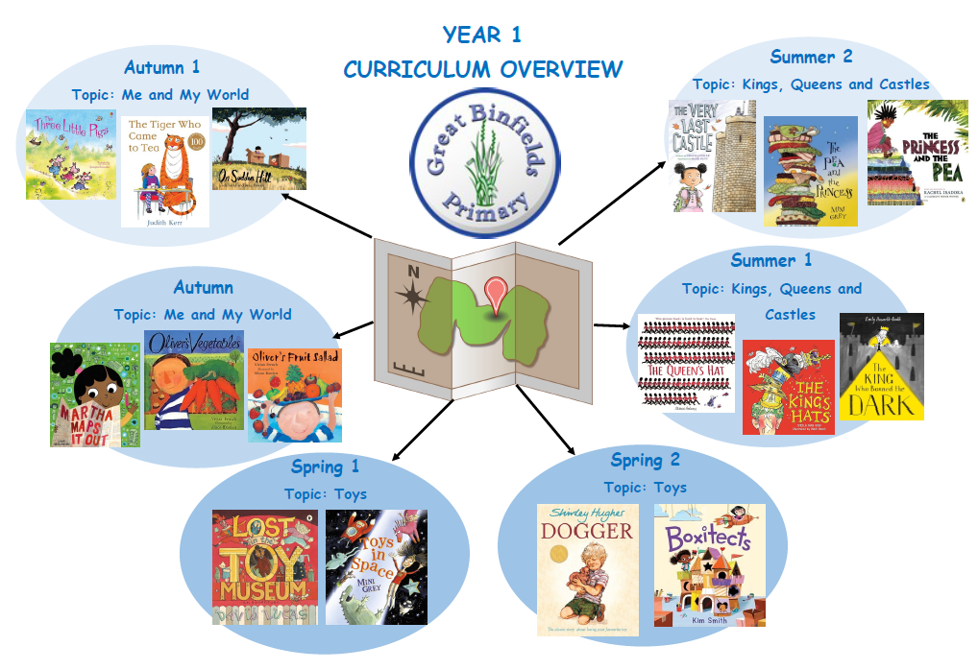




Year 1 Curriculum Overview
2
Notes:
Natalie
These are our focus stories throughout the year for our English lessons. These stories link to our topics and focus on other areas of the curriculum such as PSHE.

Slide 14
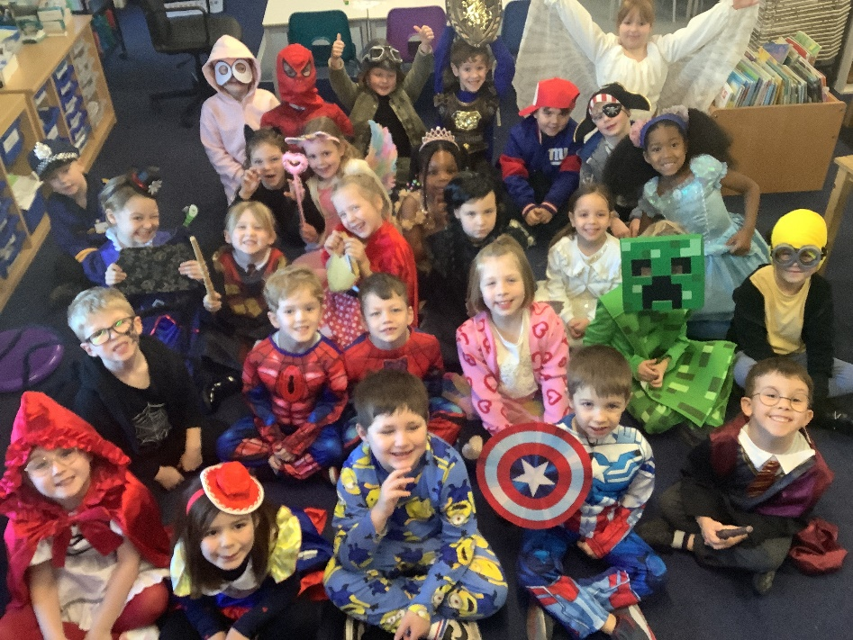
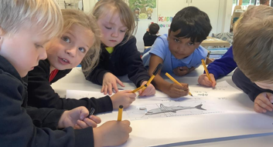
Whole School Highlights
Outdoor week and learning experiences outside.
Jigsaw days – half termly events, each with a different theme based on PSHE (Jigsaw) learning.
RE days
Topic visitors and trips
World Book Day
Geography fieldwork
Creativity Week
Sports Day
House Point Reward Time
Learning together, achieving forever.
Notes:
Lisa

Slide 15
General Information
Settling in – Autumn 1 and 2 is all about getting to know our children and settling them into new classes and routines.
Children in KS1 are not required to bring in any additional equipment, such as pencil cases.
Bookbags - Children must use the school bookbag in Year R and KS1. Please do not allow your child to bring in a rucksack until Year 3. Space is limited in our cubby holes, and bookbags are the perfect size for home school diaries, reading books, and library books.
Healthy snacks - Children in Key Stage 1 participate in the free Fruit and Vegetable Scheme, which is used as their mid-morning snack. If your child is not able to eat certain fruits, an alternative may be brought from home – fruit and vegetables only please. Sweets, crisps and chocolate and cereal bars are not permitted. (We are a nut and pea free school)
Milk - If you would like your child to have milk in school – please contact the school office to join the ‘Cool Milk’ scheme.
Belongings – Please ensure that all belongings, such as lunchboxes, water bottles and coats are clearly named and that your children understand it is their responsibility to look after them! (Lost property in the entrance hall)
Please do not allow your child to bring in toys from home, unless requested. Keep them safe for home use.
Year group costs – a letter regarding this has been emailed out
Notes:
Lisa

Slide 16

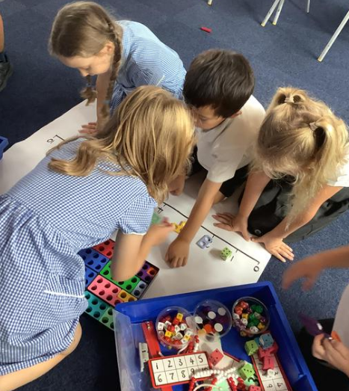
Maths
To begin this academic year, we will follow HIAS planning from Hampshire County Council and we will be reviewing and developing our maths curriculum through a more mastery and practical approach.
We also use MathSeeds in KS1 to support lessons and some homework activities.
Mathseeds is a guided learning journey.
All children will be given a log in to practice weekly online. There is also a printables library for offline practice.
You should receive information and a guide on how to use this soon.
‘How can I support at home?’
Play games
Number bond practise
Pattern spotting in Maths all around you
Notes:
Natalie
Online game – have own personal account
When first log in – have an assessment to complete to determine their ability– depends on this where they start on the map
Mental maths skills – games / videos / lessons
Short sharp lessons and games.
Child friendly and interactive
Log ins will be put in diaries over next week or 2

Slide 17

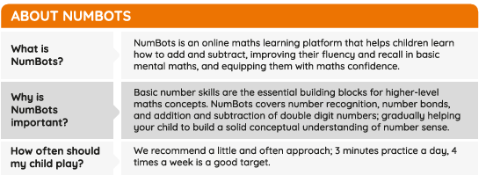
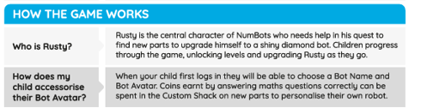
Notes:
Lisa
Another maths platform that can be used for maths - your child will like one or another and ok with that – give both a try (there as a resources for home)
Don’t have to use both
Do need to use at least one of them has supporting maths at home
Maths seeds more user friendly
Child may like numbots – timed assessment – quick fire answer questions
Number bonds

Slide 18
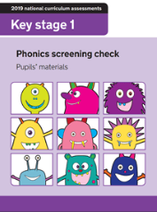
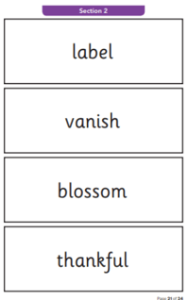
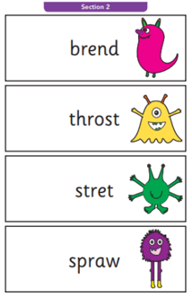
Year 1 Phonics screening check
This is a national phonics check, which takes place in June. Children are tested on a 1-1 basis with their class teacher.
During the check they read 40 words, consisting of real and alien words.
The test allows them to apply their knowledge of phonics to words, rather than sight word reading. We cannot emphasise enough the importance of regular reading and giving your child the opportunity to succeed.
Children who do not pass the Phonics Screening Check in Year 1 will have the opportunity to take it again in Year 2.
Notes:
Lisa

Slide 19
Phonics
The National Literacy Trust states:
Phonics is a way of teaching children how to read and write. It helps children hear, identify and use different sounds that distinguish one word from another in the English language.
Written language can be compared to a code, so knowing the sounds of individual letters and how those letters sound when they’re combined will help children decode words as they read.
Children use blending of sounds to decode unfamiliar words. E.g. when a child can sound out/read s, a, t, p they can then build words such as sat, sap, pat, tap etc.
We teach phonics for half an hour, 4 times per week using Monster Phonics. This is a systematic synthetic approach to phonics.
You will find the graphemes (the written sound – see glossary) at the front of your child’s Home School diary (EYFS and KS1). This is a useful resource to practise with your child, ticking them off once your child is confident with reading and sounding out each grapheme regularly.
https://literacytrust.org.uk/information/what-is-literacy/what-phonics/?saved#cookies-form
Notes:
Lisa

Slide 20

At the heart of Monster Phonics is a unique colour-coding system which links letters and sounds to a named monster. This gives powerful new tools to teach phonics, making phonics memorable as well as fun!
Monster Phonics uses a multisensory approach through songs, colour-coding and engaging materials such as magnetic letters, playdough and apps to learn sounds and their written form. These resources can be used both at school and at home.
Monster Phonics consistently colour-codes the written sound in order to identify the sound heard. Monster Phonics focuses on coding the vowel sounds, silent letters and tricky letters. This method helps accelerate progress as the monsters make it a more memorable way to identify sounds when reading and writing… be sure to ask your child which monsters they can find within their reading next time!
Sign up for newsletters and webinars on the Monster Phonics website.
https://www.eventbrite.co.uk/o/monster-phonics-19791043283
Notes:
Lisa

Slide 21
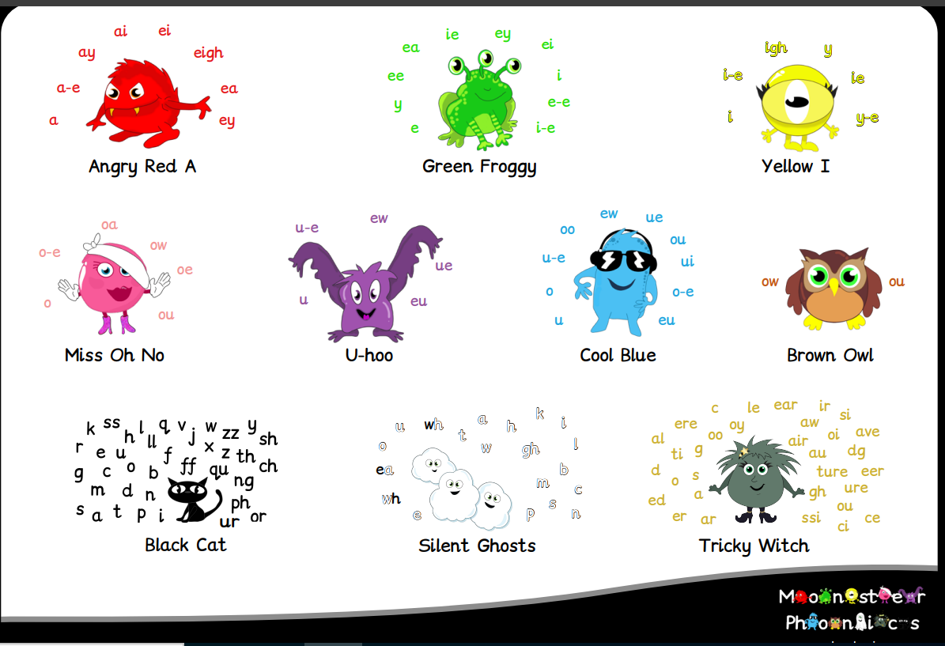
Monster Phonics
Meet the Monsters https://www.youtube.com/watch?v=B5pWEBNL0zU
Notes:
Lisa

Slide 22
Phonics glossary
Phoneme - The smallest unit of sound. There are approximately 44 phonemes in English (it depends on different accents). Phonemes can be put together to make words.
Grapheme - A way of writing down a phoneme. Graphemes can be made up from 1 letter e.g. p, 2 letters e.g. sh, 3 letters e.g. tch or 4 letters e.g ough.
GPC - This is short for Grapheme Phoneme Correspondence. Knowing a GPC means being able to match a phoneme (the sound) to a grapheme (the written form) and vice versa.
Digraph - A grapheme containing two letters that makes just one sound (phoneme e.g. ch, sh, th).
Trigraph - A grapheme containing three letters that makes just one sound (phoneme e.g. air, ear, ure).
Oral Blending - This involves hearing phonemes and being able to merge them together to make a word. Children need to develop this skill before they will be able to blend written words.
Blending- This involves looking at a written word, looking at each grapheme and using knowledge of GPCs to work out which phoneme each grapheme represents and then merging these phonemes together to make a word. This is the basis of reading.
Oral Segmenting - This is the act hearing a whole word and then splitting it up into the phonemes that make it. Children need to develop this skill before they will be able to segment words to spell them.
Segmenting - This involves hearing a word, splitting it up into the phonemes that make it, using knowledge of GPCs to work out which graphemes represent those phonemes and then writing those graphemes down in the right order. This is the basis of spelling.
Alien words - Alien words are often also called nonsense words or pseudo words, and are words made up of sounds a child has already been taught through the DfE scheme.
Notes:
Lisa

Slide 23
Reading
When your child joins Year 1, we take the time with them to assess their reading. We begin by asking them to read books on the same level that they were on when they finished Year R. By doing this we are able to determine if they have retained their phonic knowledge or if they need to revisit books they have read before to build their confidence back and fluency before moving them on to the next book band.
Once a week, your child will have a new Monster Phonics reading book, alongside an additional reading for pleasure book (2 books in total). The day that your child receives a new reading book will depend on which reading group they are in. The Monster Phonics book they are given will focus on a particular sound, whereas the reading for pleasure book is an alternative style of book, which may provide more opportunities for language development and non-fiction reading.
Please be aware that some book bands within the Monster Phonics scheme can take longer than others to get through as there is a different number of books in each band. Therefore, please do not feel disheartened if your child appears to be on the same level for a long period of time. Also, we assess our children through the Monster Phonics assessment tracker, alongside their reading to give us a better understanding of their reading ability before moving them up levels. Moving children quickly through the book bands or moving them too soon can be counter productive to their reading development.
Diaries should be in school every day, so they can be stamped/signed if your child reads 1-1 or in a group reading session. However, diaries are not checked by staff every day so please do not send communication to teachers via diaries. Come and see us at the door at pick up if you have any quick discussions or queries regarding their reading.
Notes:
Natalie
Mention its normal to feel like a child might have forgotten stuff

Slide 24
Home School Diary
This book is to travel to and from school every day.
We hope that your child and you as parents find it a useful tool to record your child’s reading achievements.
This book will last for the whole school year and is provided free of charge, however if your child loses their home school book there is a cost of £4.00 to replace it. Please contact the admin office if you need a new diary.
Children need to read at least 5 times a week at home. You will need to sign to indicate they have done this.
Reading to your child is still very important, please continue to read bedtime stories and any other opportunities to share a book together.
Learning together, achieving forever.
Notes:
Lisa

Slide 25

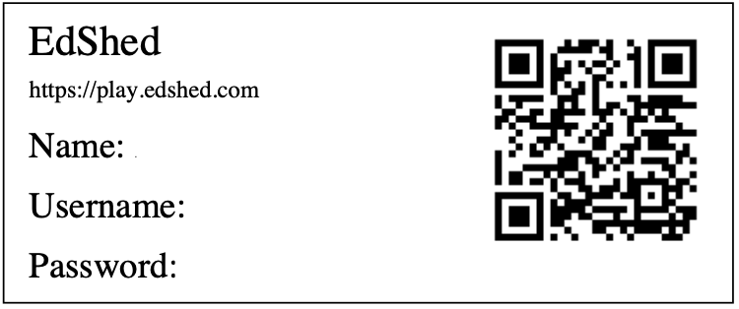
Spellings
From September, the children in KS1 will be using a programme called ‘Spelling Shed’ to support the children with their spellings.
This consists of one taught spelling session a week.
Spelling Shed is full of many interactive games and activities. Spelling Shed's approach to spelling involves the relationship between sounds and written symbols as well as using morphology to help spell through meaning.
When the children are ready, they will have weekly spellings set alongside their homework, which will then be tested the following week.
On Friday, when we start, the children are set an activity on Spelling Shed to complete at home. They are tested on the words they have been focusing on in school on the following Friday.
You will also get a paper copy in the diary of the list if you want to reduce screen time and practice another way.
The spellings can be taken from the first 100 and 200 high frequency words, and also be linked to certain sound patterns.
Notes:
Natalie
Start spellings in class probably before we send home
Might not start testing until aut 2/spring 1
But we still do the lessons in class and focus on this

Slide 26
Home Learning Expectations
Our Home Learning Policy can be found on our school website in the ‘Key Information’ section.
We recognise and value the contribution that learning in the home environment can make to our children’s education. All Home Learning is linked to learning done in class. This may consist of activities to consolidate and reinforce what has been learnt in a lesson, or investigation work linked to a topic.
The expectation for this year group is: 30 minutes a week in addition to reading.
Instead of the weekly tasks set, there will be a maximum of one home learning project (with at least 2 weeks given to complete) in every year group per half term. These tasks are more research and project based but provide stimulating and relevant open-ended tasks for those children who may manage to complete their set homework very quickly.
Home learning will be posted on Seesaw on a Friday, to be returned via Seesaw by the following Thursday.
We believe that the support of parents and carers is essential for children to make the most of their home learning opportunities. There are many ways in which parents can help their children, for example, by: encouraging and supporting them; playing games with them; practicing times tables, number bonds and telling the time; practicing the children’s phonic patterns and spellings they receive; listening to children read 5 times per week and providing opportunities for real life experience; talking, shopping, using money, cooking, letter writing etc
Notes:
Lisa

Slide 27

As children move up through the school, they will become more and more proficient at using Seesaw for their Home Learning but also for in-school learning opportunities.
Year 1 –You will have received a letter outlining the transition from Tapestry onto Seesaw.
As children progress into KS2, they will have increased independence when it comes to accessing their Home Learning and the use of Seesaw for home and in class will reflect this in time.
Seesaw is a really creative way for children to showcase their learning, we would encourage them to make use of these tools as they feel more confident.
We encourage you to leave a comment regarding how your child may have done with the home learning. However, please note that Seesaw isn’t for general communications. These could easily be missed as we do not visit the site daily. All communications are to go through the office or catch us at the door at pick up.
In addition to their home learning task we may also upload a Monster Phonics E-book for you to practice with your child which will link to the sound or sounds we have been focusing on that week. This may mean that the book is not at your child’s current reading level, so you may need to support them if appropriate or read it to them.
Notes:
Lisa

Slide 28
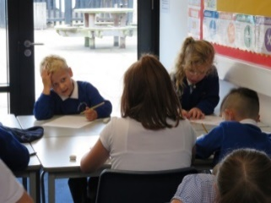
Some further guidance about Home Learning
Pupils are expected to complete tasks given in the time allocated.
Staff will provide feedback to each piece of Home Learning. This may be in the written or audio form.
Children who do not do their homework: It is the responsibility of all class teachers to see who has completed the home learning on the day that it is due to be returned. If unforeseen circumstances have arisen and made it impossible for the child to do the home learning set, please notify the class teacher of this.
If you struggle to complete the home learning on a regular basis please speak to the class teacher to see if there is a way we can support or the class teacher may approach you to see how we can help.
If homelearning is handed in later than the due date – it may well be that the teacher will not mark it until the following week due to other working commitments.
All of this information can be found in our Home Learning Policy.
Notes:
Lisa

Slide 29
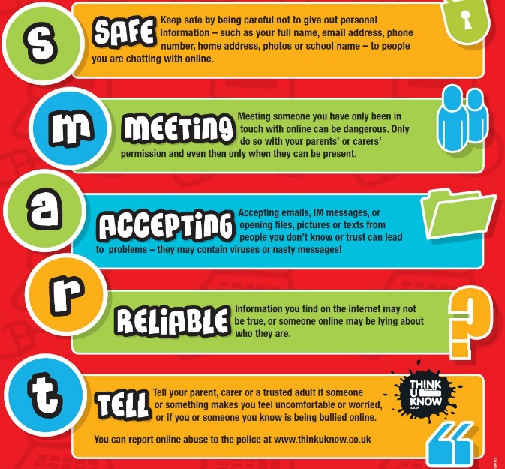

Computing and E-Safety
Our Safer Internet Day for our children is in the Spring term – further details to follow.
E-safety is planned into our curriculum in both Computing and as part of our PSHE learning.
We also have lots of information on e-safety on our website in the Children’s section and will signpost you accordingly.
Our Computing and E-Safety lead (Deputy Headteacher Mrs Holdsworth) is informed of all E-Safety concerns in school and keeps track of emerging patterns.
Notes:
Natalie
Main things to teach children to remember online – keppin g personal information safe, not meeting up with people you don’t know, not accepting pop ups/ things that you don’t understand, checking information before believing it straight away, always telling an adult if something doesn't feel right.

Slide 30
Continuous and end of year assessment for our year group
We continually assess our children throughout the day, week, term so that we know we are providing them with a curriculum they can access and rightfully deserve. This is called formative assessment.
We use a system in school to record your children’s progress throughout the year. Our Leadership Team monitor this system regularly to ensure all pupils are adequately challenged and supported.
In addition to this, Pupil Progress Meetings are held where class teachers and the Leadership team meet to discuss how individuals, specific groups or cohorts have been targeted, supported and challenged in the form of various interventions so that all children in our school have the best possible chance of meeting their end of year expectations as set out by the Government.
We report how your child/ren are doing in their ongoing and end of year assessments during our Autumn and Spring Parents’ Meetings and of course in their end of year Achievement Report, which is sent home in July.
Please do contact us if you have any questions of concerns regarding your child’s curriculum progress.
Assessment information is also fed back to our Governing Body, our Local Authority and in the case of some year groups, the Government for statistical analysis.
Learning together, achieving forever.
Notes:
Lisa

Slide 31
School Uniform Expectations
We take great pride in our uniform and it is important that all children and parents support us in ensuring that children have the correct uniform at all times. Wearing a school uniform helps to promote unity and team spirit among our pupils.
PLEASE REFER TO OUR RECENTLY REVISED GUIDANCE WHICH CAN BE FOUND ON OUR WEBSITE https://www.greatbinfields.co.uk/school-uniform/
Children wear a blue logoed school cardigan or sweatshirt (no fleeces inside), white polo shirt*, grey skirt or grey trousers for girls, and grey trousers for boys.
In the summer boys can wear grey shorts and girls can wear a dress, either blue/white stripe or gingham.
We ask that sensible, robust, black shoes are worn, and not trainers.
To avoid unnecessary cost, please ensure all uniform is clearly labelled with your child’s name.
Learning together, achieving forever.
Notes:
Natalie
Children will get muddy as per year R – come home messy – this is good!

Slide 32
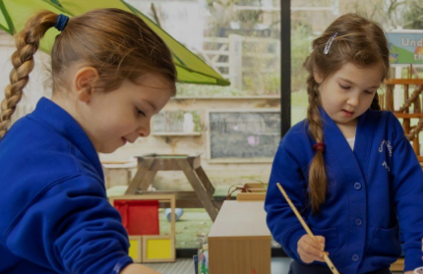
Clothing Grants
If you have difficulty providing your child with essential items of clothing or footwear, a limited amount of financial assistance may be available through Pupil Premium Funding depending on your income.
We also have lots of second-hand uniform sales throughout the school year. Check out our FOGB page for further information.
Further advice is available from our school office.
Learning together, achieving forever.
Notes:
Nat

Slide 33
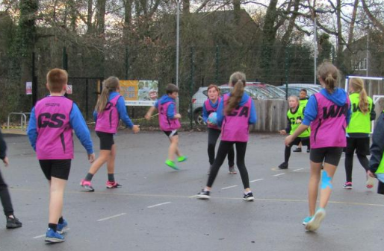
PE Kit Expectations
All children need to come into school wearing a complete P.E. kit on their PE days (Mondays and Fridays). Your child needs:
To remove earrings before they come into school. If hair is long, it needs to be tied up. If earrings are worn, your child will need to use cover tape or take them out. Stud earrings only.
To wear plain blue or black shorts underneath jogging bottoms/leggings for indoor PE. Children must have shorts on for health and safety reasons, particularly when using equipment in the hall.
Coloured t-shirts to represent their house team (available from FOGB PTA)
To wear sensible trainers for the whole day
Everything should still be clearly named.
It is your family’s responsibility to ensure they wear their kit in school on the right days as PE is a statutory part of our curriculum.
Notes:
Nat

Slide 34


Our relational approach
We are firm believers of connection before correction
We place relationships at the heart of all we do
We are proud to be an accredited Gold level ATA (Attachment and Trauma Aware) School.
We move through a system of: verbal warning, RP (reflection points), RF (reflection form).
Notes:
Lisa

Slide 35
If a child receives a reflection form, this is usually completed by a member of the Senior Leadership Team (Miss Dillon – HT or Mrs Holdsworth – DHT/Behaviour Lead) or the SENDCO (Miss Khan). We encourage the child to reflect on their choices and think about how they could have handled it differently. We link this to our zones of regulation and we consider ‘natural consequences’ to ‘repair damage’.
Parents/carers are notified by the Admin team via e-mail if their child is bringing a reflection form home with them. This is to keep you informed about the events of the day. Please sign to acknowledge receipt of it. There is also the option to speak to someone further about the incident, if necessary.
We adopt a model of ‘restorative justice’ between pupils where appropriate and ask them to consider each other’s viewpoints.

Slide 36
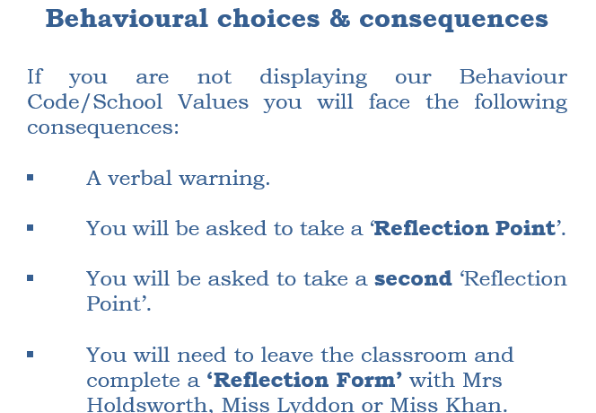
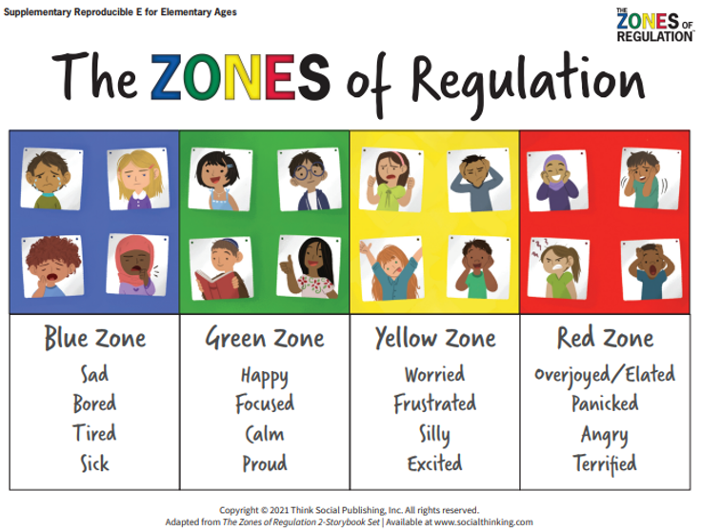
Zones of Regulation
Our Behaviour Code is underpinned by Zones of regulation. This helps enable the children to label their emotions, how their bodies may have been feeling and possible reasons for why they may have felt this way.
We also encourage the children to reflect on their behaviour choices and think about how they could have acted differently. We refer to the restoration process as ‘repairing damage’ and this may be in the form of an apology to someone, picking something up from the floor or mending something which has become broken as a result of their actions.
Notes:
Lisa

Slide 37
Rewards at GBP for fulfilling responsibilities and for trying to be the very best version of themselves
Golden Trail Treat – whole class team effort – once completed they vote for a safe trail treat, e.g. in class biscuit decorating, craft, pebble painting, etc.
Pupil of the Week – awarded to 1 child from each class, each week during Friday’s celebration assembly.
Home Notes from Miss Dillon (HT) or Mrs Holdsworth (DHT) – awarded for exceptional effort.
Values certificates and rainbow pin badges – for following the school’s values.
House points & House point reward time for the winning house each half term. Children stay in the same team throughout their time at our school. They collect house points for following the school’s values and Behaviour Code throughout the school day, including playtimes.
Learning together, achieving forever.
Notes:
Lisa

Slide 38

Sharing your children’s out of school achievements
If your child has accomplished something special out of school, please do encourage them to speak to us and they can share this with their classmates or, if a particularly special moment, the rest of our school during our Friday assemblies.
We regularly have children sharing their sporting/dance achievements, their work for charity etc. and also their musical achievements too. We love seeing our children live out the Great Binfields values.
Notes:
Natalie
Friday - Merit assembly – pupil of the week (whole school)
If you child has done things special let us know – they could share it
Mention show and tell – only achievements or upload it to seesaw if the child is desperate to share something

Slide 39
Safeguarding Responsibilities
Everyone in our school community has a responsibility to safeguard our children.
Our school’s DSL(*)s are: Miss Dillon (Lead), Mrs Holdsworth (Deputy Headteacher) and Miss Khan (SENCo). All of our staff are safeguarding trained.
Please contact school to speak to our DSL or one of our DDSLs if you have any safeguarding concerns.
We have lots of safeguarding information on our school website.
(*) (D)DSL = (Deputy) Designated Safeguarding Lead
Notes:
Nat

Slide 40

Any questions?
Notes:
Lisa

Slide 41
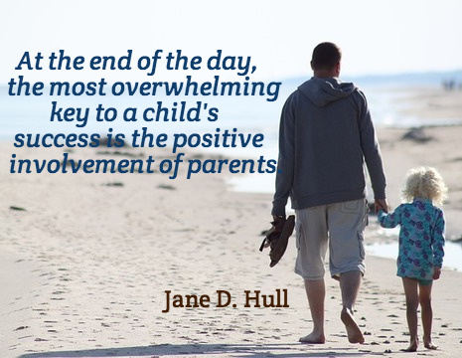
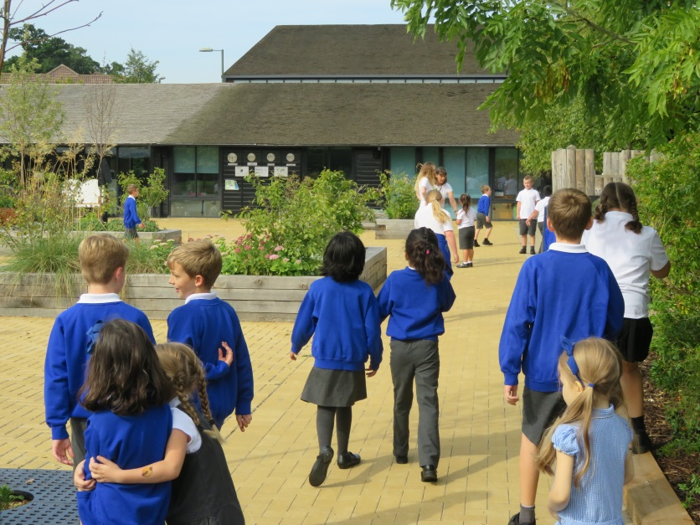
Thank you for attending this meeting – your support is very much appreciated and we look forward to working together with your children.
Notes:
Lisa

