Slide 1

Expectations for Year 2
What to expect this year….
Learning together, achieving forever.
Notes:
Everyone

Slide 2
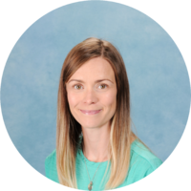
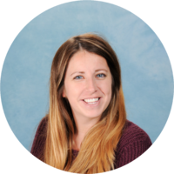
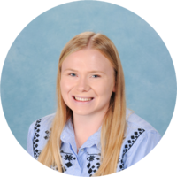
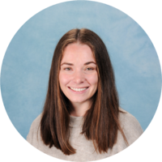
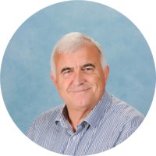
Meet the staff team.
Teachers
LSAs
The team very much work as a cohort unit so your child will work with a range of adults. We pride ourselves on being an approachable and friendly staff team, so please do contact us as you need!
Willow Sycamore
Mrs Barnhouse (Mon/Tues) Miss Canfield (Weds-Fri) Mrs Gough
Mrs Taylor
(also PPA cover for Yr2)
Mr Wood
Learning together, achieving forever.
Notes:
Nicola

Slide 3
Year 2 Highlights:
Trip to Titanic Museum, Southampton
Walk to Bartons Mill as part of ‘Hike’
Outdoor learning week
Paddington assembly
Making marmalade sandwiches for Paddington Bear
Great Fire of London day with Treehouse theatre
Whilst we will send out reminders of key events, please do refer to our termly dates letter and school calendar found on our website. You can also subscribe to this so you never miss a thing!
Learning together, achieving forever.

Slide 4
Topics in Year 2
Autumn 1 – Great Fire of London
Great Fire of London day with dress up! We make fire engines in DT. We write non fiction paragraphs about the Great Fire of London.
Autumn 2 – Paddington in London
We write an adventure story about Paddington in London, we sketch Paddington and we make marmalade sandwiches!
Spring 1– Titanic
Our Topic starts by turning the hall into the Titanic and role playing the different classes. We sketch the Titanic and create our very own non-chronological report all about it. We will be visiting the Titanic museum!
Spring 2- Journey
Using the book called Journey, we create our own imaginative stories. We learn about and track the weather around the UK.
Summer 1 – Mary Seacole and Florence Nightingale
We learn about why they are so significant in history and the impact they made. We read George’s Marvellous Medicine and create our own potions!
Summer 2 – HIKE
We focus on the book Hike. We go on a hike to the Mill Field. We learn about habitats in Science.
Learning together, achieving forever.
Notes:
Grace

Slide 5
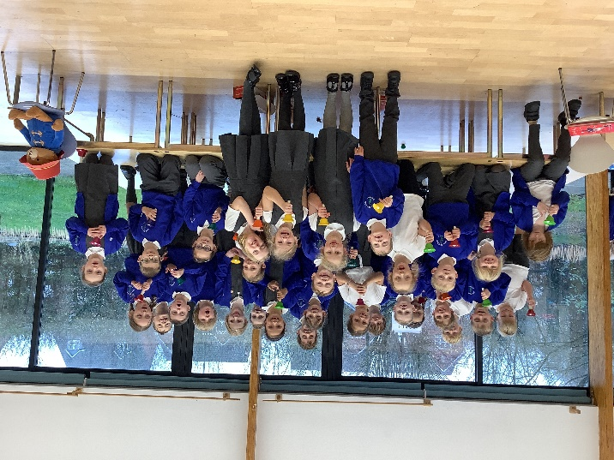
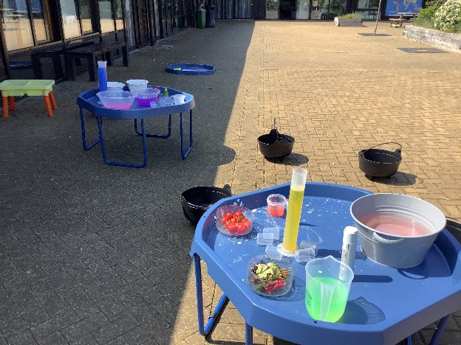
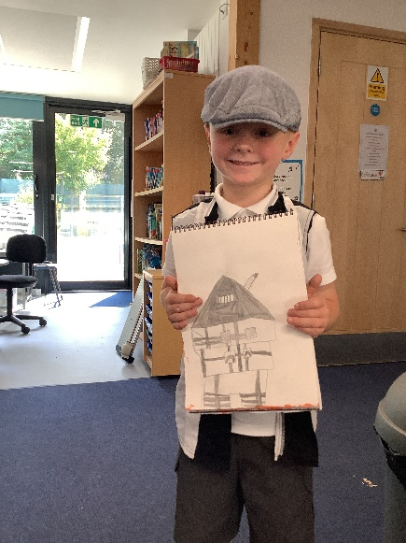
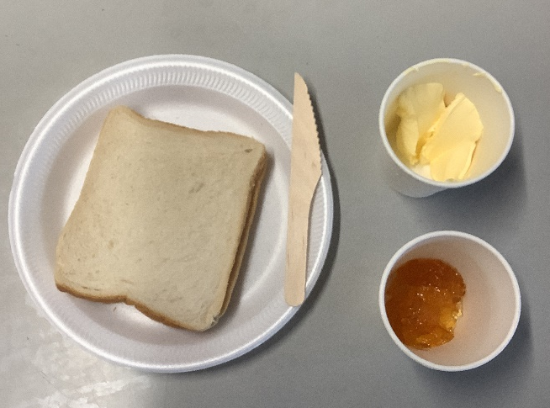
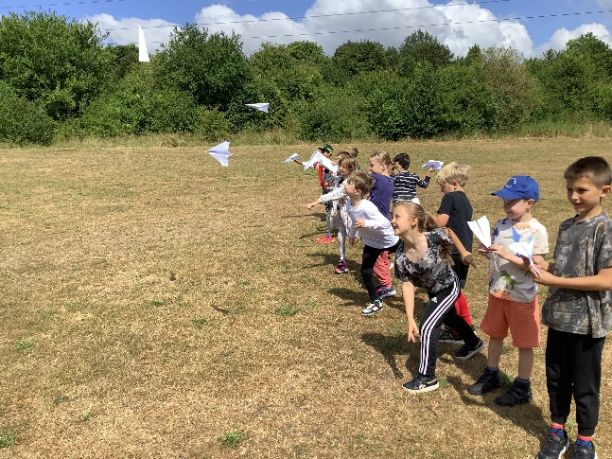
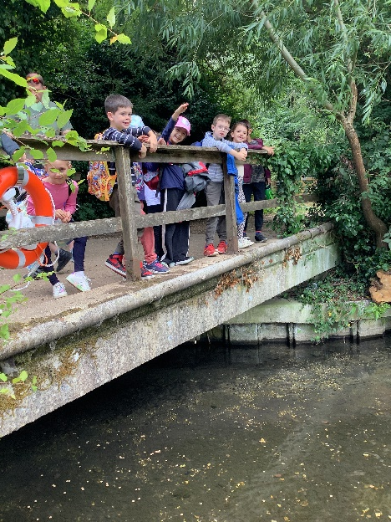
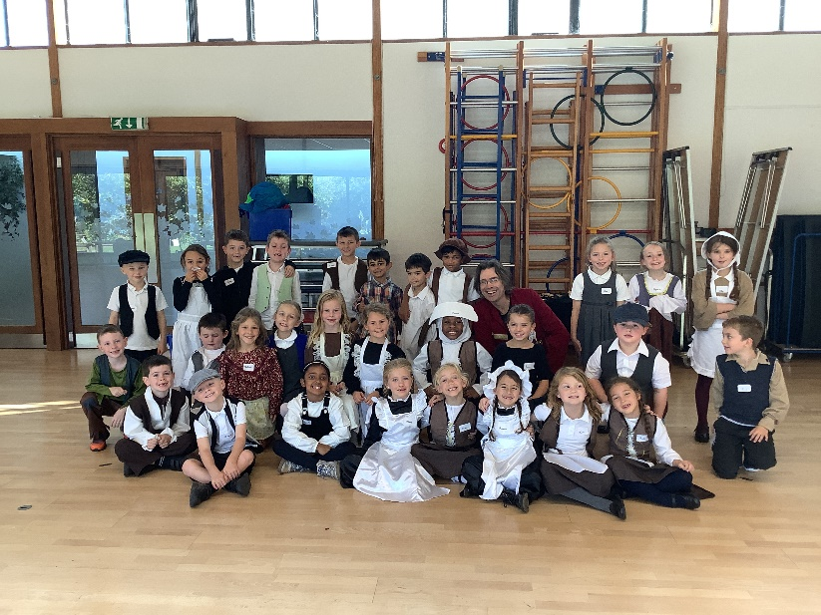
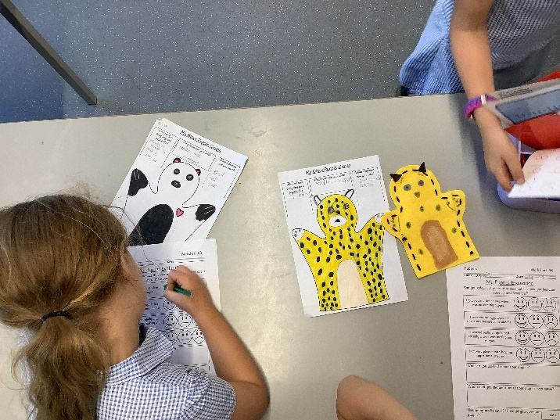
Notes:
Grace

Slide 6
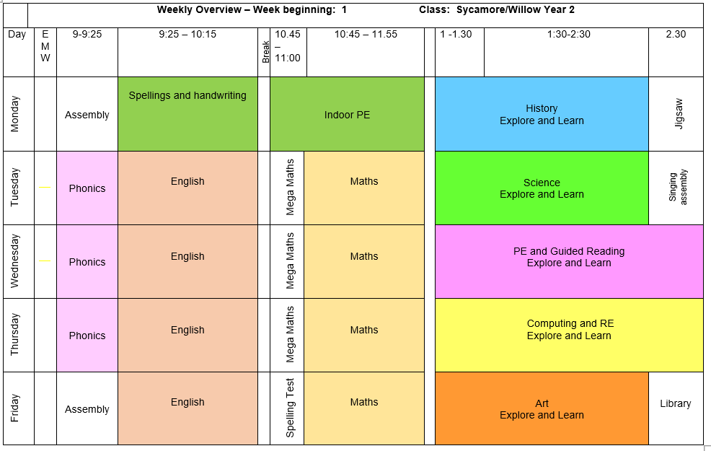
A typical week in Year 2
Notes:
(TIMETABLE SCREEN SHOT take out timings – focus on PE days and them coming in in correct kit)
Changes to shared break time – fruit or healthy snack

Slide 7
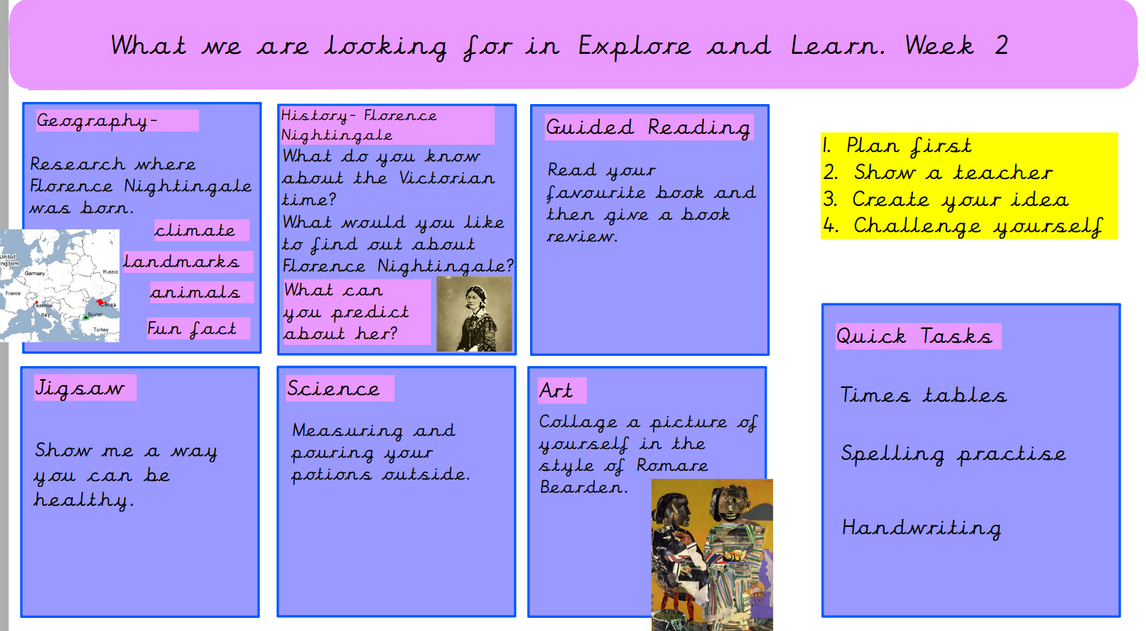
Explore and Learn

Slide 8

Autumn 1- Being me in my world
Autumn 2- Celebrating difference
Spring 1- Dreams and Goals
Spring 2- Healthy Me
Summer 1- Relationships
Summer 2- Changing Me
https://www.greatbinfields.co.uk/pshe-and-citizenship-jigsaw/
Please visit our website for our PSHE and RSE policies and more information on how each are taught.
Notes:
Holly

Slide 9
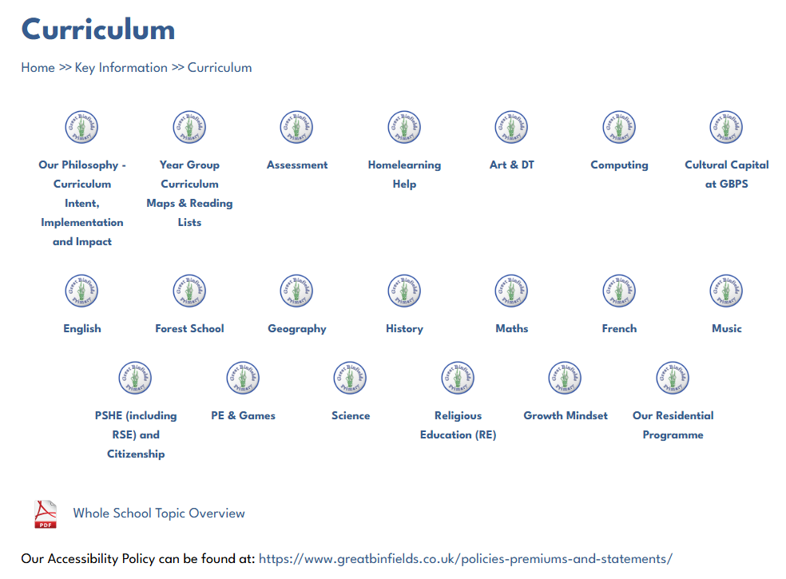
Curriculum pages on our website
https://www.greatbinfields.co.uk/curriculum/
Each area of the curriculum has a dedicated information page on our school website. These pages are kept up to date by our Subject Leads. These pages outline the long term plan for that area across the school. For example, you can see what your child will be learning in Science during their school year, how this progresses from KS1 to KS2 and which objectives we are assessing your children against.

Slide 10
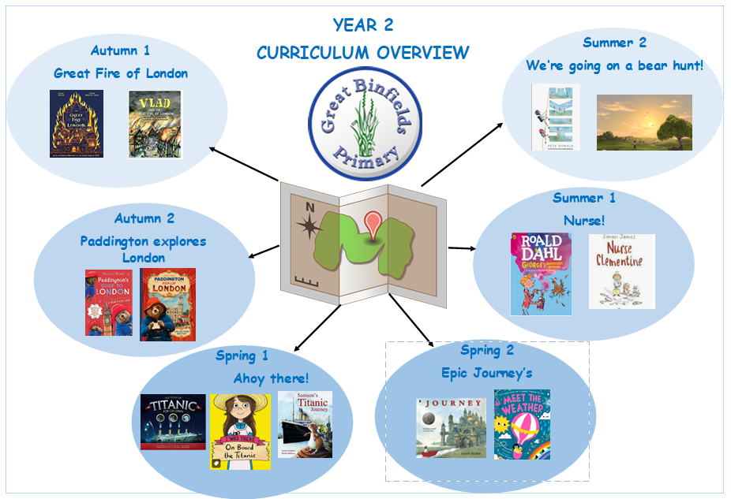
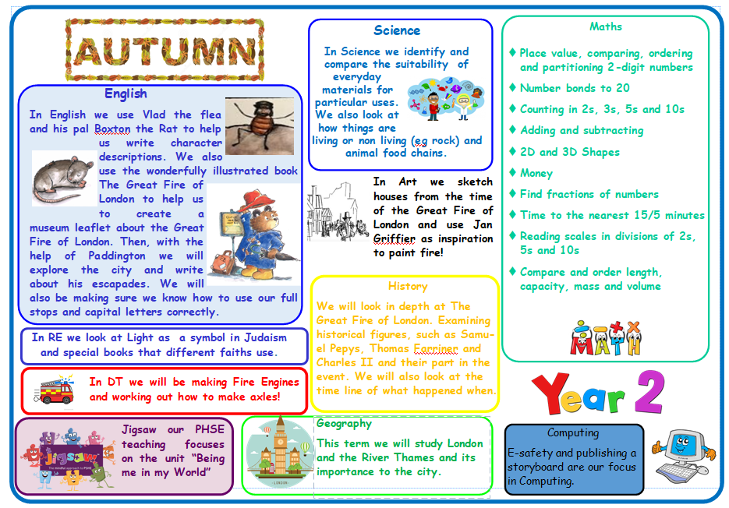
Notes:
Add termly overview that goes on Seesaw – their responsibility to check that each term. It will be an ‘announcement’ not an activity (no responses)

Slide 11
Whole School Highlights
Forest Schools activities for each year group
Jigsaw Days – half termly events, each with different theme based on PSHE (Jigsaw) learning
Topic visitors and trips
Geography fieldwork
Creativity Week
Sports Day
EYFS Nativity
Y5/6 End of year production
Y3 L2Me concerts
Half termly House Point Reward Time – a thank you for following the school’s values and Behaviour Code
Learning together, achieving forever.
Notes:
Holly

Slide 12
General Information
Settling in – usual transition and Jigsaw (PSHE) element
Approachable staff team
Children must not bring in any unnecessary equipment. They are permitted to bring with them a bookbag only containing their lunchbox (if they do not have a school lunch)/healthy break time snack (*), clearly named water bottle and coat
Healthy snack only - Children in Key Stage 1 participate in the free Fruit and Vegetable Scheme, which is used as their mid-morning snack. If your child is not able to eat certain fruits an alternative may be brought from home – fruit and vegetables only please. Sweets, crisps and chocolate are not permitted.
Stationery equipment and pencil cases, etc. are provided by school. Please do not send your children in with these. Thank you.
Belongings – please ensure all belongings are named and that your children understand it is their responsibility to look after them. (Lost property in the entrance hall)
No toys / teddies are permitted. Keep them safe for home use.
Year group costs – a letter regarding this has been emailed out
Learning together, achieving forever.
Notes:
Laura

Slide 13

https://www.greatbinfields.co.uk/
We will regularly post updates on the latest news page (front page) as the year group enjoys special events.
Each half term, we will post a round up of the topic including pictures of your children learning in action! This will be in the ‘class page’ section of the website (under red ‘children’ tab then ‘class pages’)
The monthly school newsletter is also published on the ‘latest news’ section. This will keep you up to date with school events.

Slide 14


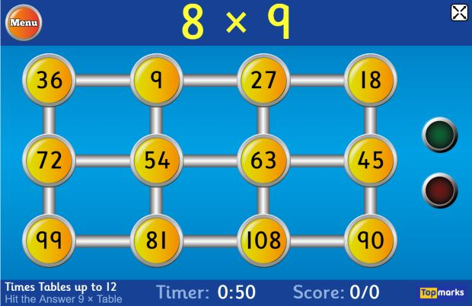

Times tables/Number bonds
Notes:
*Need to offer paper free copies for those trying to reduce screen time*
Y1 – Mention Numbots and the use of this.
Y2 – Will start TTRS in Spring/Summer term.
Y3 - – MENTION ^^^ aim, working towards this
Y4 – GO OVER Statutory test in June – ALL TABLES UP TO 12X – looks like a game
Y5 – NOD TO USING Y4 DATA TO SUPPORT CLASS LEARNING, what does this look like moving forward
All year groups please mention the importance of continuous practise and how in UKS2 times tables are needed for many methods and calculations.

Slide 15

Maths
We will be using MathSeeds (KS1)
Used for lessons and some homework activities
Guided learning journey
All children will be given a log in
All parents will get information and a guide on how to use this.
‘How can I support at home?’
Play games
Number bond practise
Times table practise
Pattern spotting in Maths all around you

Slide 16
Phonics
The National Literacy Trust states:
Phonics is a way of teaching children how to read and write. It helps children hear, identify and use different sounds that distinguish one word from another in the English language.
Written language can be compared to a code, so knowing the sounds of individual letters and how those letters sound when they’re combined will help children decode words as they read.
Children use blending of sounds to decode unfamiliar words. E.g. when a child can sound out/read s, a, t, p they can then build words such as sat, sap, pat, tap etc.
We teach phonics for half an hour, 4 times per week using Monster Phonics. This is a systematic synthetic approach to phonics.
You will find the graphemes (the written sound – see glossary) at the front of your child’s Home School diary (EYFS and KS1). This is a useful resource to practise with your child, ticking them off once your child is confident with reading and sounding out each grapheme regularly.
https://literacytrust.org.uk/information/what-is-literacy/what-phonics/?saved#cookies-form
Notes:
Laura

Slide 17

At the heart of Monster Phonics is a unique colour-coding system which links letters and sounds to a named monster. This gives powerful new tools to teach phonics, making phonics memorable as well as fun!
Monster Phonics uses a multisensory approach through songs, colour-coding and engaging materials such as magnetic letters, playdough and apps to learn sounds and their written form. These resources can be used both at school and at home.
Monster Phonics consistently colour-codes the written sound in order to identify the sound heard. Monster Phonics focuses on coding the vowel sounds, silent letters and tricky letters. This method helps accelerate progress as the monsters make it a more memorable way to identify sounds when reading and writing… be sure to ask your child which monsters they can find within their reading next time!
Sign up for newsletters and webinars on the Monster Phonics website.
https://www.eventbrite.co.uk/o/monster-phonics-19791043283

Slide 18
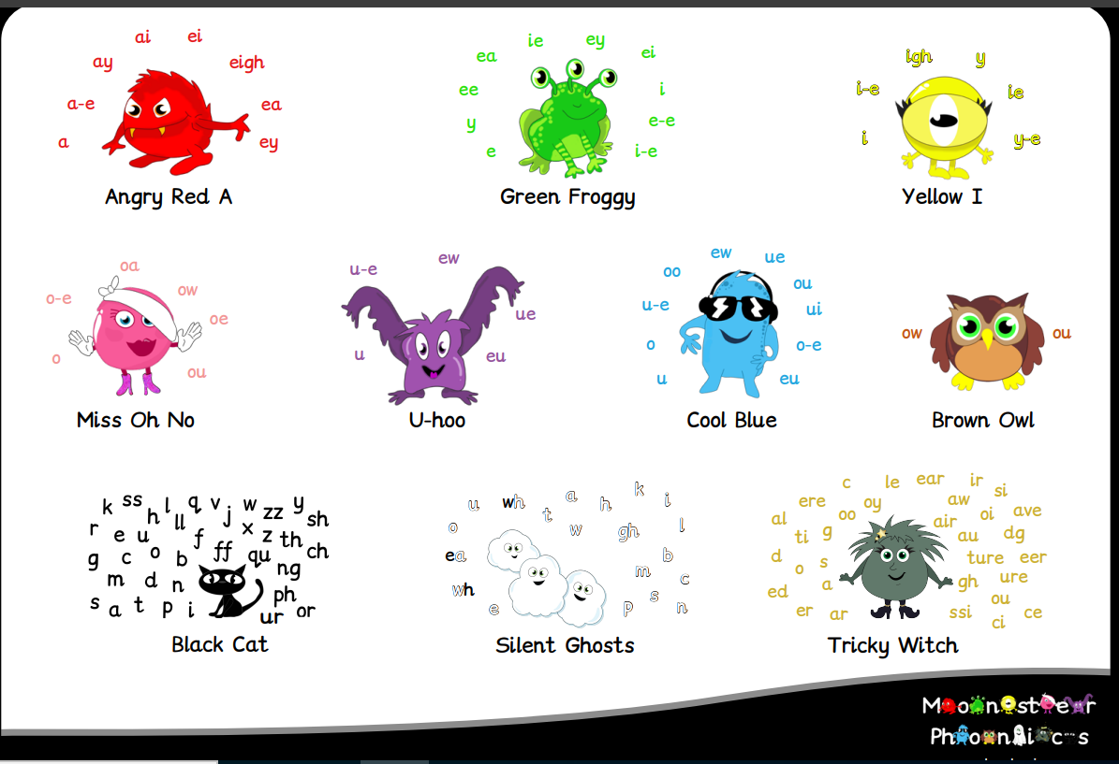
Monster Phonics
Meet the Monsters https://www.youtube.com/watch?v=B5pWEBNL0zU

Slide 19
Phonics glossary
Phoneme - The smallest unit of sound. There are approximately 44 phonemes in English (it depends on different accents). Phonemes can be put together to make words.
Grapheme - A way of writing down a phoneme. Graphemes can be made up from 1 letter e.g. p, 2 letters e.g. sh, 3 letters e.g. tch or 4 letters e.g ough.
GPC - This is short for Grapheme Phoneme Correspondence. Knowing a GPC means being able to match a phoneme (the sound) to a grapheme (the written form) and vice versa.
Digraph - A grapheme containing two letters that makes just one sound (phoneme e.g. ch, sh, th).
Trigraph - A grapheme containing three letters that makes just one sound (phoneme e.g. air, ear, ure).
Oral Blending - This involves hearing phonemes and being able to merge them together to make a word. Children need to develop this skill before they will be able to blend written words.
Blending- This involves looking at a written word, looking at each grapheme and using knowledge of GPCs to work out which phoneme each grapheme represents and then merging these phonemes together to make a word. This is the basis of reading.
Oral Segmenting - This is the act hearing a whole word and then splitting it up into the phonemes that make it. Children need to develop this skill before they will be able to segment words to spell them.
Segmenting - This involves hearing a word, splitting it up into the phonemes that make it, using knowledge of GPCs to work out which graphemes represent those phonemes and then writing those graphemes down in the right order. This is the basis of spelling.
Alien words - Alien words are often also called nonsense words or pseudo words, and are words made up of sounds a child has already been taught through the DfE scheme.
Notes:
Laura

Slide 20

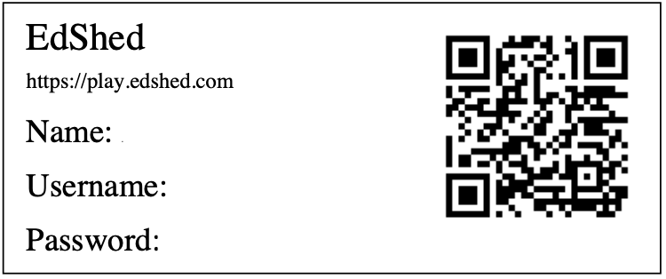
Spellings
The children in KS2 use a programme called ‘Spelling Shed’ to learn their spellings.
The children in KS1 also use Spelling Shed alongside their Monster Phonics.
Spelling Shed is full of many interactive games and activities. Spelling Shed's approach to spelling involves the relationship between sounds and written symbols as well as using morphology to help spell through meaning.
Every Friday, the children are set an activity on Spelling Shed to complete at home. They are tested on the words they have been focusing on in school on the following Thursday.
The children have their own Spelling Shed log in details in their Home School Diary.
Notes:
*Need to offer paper copies for those trying to reduce screen time*
Reminder that if they don’t complete the quiz online, it looks like they haven’t done their homework. Would need to be cross referenced to paper copies. Would not need to be marked, just submitted

Slide 21
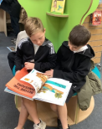

Reading
KS1
Book changing –please bear with us!
As your child is developing their independence skills they may bring home a book they have read before. Whilst we want the children reading a range of texts, we do also encourage them to re-read some of their books as it can be great for confidence building, expression development and also reading for pleasure.
Each day your child will be reminded by a member of staff to change their book and the trays will be out in the same place each day. If you notice your child has had the same book for a few days and it needs changing, please remind them as they come into school and let us know so we can re-model book changing if needed and make sure they are getting new books regularly.
Diaries should be in school every day, so they can be stamped if your child reads 1-1, in a Blended Reading session or in a Guided Reading session. However, diaries are not checked by staff every day so please do not send communication to teachers via diaries.
Remember the expectation is to read to an adult 5 x per week and
for this to be recorded in their home school log.
Notes:
Holly

Slide 22
Our Home School Log
This book is to travel to and from school every day.
We expect all children to read at least 5 times a week at home. You will need to sign to indicate they have done this.
We hope that your child and you as parents find it a useful tool to record your child’s reading achievements.
This book will last for the whole school year and is provided free of charge, however if your child loses their home school book there is a cost of £4.00 to replace it. Please contact the admin office if you need a new diary.
Learning together, achieving forever.
Notes:
Holly

Slide 23
Normal Home Learning Expectations
Our Home Learning Policy can be found on our school website in the Key Information section.
We recognise and value the contribution that learning in the home environment can make to our children’s education. All Home Learning is linked to learning done in class. This may consist of activities to consolidate and re-enforce what has been learnt in a lesson, or investigation work linked to a topic.
The expectation for this year group is: 15-20 minutes a week in addition to reading. Seesaw home learning will begin in Autumn 2. Autumn 1 focuses on reading 5x a week, spellings and times table rockstars.
Instead of the weekly tasks set, there will be a maximum of one home learning project (with at least 2 weeks given to complete) in every year group per half term. These tasks are more research and project based but provide stimulating and relevant open-ended tasks for those children who may manage to complete their set homework very quickly.
Home learning will be posted on Seesaw on a Friday, to be returned via Seesaw by the following Thursday.
We believe that the support of parents and carers is essential for children to make the most of their home learning opportunities. There are many ways in which parents can help their children, for example, by: encouraging and supporting them; playing games with them; practicing times tables, number bonds and telling the time; practicing the children’s phonic patterns and spellings they receive; listening to children read 5 times per week and providing opportunities for real life experience; talking, shopping, using money, cooking, letter writing etc.
Learning together, achieving forever.
Notes:
Lois

Slide 24

As children move up through the school, they will become more and more proficient at using Seesaw for their Home Learning but also for in-school learning opportunities.
Your child may have an activity on their account that says “In school activity – no home action required”. This means they will be completing the task in school and will not need to complete it at home. This does however provide a good talking point of what your child has been doing in their learning time!
As children progress into KS2, they will have increased independence when it comes to accessing their Home Learning.
On each Home Learning activity set, there will be capacity to indicate whether the activity was completed independently or with support.
Seesaw is a really creative way for children to showcase their learning, we would encourage them to make use of these tools as they feel more confident.

Slide 25
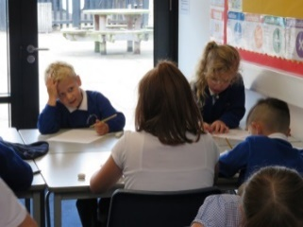
Some further guidance about Home Learning
Pupils are expected to complete tasks given in the time allocated.
Staff will provide feedback to each piece of Home Learning. This may be in the written or audio form.
Children who do not do their homework: It is the responsibility of all class teachers to see who has completed the home learning on the day that it is due to be returned. If unforeseen circumstances have arisen and made it impossible for the child to do the home learning set, please notify the class teacher of this.
If a child does not complete their Home Learning twice the class teacher will contact the child’s parents to discuss what support can be put in place.
If this continues for three consecutive weeks, the Deputy Headteacher will be informed and will contact parents to ascertain the possible reasons why.
If homelearning is handed in late – it may well be that the teacher will not mark it until the following week due to other working commitments.
All of this information can be found in our Home Learning Policy.

Slide 26
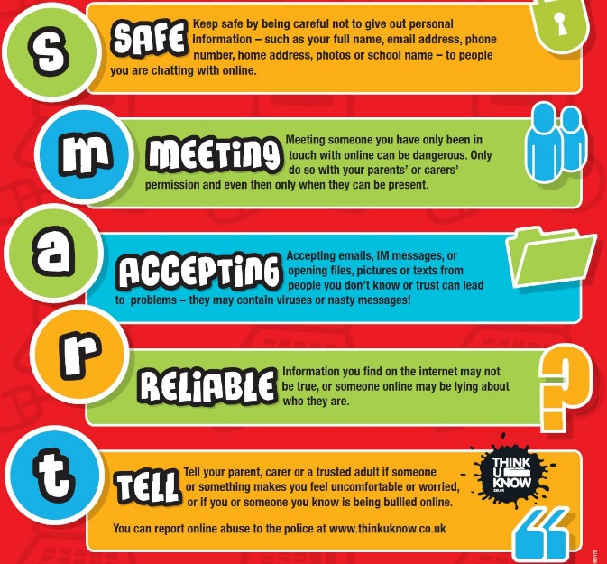
Computing and e-safety
A reminder for you: Our Safer Internet Day for our children is in the Spring term – further details to follow.
E-safety is planned into our curriculum in both Computing and as part of our PSHE/Jigsaw learning.
We also have lots of information on e-safety on our website in the Children’s section and will signpost you accordingly.
Our E-safety lead (Deputy Headteacher Mrs Holdsworth) is informed of all e-safety concerns in school and keeps track of emerging patterns.
Learning together, achieving forever.
Notes:
Laura

Slide 27
Continuous and end of year assessment for our year group
We continually assess our children throughout the day, week, term so that we know we are providing them with a curriculum they can access and rightfully deserve. This is called formative assessment.
We use a system in school to record your children’s progress throughout the year. Our Leadership Team monitor this system regularly to ensure all pupils are adequately challenged and supported. In addition to this, Pupil Progress Meetings are held where class teachers and the Leadership team meet to discuss how individuals, specific groups or cohorts have been targeted, supported and challenged in the form of various interventions so that all children in our school have the best possible chance of meeting their end of year expectations as set out by the Government.
We report how your child/ren are doing in their ongoing and end of year assessments during our Autumn and Spring Parents’ Meetings and of course in their end of year Achievement Report which is sent home in July.
Please do contact us if you have any questions of concerns regarding your child’s curriculum progress.
Assessment information is also fed back to our Governing Body, our Local Authority and in the case of some year groups, the Government for statistical analysis.
Learning together, achieving forever.
Notes:
Lois

Slide 28
School Uniform Expectations
We take great pride in our uniform and it is important that all children and parents support us in ensuring that children have the correct uniform at all times. Wearing a school uniform helps to promote unity and team spirit among our pupils.
PLEASE REFER TO OUR RECENTLY REVISED GUIDANCE WHICH CAN BE FOUND ON OUR WEBSITE https://www.greatbinfields.co.uk/school-uniform/
Children wear a blue logoed school cardigan or sweatshirt (no fleeces inside), white polo shirt*, grey skirt or grey trousers for girls, and grey trousers for boys.
In the summer boys can wear grey shorts and girls can wear a dress, either blue/white stripe or gingham.
We ask that sensible, robust, black shoes are worn, and not trainers.
To avoid unnecessary cost, please ensure all uniform is clearly labelled with your child’s name.
Learning together, achieving forever.
Notes:
Laura

Slide 29
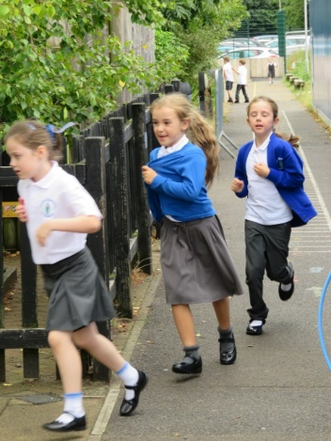
Clothing Grants
If you have difficulty providing your child with essential items of clothing or footwear, a limited amount of financial assistance may be available through Pupil Premium Funding depending on your income.
We also have lots of second-hand uniform (check out our FOGB page)
Further advice is available from our school office.
Learning together, achieving forever.
Notes:
Laura

Slide 30
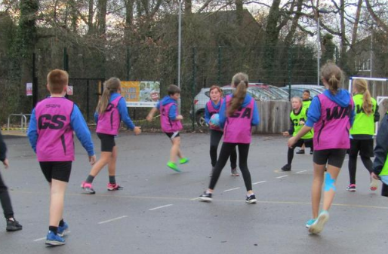
PE Kit Expectations
All children need to come into school wearing a complete P.E. / Games kit on their PE days. Your child needs:
To remove earrings before they come into school and if hair is long, it needs to be tied up. If earrings are worn, they will need to use cover tape
To wear plain blue or black shorts underneath jogging bottoms/leggings for indoor PE. Children must have shorts on for health and safety (friction on wall bars – less slippy!)
To wear their plain house coloured T-shirt (these are available from FOGB PTA)
To wear sensible trainers for the whole day
Everything should still be clearly named
It is your family’s responsibility to ensure they wear their kit in school on the right days as PE/Games is a statutory part of our curriculum
Notes:
Laura

Slide 31


Our relational approach
We are firm believers of connection before correction
We place relationships at the heart of all we do
We are proud to be an accredited bronze level ATA (Attachment and Trauma Aware) School.
We move through a system of: verbal warning, RP (reflection points), RF (reflection form).

Slide 32
If a child receives a reflection form, this is usually completed by a member of SLT (Miss Lyddon – HT or Mrs Holdsworth – DHT/Behaviour Lead) or the SENDCO (Miss Khan). We encourage the child to reflect on their choices and think about how they could have handled it differently. We link this to our zones of regulation and we consider ‘natural consequences’ to ‘repair damage’.
Parents/carers are notified by the Admin team via e-mail if their child is bringing a reflection form home with them. This is to keep you informed about the events of the day. Please sign to acknowledge receipt of it. There is also the option to speak to someone further about the incident, if necessary.
We adopt a model of ‘restorative justice’ between pupils where appropriate and ask them to consider each other’s viewpoints.

Slide 33
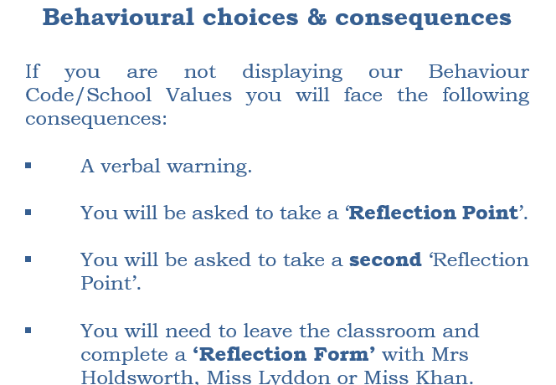
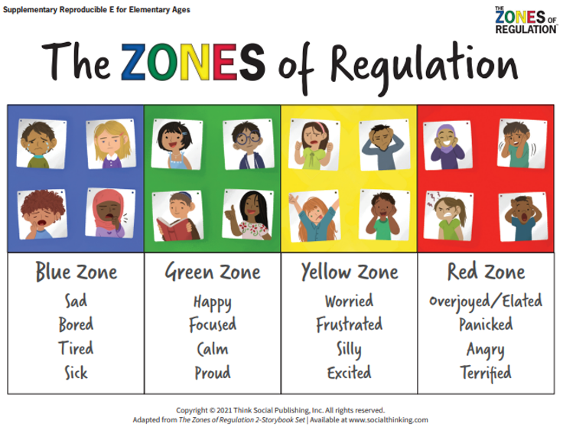
Zones of regulation
Our Behaviour Code is underpinned by Zones of regulation. This helps enable the children to label their emotions, how their bodies may have been feeling and possible reasons for why they may have felt this way. We also encourage the children to reflect on their behaviour choices and think about how they could have acted differently. We refer to the restoration process as ‘repairing damage’ and this may be in the form of an apology to someone, picking something up from the floor or mending something which has become broken as a result of their actions.

Slide 34
Rewards at GBP for fulfilling responsibilities and for trying to be the very best version of themselves
Golden Trail Treat – whole class team effort – once completed they vote for a safe trail treat, e.g. in class biscuit decorating, craft, pebble painting, etc.
Pupil of the Week – awarded to 1 child from each class, each week during Friday’s celebration assembly.
Home Notes from Miss Lyddon (HT) or Mrs Holdsworth (DHT) – awarded for exceptional effort.
Values certificates and rainbow pin badges – for following the school’s values.
House points & House point reward time for the winning house each half term. Children stay in the same team throughout their time at our school. They collect house points for following the school’s values and Behaviour Code throughout the school day, including playtimes.
Learning together, achieving forever.
Notes:
Lois

Slide 35
Sharing your children’s out of school achievements
If your child has accomplished something special out of school, please do encourage them to speak to us and they can share this with their classmates or, if a particularly special moment, the rest of our school during our Friday assemblies.
We regularly have children sharing their sporting/dance achievements, their work for charity etc. and also their musical achievements too. We love seeing our children live out the Great Binfields values.

Slide 36
Safeguarding Responsibilities
Everyone in our school community has a responsibility to safeguard our children.
Our school’s DSL(*)s are: Miss Lyddon (Lead), Mrs Holdsworth (Deputy Headteacher) and Miss Khan (SENCo). All of our staff are safeguarding trained.
Please contact school to speak to our DSL or one of our DDSLs if you have any safeguarding concerns.
We have lots of safeguarding information on our school website.
(*) (D)DSL = (Deputy) Designated Safeguarding Lead

Slide 37
Any Questions?

Slide 38

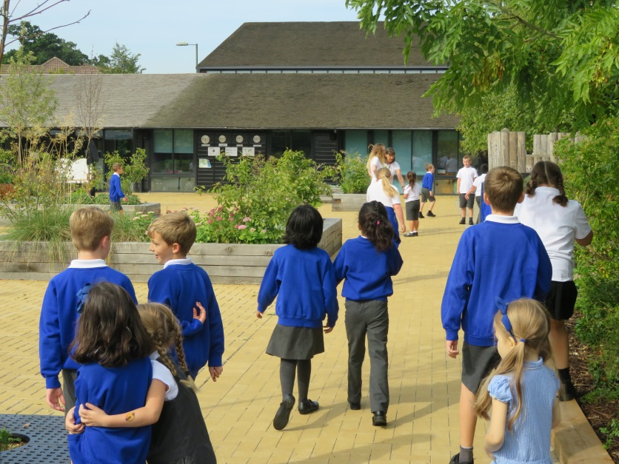
Thank you for attending this meeting – your support is very much appreciated and we look forward to working together with your children.

