Slide 1

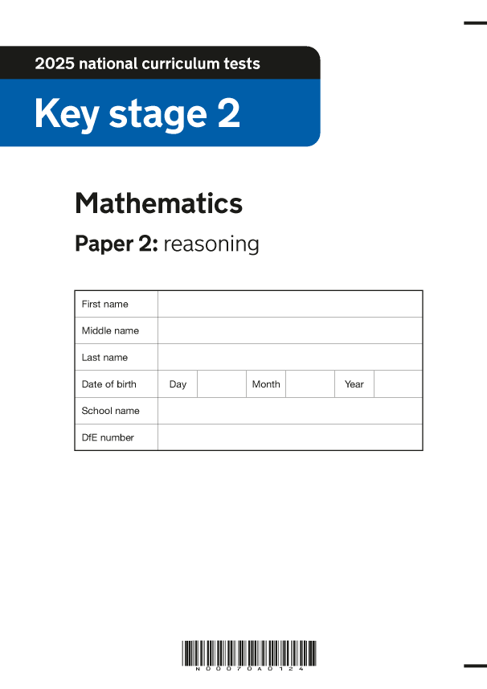
SATs Information Evening: Part 2
2026 Statutory Assessment Tests
Aims of the session:
A reminder of when the SATS are and their timings.
The common misconceptions from your children.
How to support your children at home.
Learning together, achieving forever.

Slide 2

When the SATs are completed:
Monday 11th May: Spelling and Grammar & Punctuation - SPaG (Papers 1 & 2).
Tuesday 12th May: Reading.
Wednesday 13th May: Mathematics (Paper 1: Arithmetic and Paper 2: Reasoning).
Thursday 14th May: Mathematics (Paper 3: Reasoning).
Learning together, achieving forever.

Slide 3
How the SATs are completed:
The tests take place during normal school hours, in the children’s classrooms but under exam conditions.
Children are not allowed to talk to each other from the moment the assessments are handed out until they are collected at the end of the test.
After the tests are completed, the papers are sent away to be marked externally.
The results are then sent to the school in July.
Each test lasts no longer than 60 minutes:
  Spelling, punctuation and grammar -
  (Paper 1: Grammar/ Punctuation) – 45 minutes
  Spelling, punctuation and grammar -
  (Paper 2: Spelling) – 15 minutes (approx.)
  Reading – 60 minutes
  Maths (paper 1: Arithmetic) – 30 minutes
  Maths (paper 2: Reasoning) – 40 minutes
  Maths (paper 3: Reasoning) – 40 minutes
Learning together, achieving forever.

Slide 4
The results
Tests are marked externally. Once marked, the tests will be given the following scores:
A raw score (total number of marks achieved for each paper);
A scaled score (see below);
A judgement on if the National Standard has been met.
After marking each test, the external marker will convert the raw score to a scaled score. Even though the tests are made to the same standard each year, the questions must be different. This means the difficulty of the tests may vary. Scaled scores ensures an accurate comparison of performance over time.
Scaled scores range from 80 to 120.
A scaled score of 100 or more shows the pupil is meeting the National Standard.
Learning together, achieving forever.
Notes:
There is no separate test that would indicate a pupil is working above the national standard.
A scaled score of less than 99 would indicate a pupil is working below the national standard.
To have a scaled score, pupils must have a minimum raw score (determined each year). If the pupil does not achieve the minimum raw score, they have not demonstrated sufficient understanding of the KS2 curriculum in the subject.

Slide 5
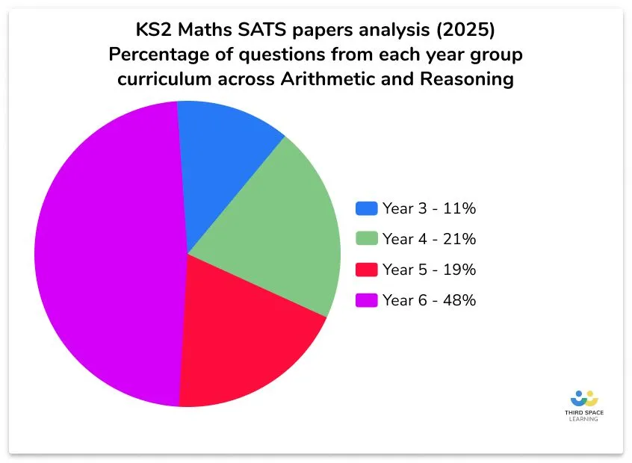
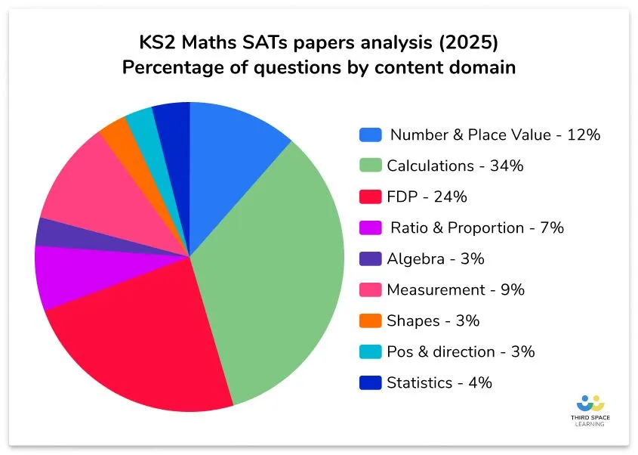
Maths: What the children will be tested on:
Learning together, achieving forever.
Notes:
A quick reminder of what the content domain % were last year.

Slide 6
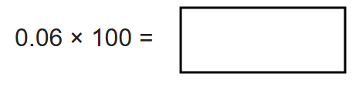
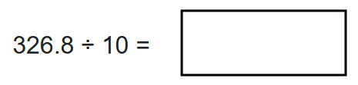
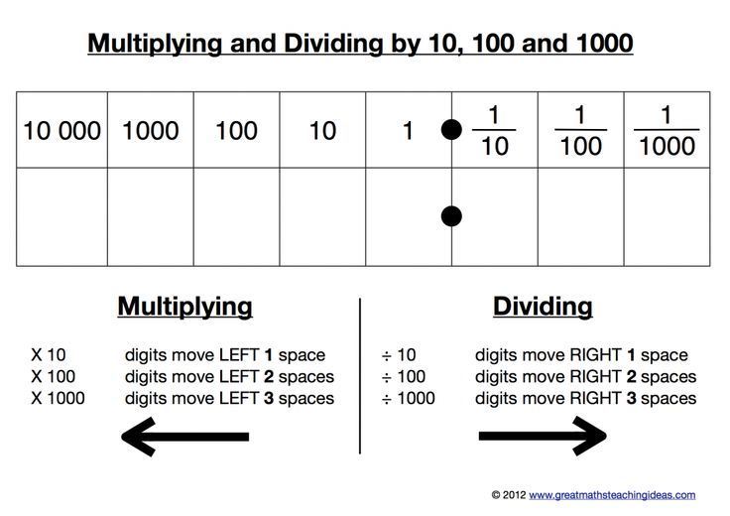
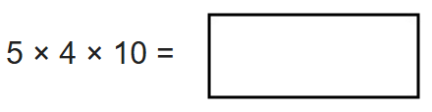
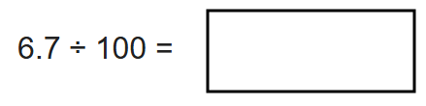
Misconceptions: Multiplying and dividing by 10, 100, 1000
Top tip: Use your place value knowledge!
Learning together, achieving forever.
Notes:
The children need a strong grasp of their place value to confidently multiply or divide by 10, 100 and 1000. We know multiplying or dividing by powers of 10 increases / decrease the value of each digit by one, two, or three place values e.g. multiplying by 10: The children will be able to quickly identify that you are moving the digits 1/2/3 spaces to the left or right on the place value chart.

Slide 7
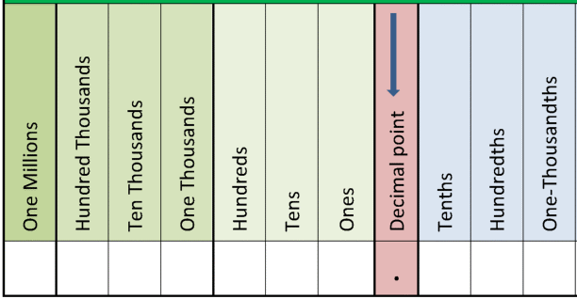
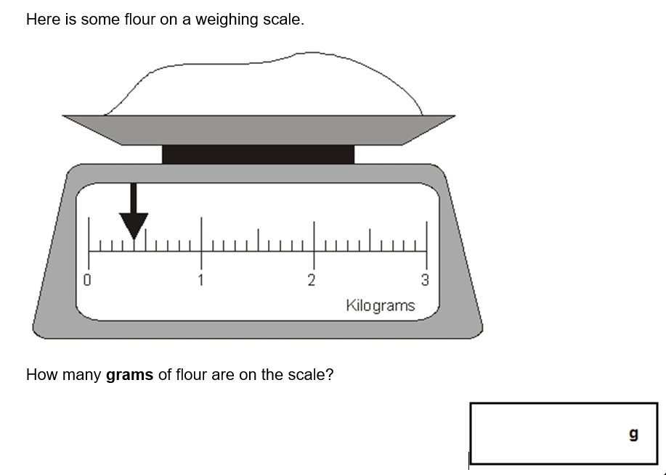
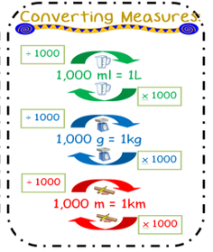
Misconceptions: Dividing by 10, 100, 1000
Learning together, achieving forever.
Notes:
The children will need to apply this knowledge to reasoning and problem solving questions. Here they are being asked to read a scale accurately but then convert from kg to g. They need to know there are 1000g in 1kg – so they need to use their place value knowledge to multiply by 1000. Answer 0.4kg = 400g

Slide 8
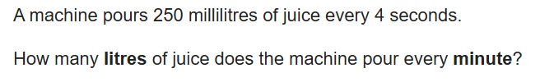
Misconceptions: Dividing by 10, 100, 1000
Sometimes these questions will be multi-step:
Learning together, achieving forever.
Notes:
The children need to read the question and identify the key information and the steps required. We encourage them to use a highlighter. They need to know that there are 60 seconds in 1 minute. So 4 x 15 = 60. Therefore, 250 ml x 15 = 3,750ml. THEN – they need to convert 3,750ml to litres by dividing by 1,000. They again need to use their place value knowledge 3,750ml = 3.75L

Slide 9
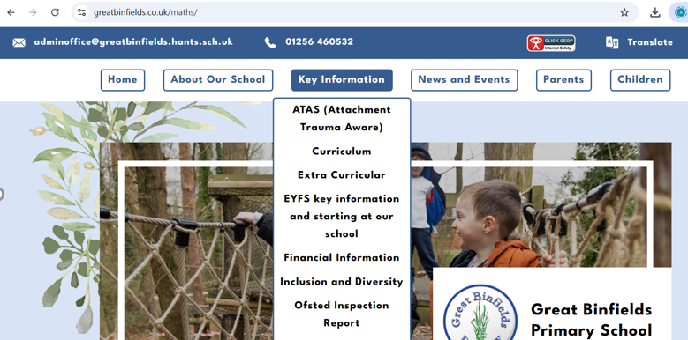

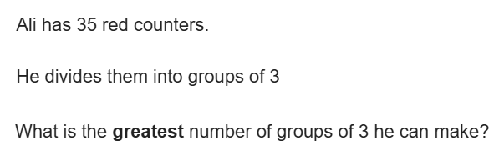
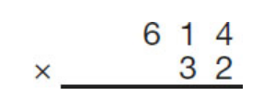
Misconceptions: ‘bus stop’ ÷ and x by a 2 digit number.
Top tip: Visit our Maths page:
www.greatbinfields.co.uk/maths-calculation-videos/
Top tip: Do I need a whole number or decimal remainder?
Learning together, achieving forever.
Notes:
Give a live example of maths page and watch: Stage 3a and 3b multiplication.MOV (1) (1).mp4

Slide 10
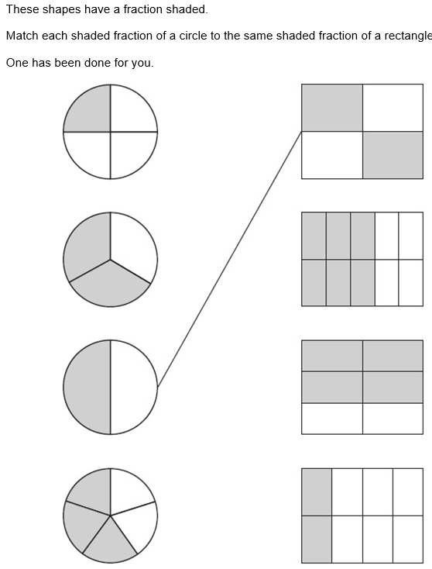
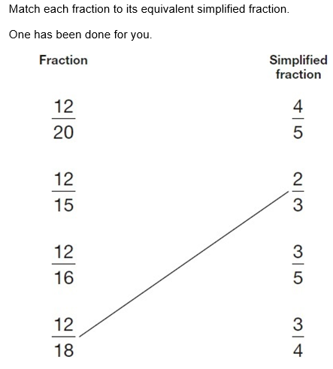
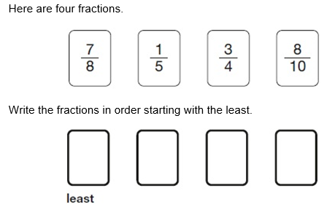
Misconceptions: Equivalent fractions
Learning together, achieving forever.
Notes:
Highlight the importance of knowing times tables.

Slide 11
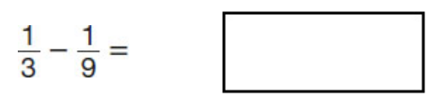
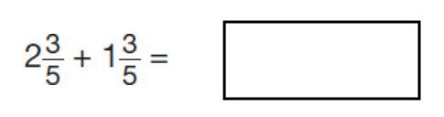
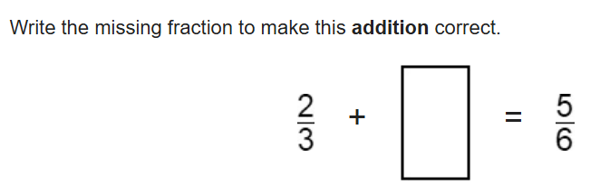
Misconceptions: + and - fractions
Arithmetic: Paper 1
Reasoning: Paper 2/3
Learning together, achieving forever.

Slide 12
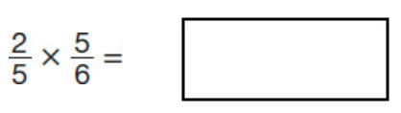
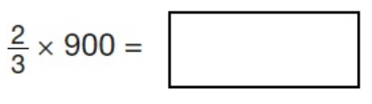
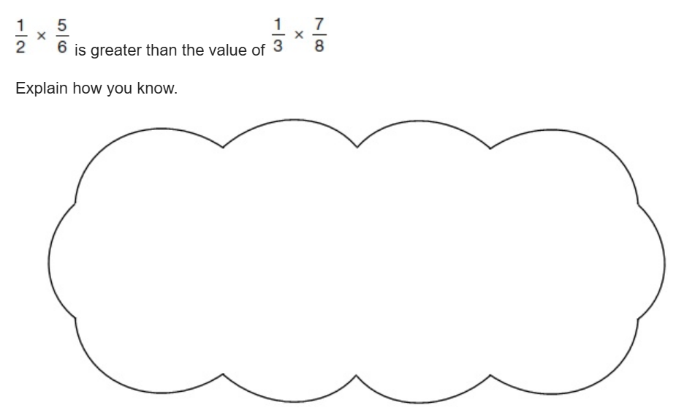
Misconceptions: x fractions
Learning together, achieving forever.
Notes:
Highlight the need for children to make their reasoning clear with a written answer + calculation.

Slide 13
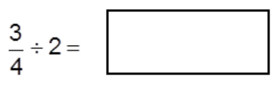
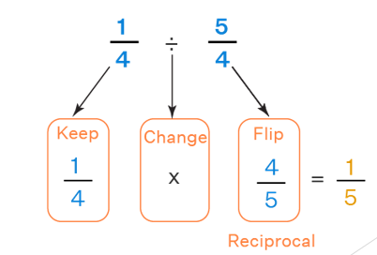
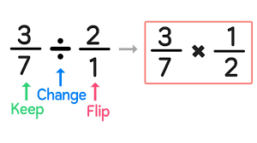
Misconceptions: ÷ fractions
Learning together, achieving forever.

Slide 14
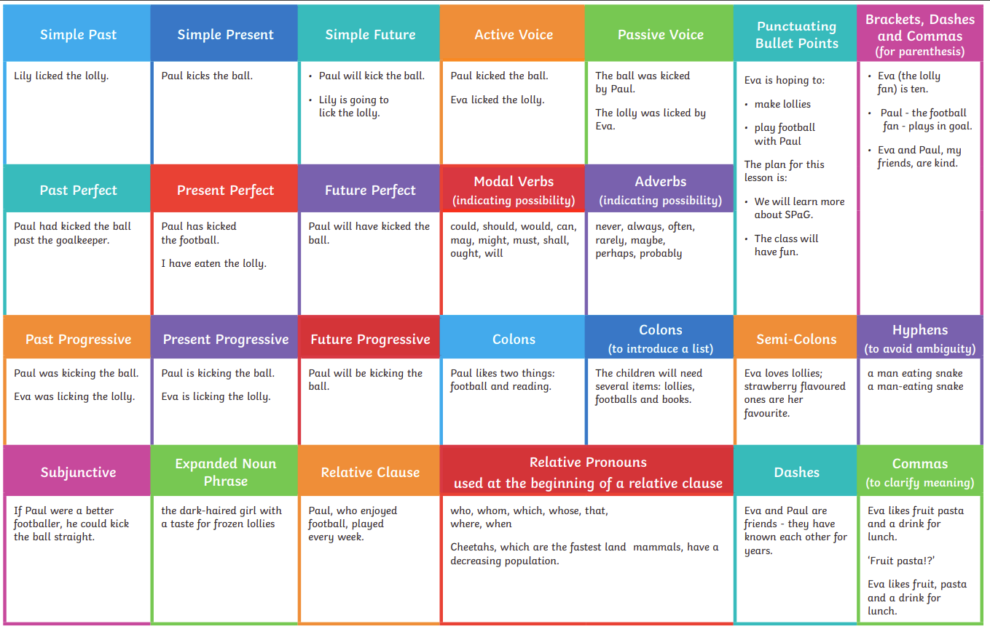
English - Grammar Glossary:
Learning together, achieving forever.

Slide 15
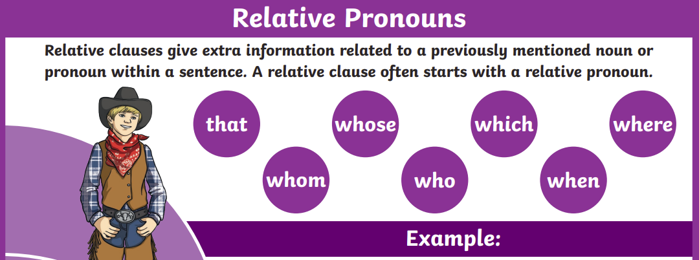
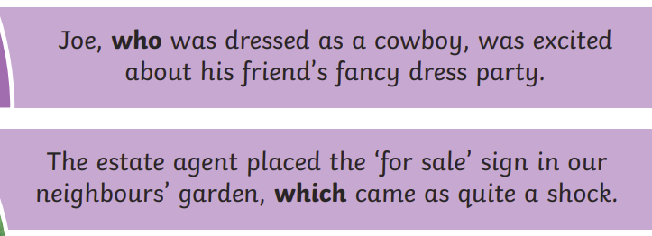
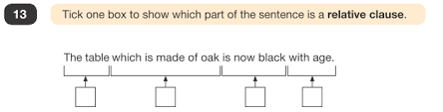
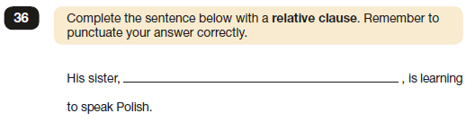
Grammar misconceptions:
Relative pronouns and relative clauses
Click here for teaching video

Slide 16
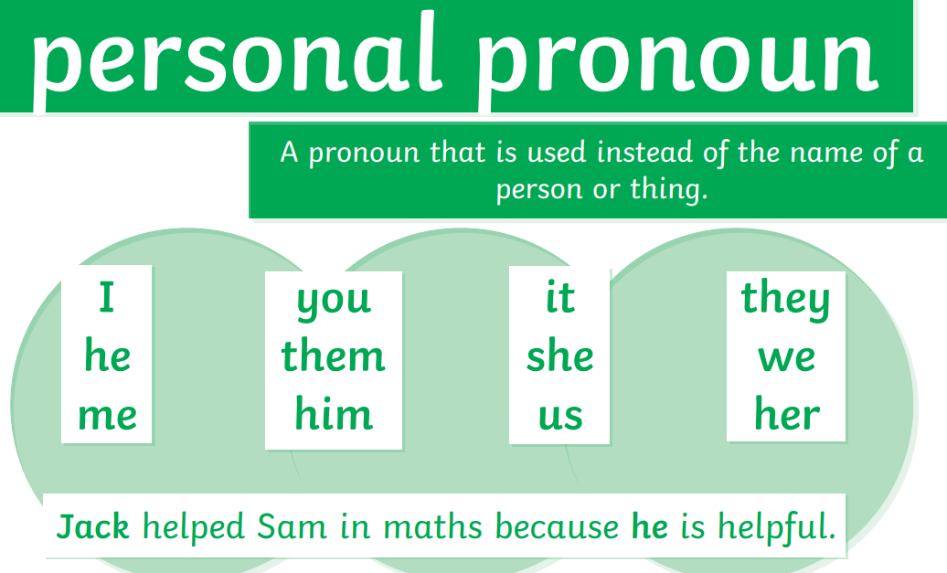
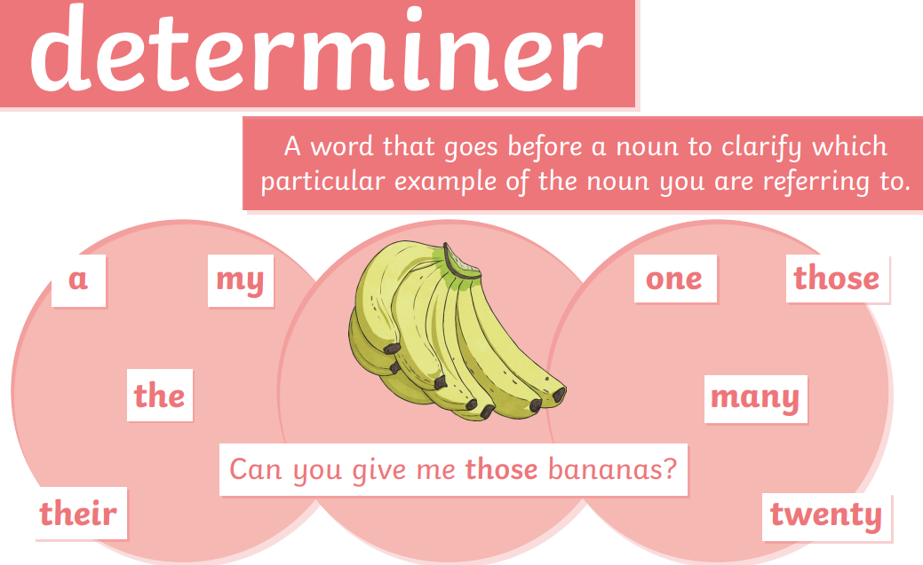
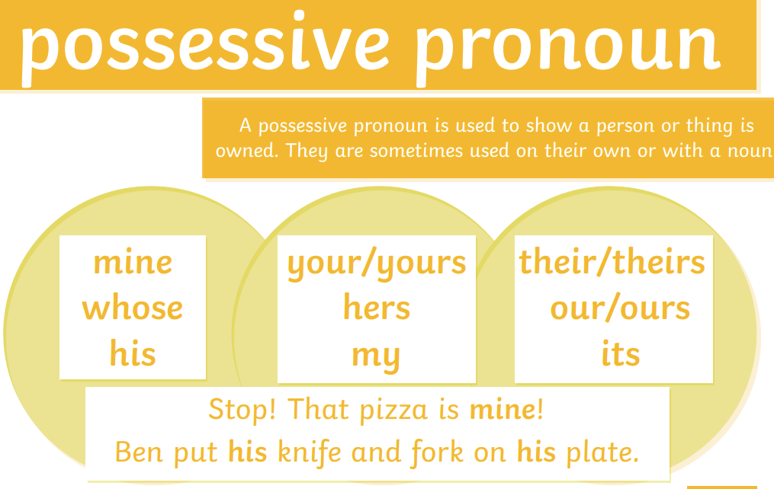
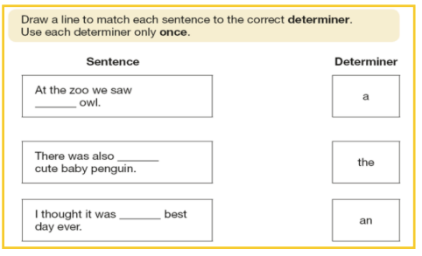
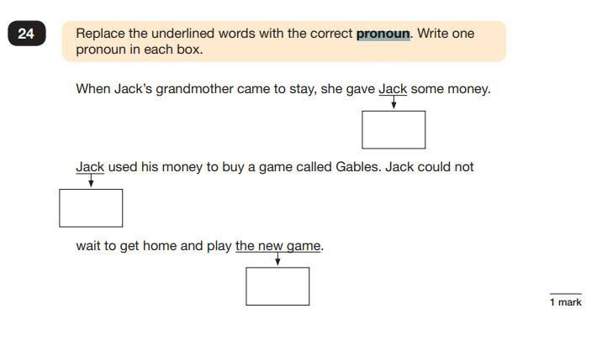

Grammar misconceptions:
Different word classes
Pronoun Teaching Video
Possessive Pronoun Teaching Video
MC Grammar Determiners Video
.

Slide 17
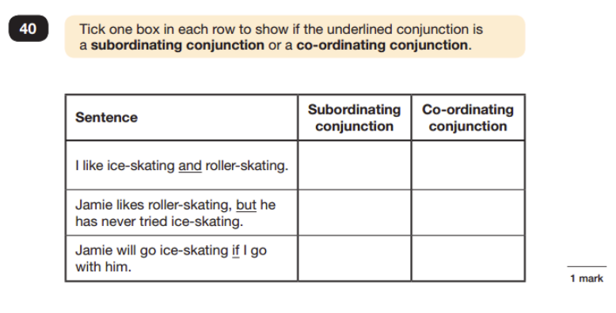
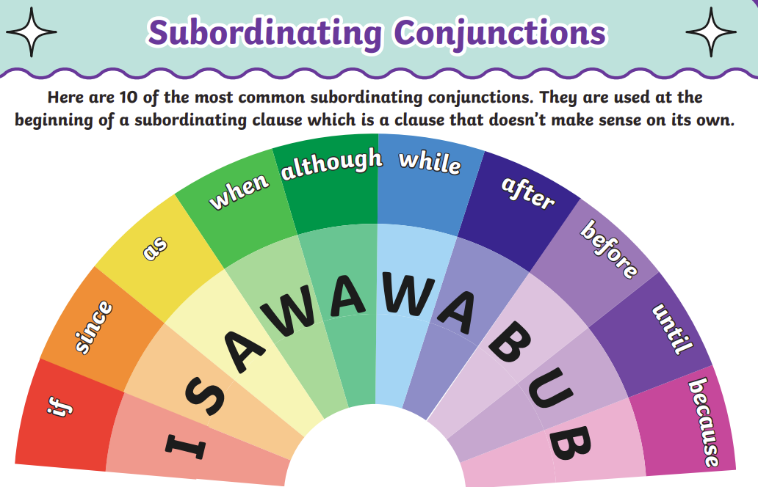
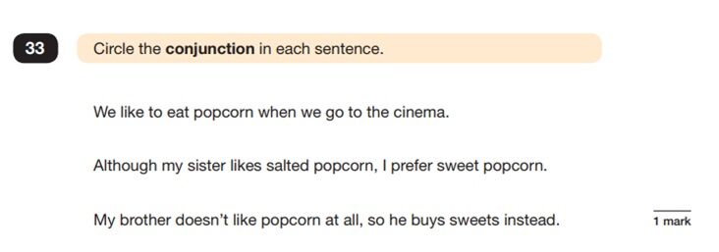
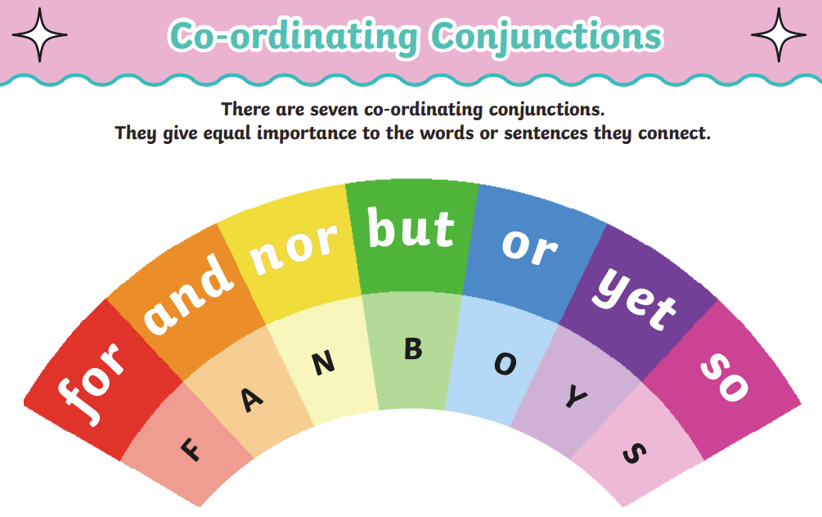
Grammar misconceptions
Conjunctions
Subordinating Conjunction Teaching Video
Co-ordinating Conjunction Teaching Video

Slide 18
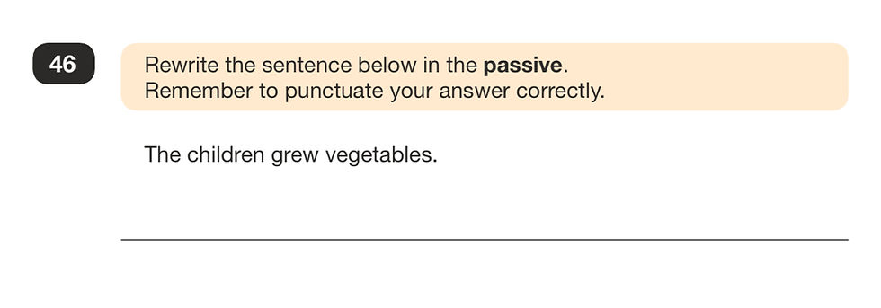
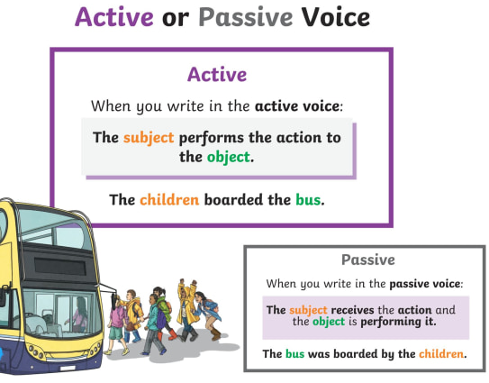
Grammar misconceptions:
Active and Passive Voice
TOP TIP:
Look for the words ‘was’ or ‘by’.
Active and Passive Teaching Video
.

Slide 19
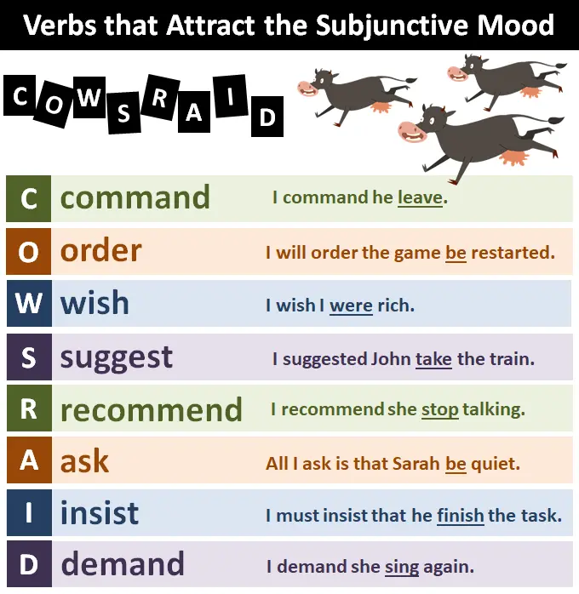
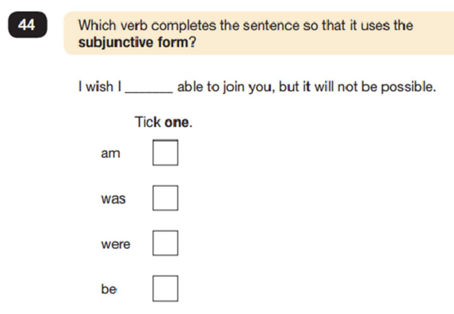
Grammar misconceptions:
Subjunctive Form
The subjunctive form is also known as the subjunctive mood. It is a way of phrasing verbs in more formal writing, usually to express doubt, possibility, necessity, or action that has not yet occurred.
Subjunctive Teaching Video
.

Slide 20
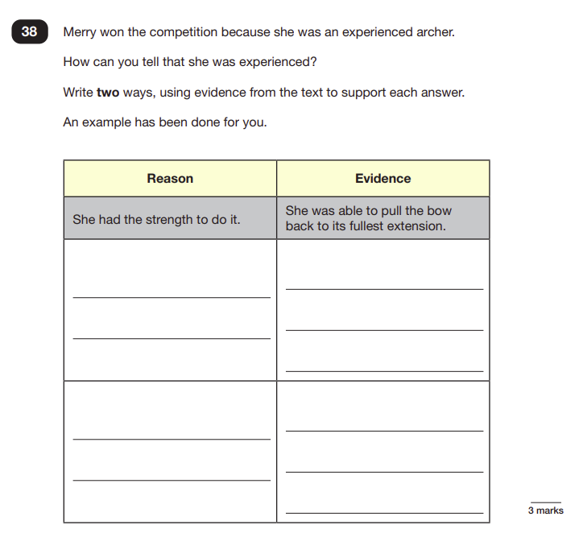
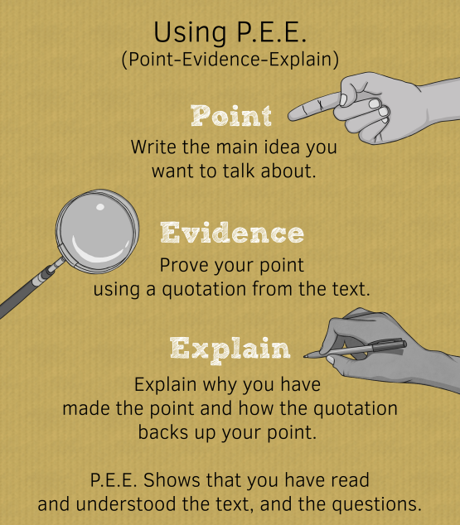
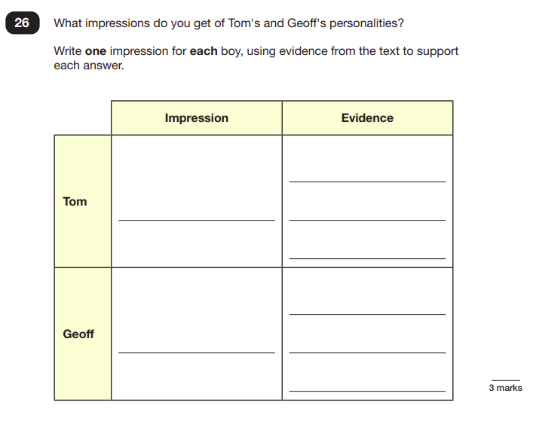
Reading techniques
Point, Evidence, Explain

Slide 21
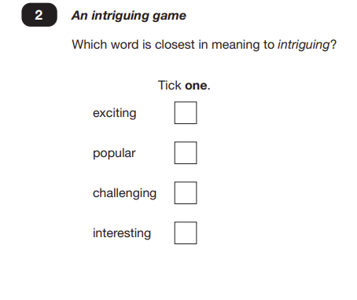
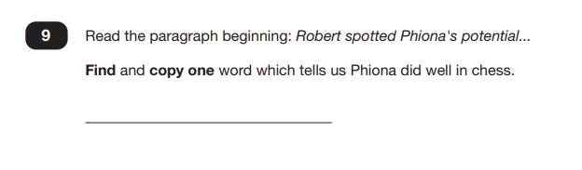

Reading techniques
Vocabulary understanding – synonyms (same meaning) and antonyms (opposite meaning)

Slide 22
Supporting your child:
Regular practise on TT Rockstars / Mathletics / BBC Bitesize.
Use your 3 CGP books.
CGP 10 minute tests online: https://www.cgpbooks.co.uk/resources/ks2-sats-online-10-minute-tests
Past SATs papers can be downloaded from: https://www.satspapersguide.co.uk/ks2-year-6-sats/ks2-year-6-sats-papers/
Learning together, achieving forever.

Slide 23
Where to find these slides…
The slides are on our school website. Please follow this pathway to find them:
Children – Class Pages – Oak and Maple (Year 6)
Scroll all the way to the bottom of that page and you will see these slides alongside the slides from the last session.
Learning together, achieving forever.

Slide 24

Thank you for attending this evening – your support is very much appreciated.
We want these exams to be as relaxed and as stress-free as possible!
Emphasis will be on effort and progress ☺
Any questions?
Learning together, achieving forever.

