Slide 1

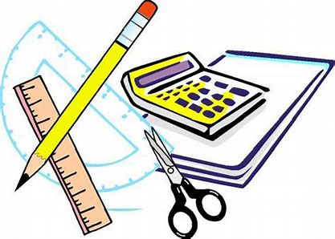

Maths at Great Binfields
How to support Maths at Home
&
Maths Accounts at GBPS
RECORD VOICE OVER USING NOTES AT THE BOTTOM AND CHECK INTERNET LINKS WORK
This presentation aims to empower you to further support your children with their Maths learning at home. It also guides you through the online Maths accounts that the children have access to, which may be referred to in your child’s weekly home learning activities.
Please use this PowerPoint as a navigation tool to signposting you to existing resources we have available on our website.
Notes:
Welcome to our annual Maths information workshop.
If you have queries or questions as a result of the information you read, please feel free to get in touch with your child’s class teacher or the school at any time regarding the maths curriculum at GBP.
This presentation aims to support you in helping your child with their maths learning at home and also providing you with further guidance around the different online accounts your child is able to access at home which aim to enhance their mathematical understanding.
As your child progresses through the school, we recognise that there are different mathematical areas that you may appreciate further information about. Please use this presentation as a signposting tool to help you navigate our existing website resources too.
We’d like to thank you for your continued support.

Slide 2


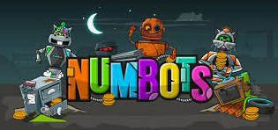

Online Maths Accounts at GBP
As part of our curriculum provision, the children have access to a wide range of online accounts which aim to support and extend their learning both within the classroom and at home too. As a school, we have thought carefully about these resources so that they encourage and motivate children to apply their understanding and consolidate the skills learnt during lessons.
Take a look at the following slides to find out more about the online games, linked specifically to Maths, that your child has access to. You will find your child’s login details for all of the following websites in the back of your child’s home school diary.
Your child will receive access to these accounts when they reach Year 1. Times Table Rock Stars is launched in Year 2 during the Summer term.
Please let your child’s class teacher know if you are missing any of these.

Slide 3
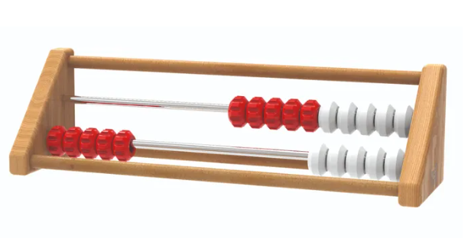
Numbots can be played online on a laptop or you can download it as an app (it’s free!).
We would like pupils to be accessing their Numbots accounts on at least a weekly basis.
It also refers to rekenrek (pictured below) which we use within our ‘Mastering Maths’ teaching sessions in EYFS & KS1.
This helps children to visualise number bonds e.g. to 10/20 through red/white beads.

Slide 4
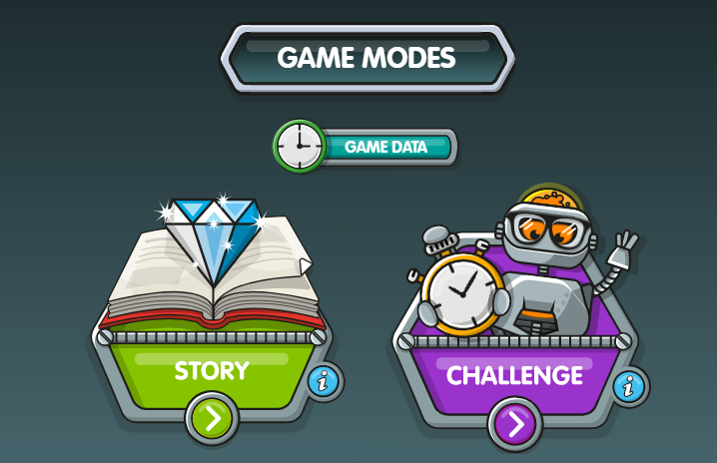
There are two game modes: story and challenge.
Each level on story mode gets progressively harder. If you find your child becoming frustrated, remember to use our Growth Mindset approach of “You just can’t do it yet!”
You may also wish to encourage them to use concrete resources around the home (including their fingers!) if they are still in the pit with their learning. It may be helpful for some pupils if you also type on their behalf.

Slide 5
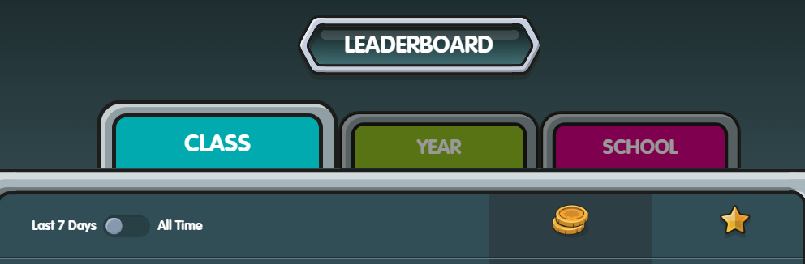
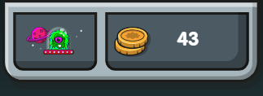
This ‘dashboard’ shows your pupil’s avatar on the left (personalised) and the amount of money they have on the right.
This ‘money’ can then be spent on…
If your child is particularly competitive (aren’t we all?!) they can see where they are on the Leaderboard. They can see how they rank amongst their class, year and even school. You can toggle between the last week and ‘all time’. You can also toggle between coins and stars. You need 3 stars to ‘pass’ and complete a level on story mode. Some challenges will earn you more coins than others, depending on your speed and accuracy!

Slide 6

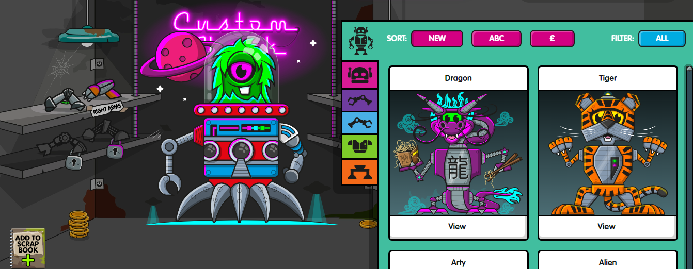
The ‘Custom shack’. This is where pupils can change their avatar. They will need coins from challenges to ‘purchase’ new outfits. They can modify one body part at a time e.g. head/arms/legs. These can be sorted by cost and alphabetically.
They also have the option to add it to their scrap book so they can see all of their previous avatar choices.

Slide 7
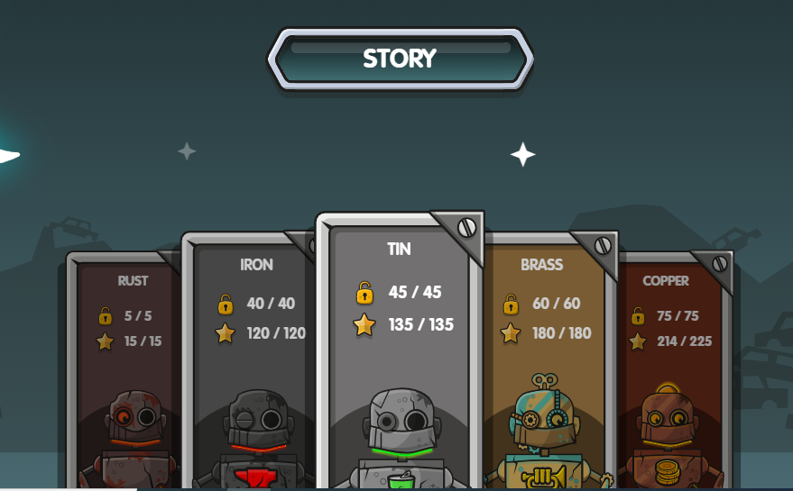
Each story has a robot name (based on a robot e.g. Iron Man) and a number of levels and sub-levels. Pupils earn a star per sub-level of which there 3 for each one. They can move on to the next metal type once they have completed all levels; even if they haven’t got 3 stars for each level.

Slide 8
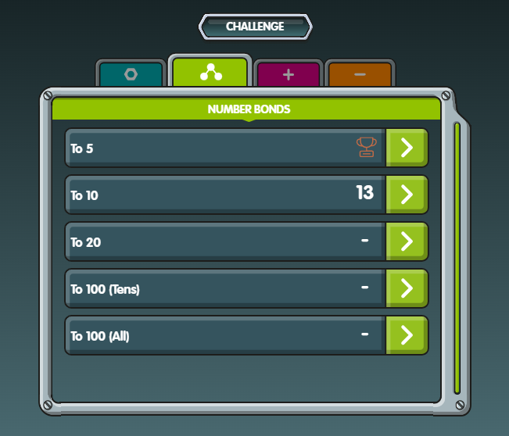
When pupils complete ‘Challenges’ they can see their score on this dashboard. They earn a trophy (bronze, silver or gold) if they are within the top 3 in their year. We always speak to the children about beating their personal best; not trying to compete with their peers.

Slide 9
Times Table Rock Stars
Having a secure understanding of the times tables facts and related division calculations up to 12x12 aids children in their mathematical learning within a wide range of different concepts.
Times Table Rock Stars is an exciting game which helps children to learn and practise their times tables. Through a “little and often” approach, children secure their times table knowledge whilst having fun! We recommend approximately 5 minutes practice a day, 4 or 5 times a week. You can download the app from the app store or play on the Times Table Rock Stars game on their website.
There are 9 different game modes each with unique features. Read on to find out more.

Slide 10
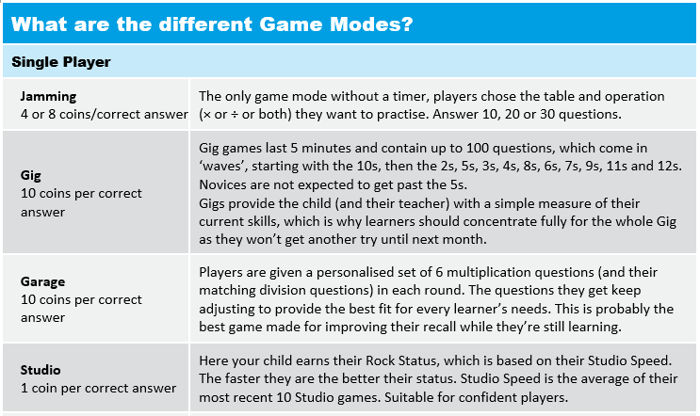
We recommend a “little and often” approach; 5 minutes practice a day, 4 or 5 times a week is a good target

Slide 11
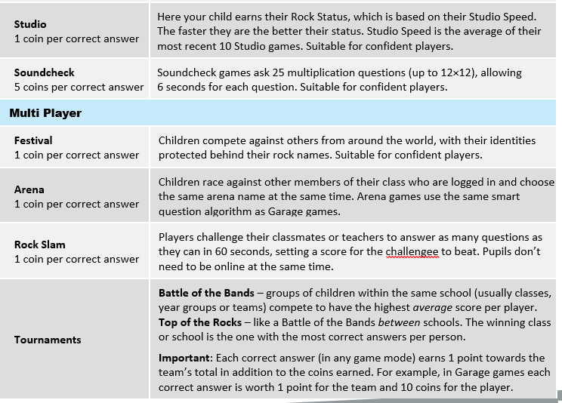
What are the different game modes?

Slide 12
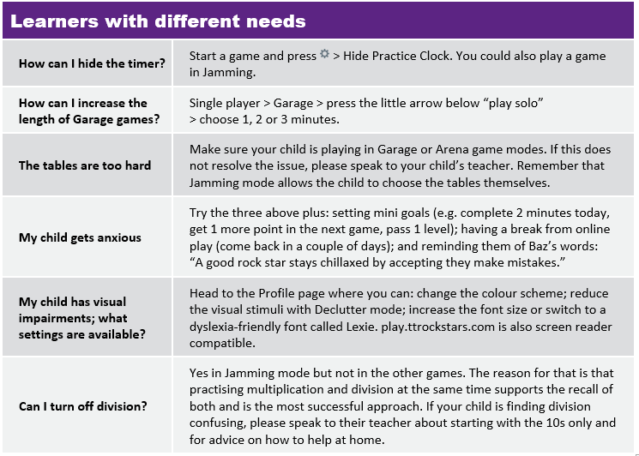
Times Table Rock Stars!

Slide 13
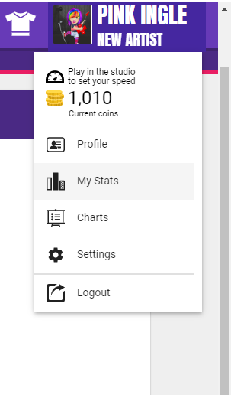
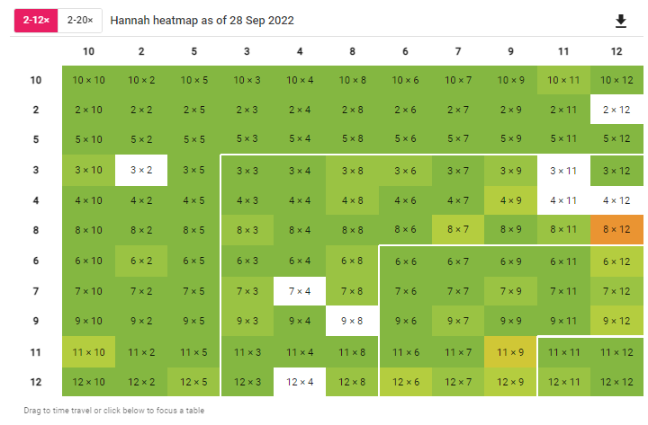
Checking your child’s progress
Checking your child’s progress is easy:
When your child has logged in, select their avatar in the top right hand corner and then select the ‘My Stats’ option.
In the effort tab, you can see how many minutes the children have played.
Under fluency, you can see how quickly your child is able to answer each question and how confident they are with their individual times table knowledge.
The URL on the right will help show you this process in more detail →
https://www.youtube.com/watch?v=phxP5_OhOtk

Slide 14
Abacus Maths
The Abacus Maths scheme provides us with the backbone to our Maths curriculum and is aimed at children from Year 1 to Year 6. It aims to inspire a genuine love of Maths and help every child practise and master mathematical concepts and skills.
Abacus is built around a spiral curriculum so children have the opportunity to revise and practise what they have learnt throughout the year.

Slide 15
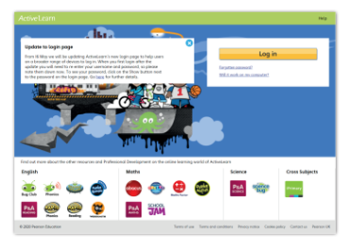
How to access Abacus
Abacus also has an online platform linked to key learning objectives which aims to encourage the children to practise skills learnt within lessons.
1. Abacus is part of ‘Active Learn Primary’. Go to www.activelearnprimary.co.uk
2. Click ‘Log in’ and enter the login details we have put in the back of your child’s home learning diary.

Slide 16
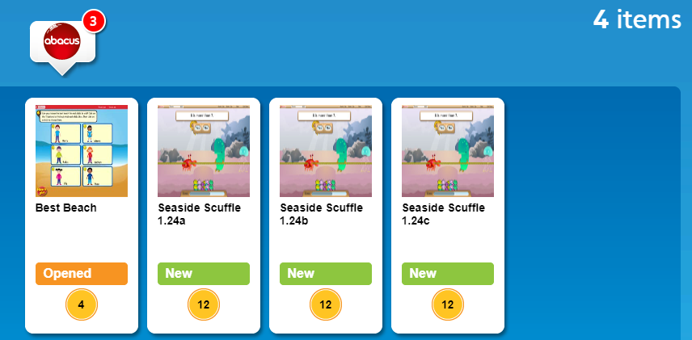
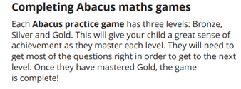

Abacus Maths games
Look at the ‘My stuff’ section.
As part of your child’s home learning activity, they will have an allocated game waiting to be played.
If the child does not have an activity waiting for them here, they have been assigned this as part of their home learning for that week.

Slide 17
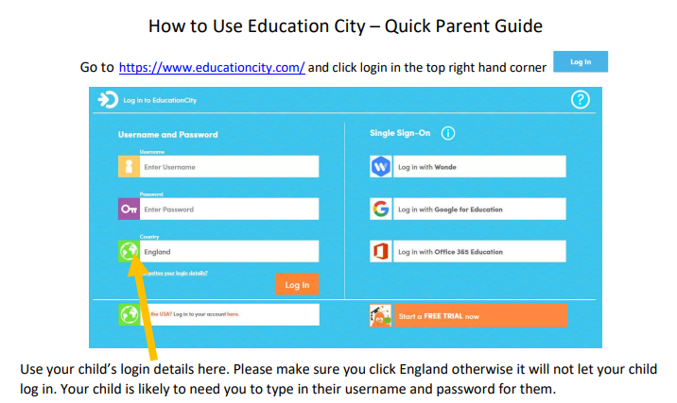
You or your child can choose which area to focus on or your child’s teacher may allocate a specific task (you will be informed if these have been set).

Slide 18
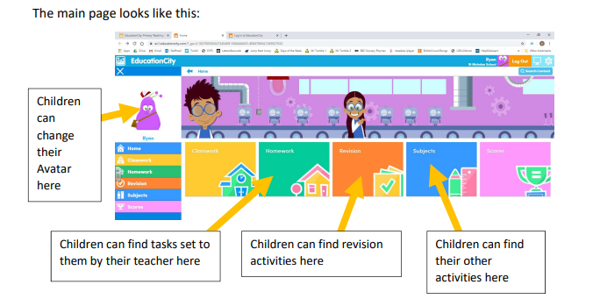

Slide 19
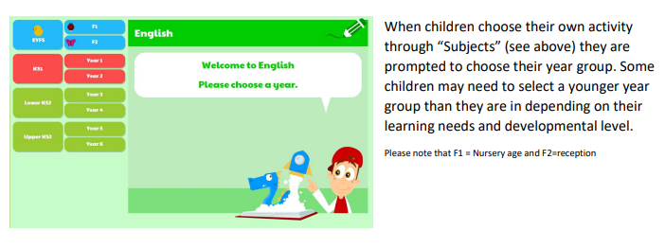
Choosing their own activities

Slide 20
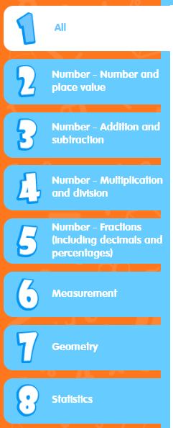
Once the children have chosen their subject and year group, clicking the activities tab will take them to a range of games organised by mathematical strand.
Choosing their own activities

Slide 21
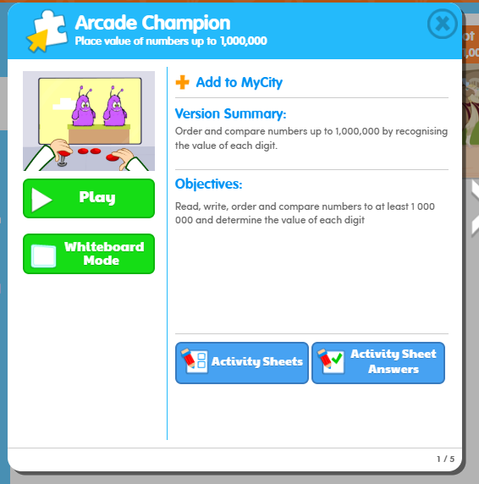
Once you have chosen an activity, clicking on it will identify the national curriculum objective which is being covered within that game.
Choosing their own activities

Slide 22
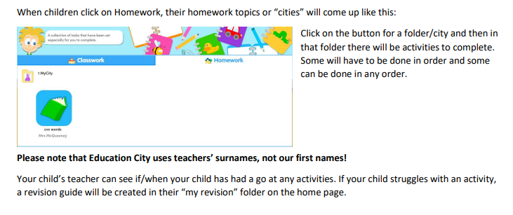
Home learning

Slide 23

What does Maths look like at GBP?
The remainder of our Maths presentation includes:
What Maths looks like within each year group at GBP
Resources available on our website – a wide range including helpful games and top tips to encourage your child to ‘learn’ maths at home!
Strategies to help your child learn their Times Tables, including why this is so important – daily practise will help your child become fluent and confident in this area.
Examples of resources to use at home (KS1 focus but also links to KS2)
This presentation provides information targeting children from Years 1-6. Please see our separate Early Years Maths presentation led by our experienced Early Years team for more information about the Early Years curriculum.

Slide 24
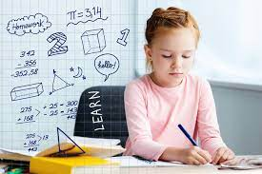
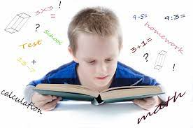
What does Maths learning look like at Great Binfields?
On the next few slides, you will see an example of a child’s piece of learning who is working at age related expectations within each year group.
You will also notice a selection of the key focus areas within each year group around the outside of piece of work. These are not a full list of objectives but just a few key elements crucial to the year group’s Maths curriculum.
We feel it’s important to share this with you so you have a clear understanding of the expectations your child will be working to achieve within each year group in Maths.

Slide 25
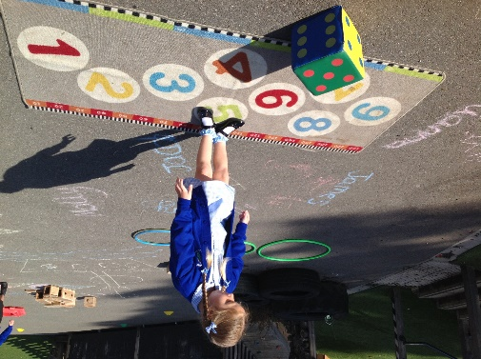
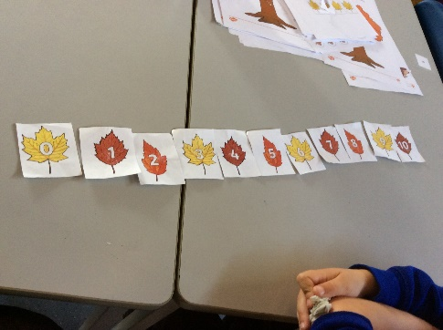
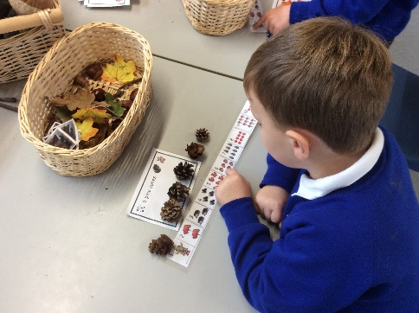
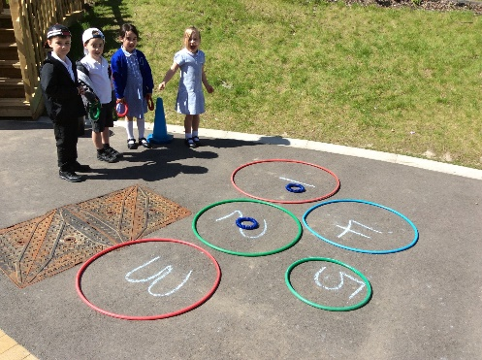
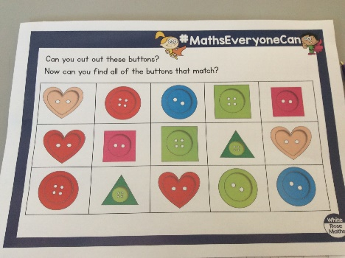
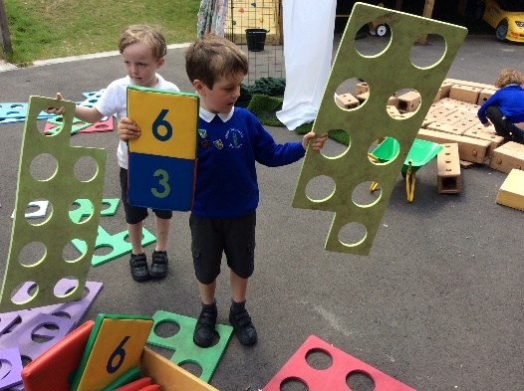
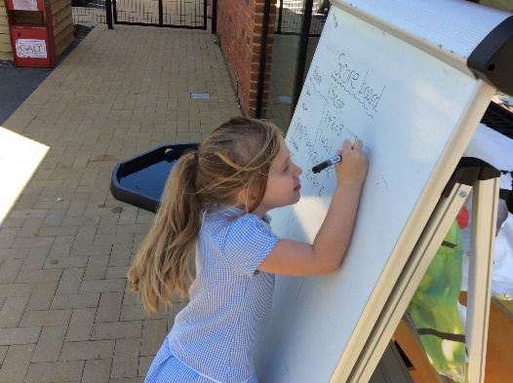

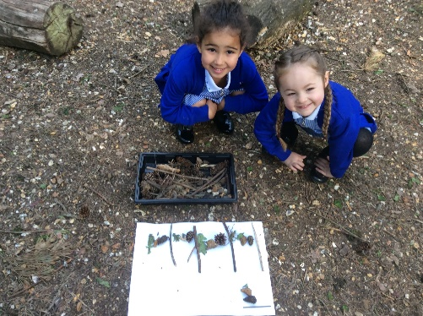
What does Maths looks like in EYFS?
Learning through play.
Outdoor activities.
Counting, counting and more counting!
Pattern spotting
Number recognition and ordering to 10.
Learning numbers bond up to 10.
Shape recognition, 2D and 3D.
Addition and subtraction using single digit numbers.
For more information see the EYFS power point.

Slide 26
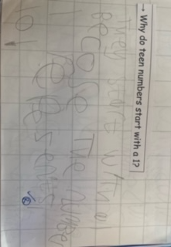
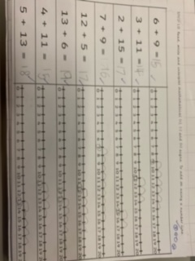
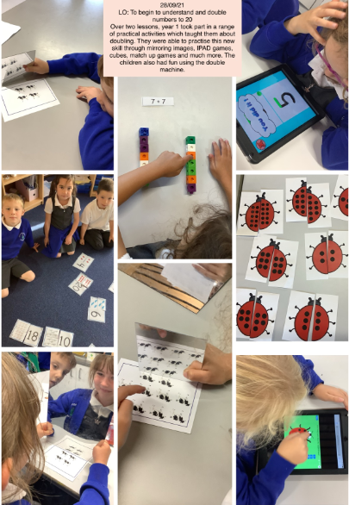
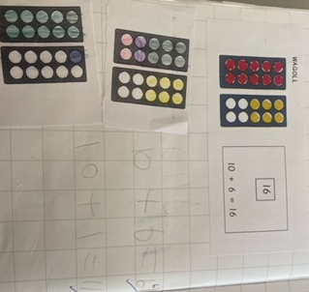
What does Maths look like in Year 1?
Number bonds to 10 and within 10.
Compose numbers to 10 from 2 parts, and partition numbers to 10 into parts, including recognising odd and even numbers.
To read time to O'clock and Half Past.
To double numbers to 10.
Count forwards and backwards in multiples of 2, 5 and 10.
Read, write and interpret equations containing +, - and = symbols.
Recognise common 2D and 3D shapes presented in different orientations, and know that rectangles, triangles, cuboids and pyramids are not always similar to one another.
Count within 100, forwards and backwards, starting with any number.

Slide 27
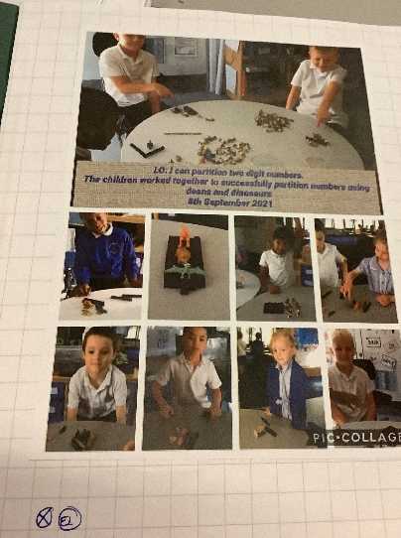
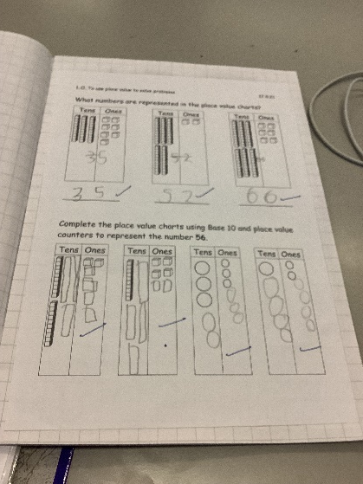
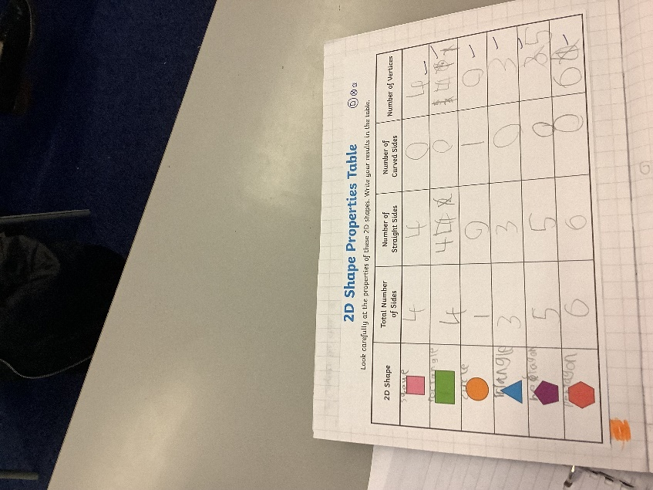
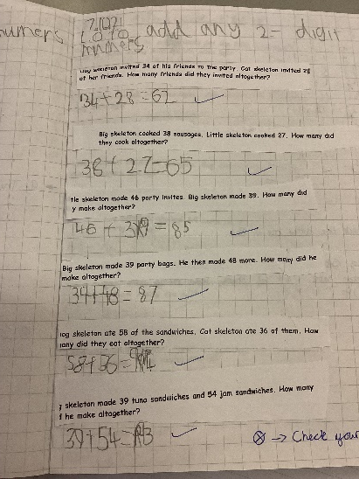
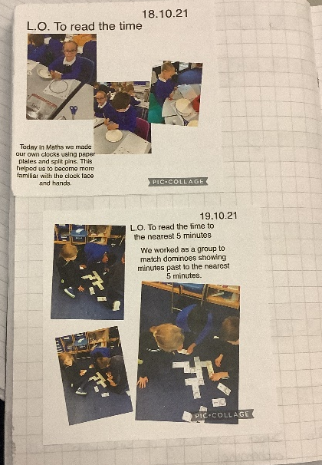
What does Maths look like in Year 2?
Add and subtract within 100 by applying one-digit addition and subtraction facts. To add and subtract any 2 two-digit numbers.
Practical learning using a variety of resources.
To read the time to the nearest five minutes
Recognise the place value of each digit in two-digit numbers.
To describe the properties of 2D and 3D shapes and compare shapes by their properties
Recognise the subtraction structure of ‘difference’ and answer questions such as “How many more…?”.
Secure fluency in addition and subtraction facts within 10.

Slide 28
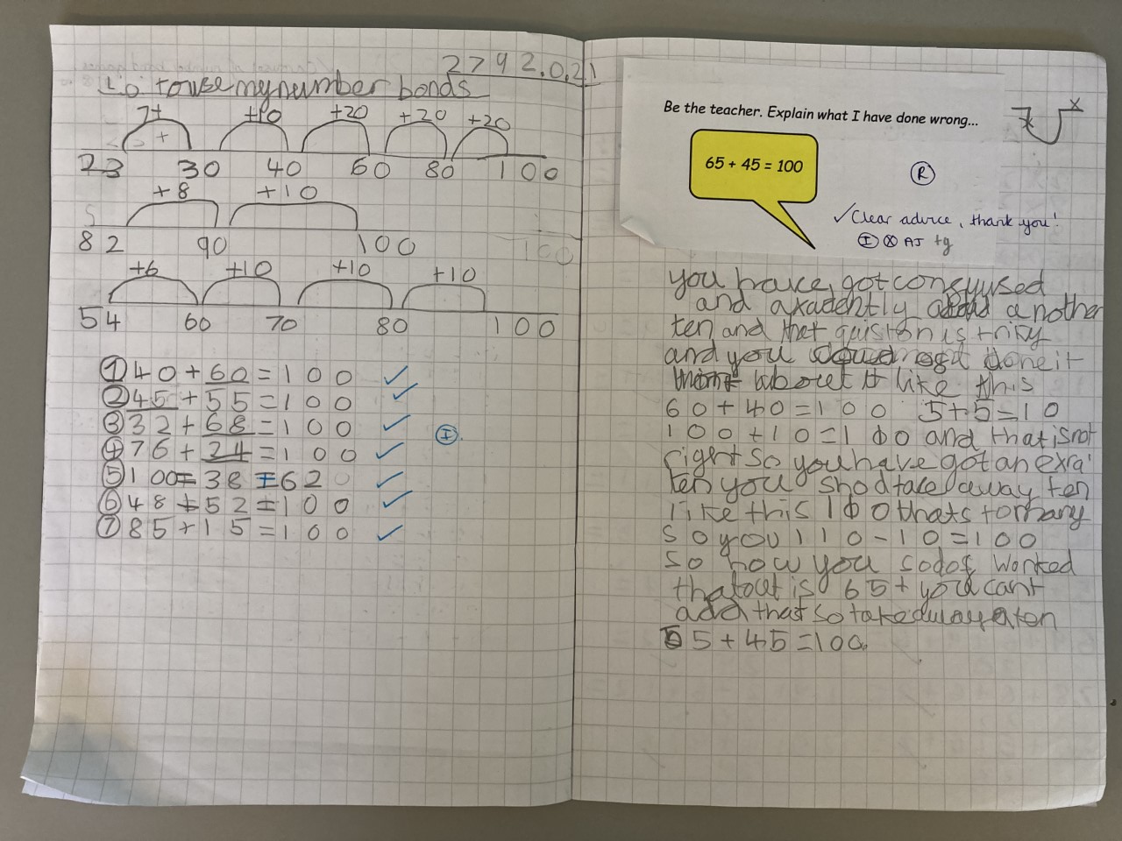
What does Maths look like in Year 3?
To use choose strategies to help me answer questions such as partitioning, number lines, counting on, counting back, bar models and eventually formal methods such as the column method.
Consistently use the correct number formation (0-9).
To recognise the place value of each digit in a three-digit number (hundreds, tens and ones).
To read and write numbers up to 1,000
To identify angles greater than or less than a right angle
To add and subtract mentally and scaling these by 10 e.g. 6 + 3 = 9, 60 + 30 = 90.
To understand the inverse relationship between add and subtract
To solve number and practical problems, including reasoning using my number knowledge.
To recall my 2, 5, 10s, 3, 4 and 8 times tables and related division facts.

Slide 29
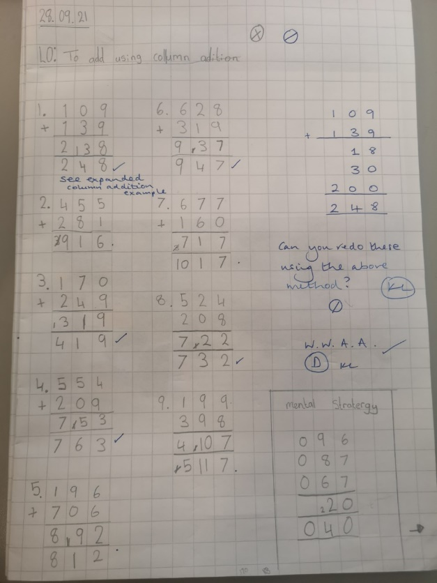
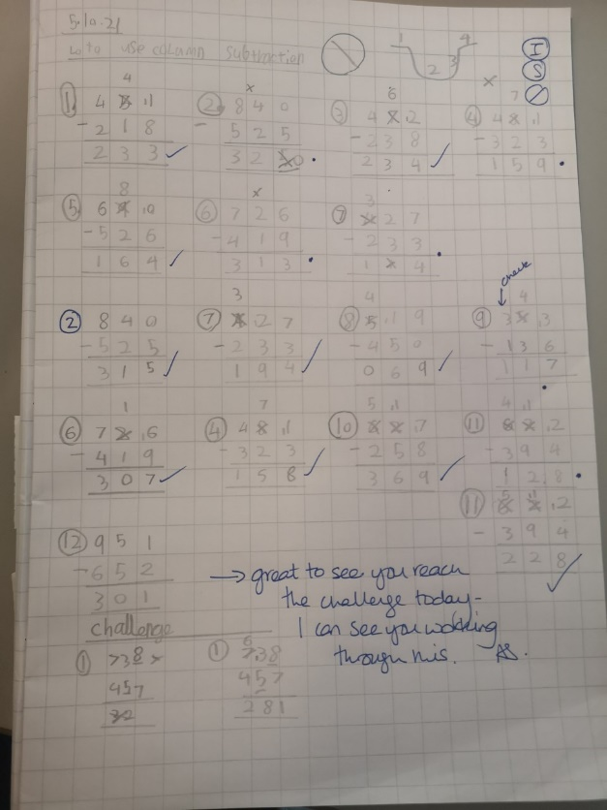
What does Maths look like in Year 4?
Find the perimeter of regular and irregular polygons
Convert mixed numbers to improper fractions and vice versa
Begin to use expanded formal methods for addition and subtraction.
Solve addition and subtraction two-step deciding which operations and methods to use and why
Have a secure understanding of number: confidently identifying the value of each digit in a 4 digit number E.g. 2378 the 3 represents 300.
Recognise common groups of equivalent fractions and finding the corresponding decimal.
To solve practical and number problems using reasoning to justify answers.
To confidently and securely know times tables facts, including the inverse up to 12x12
Multiply two-digit and three-digit numbers by a one-digit number using formal written layout

Slide 30
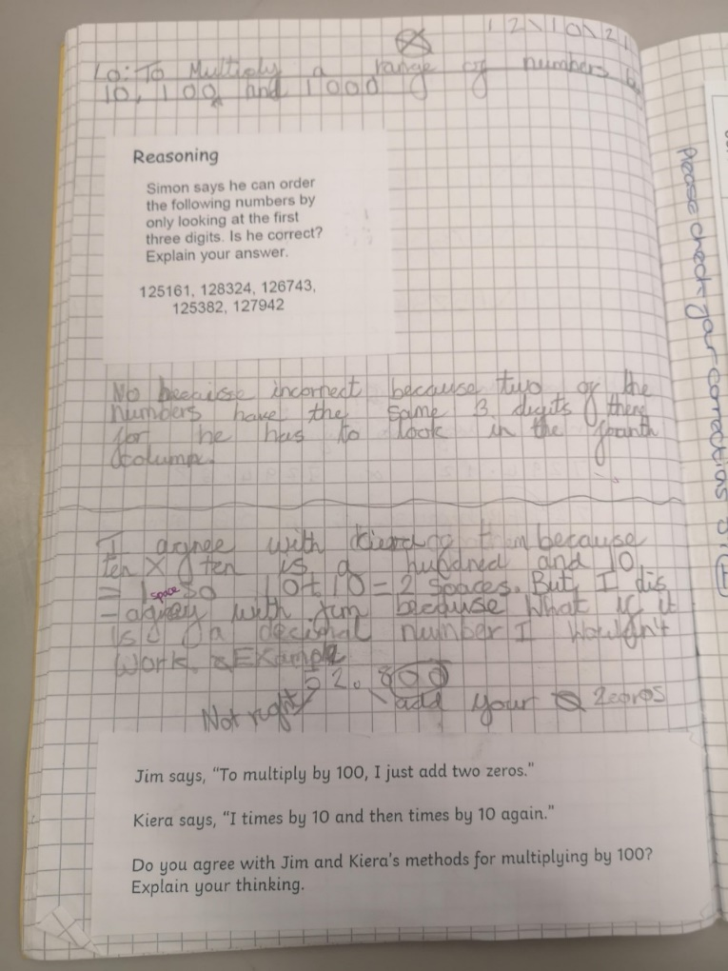
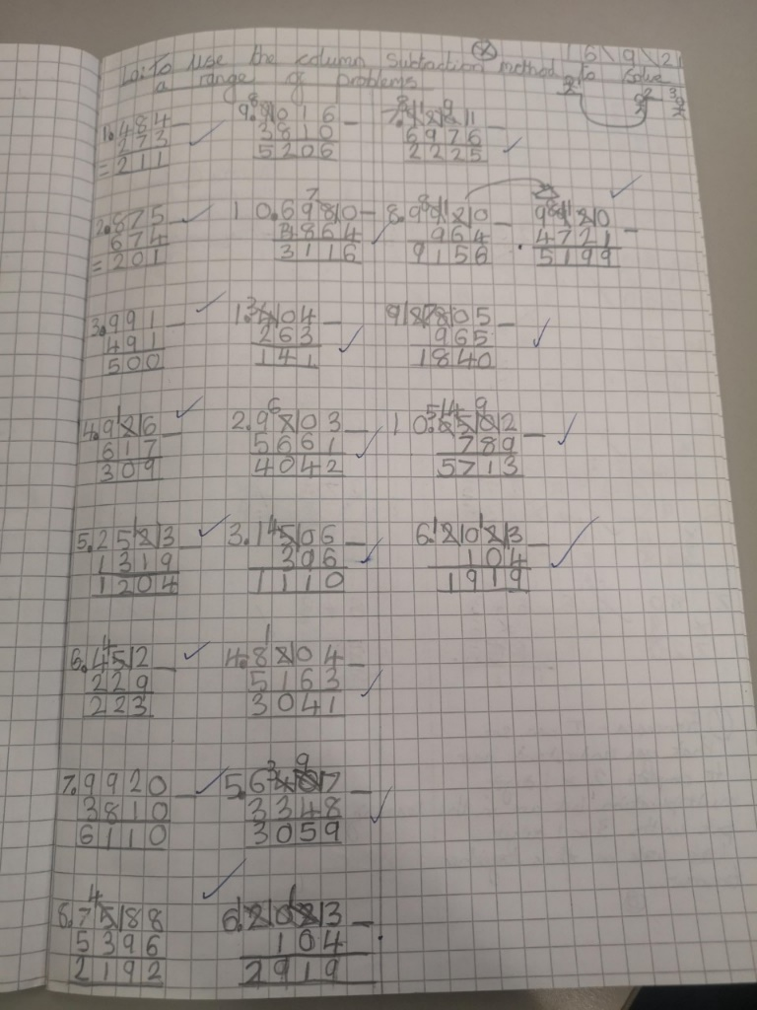
What does Maths look like in Year 5?
Measure angles in degrees (°) and draw angles of a given size.
Recognise the place value of each digit in numbers with up to 2 decimal places
Secure understanding of fractions including simplifying, equivalent fractions and calculating with fractions (+ - and x by integers)
To use the formal written methods for all four operations (addition, subtraction, division and multiplication)
Convert between units of measure e.g. grams to kilograms
Rapid and accurate recall of ALL times tables and related division facts
To solve number problems using reasoning to justify my answers and to prove and disprove.
Find non-unit fractions of quantities.
Draw upon a variety of mental maths strategies to support arithmetic skills

Slide 31
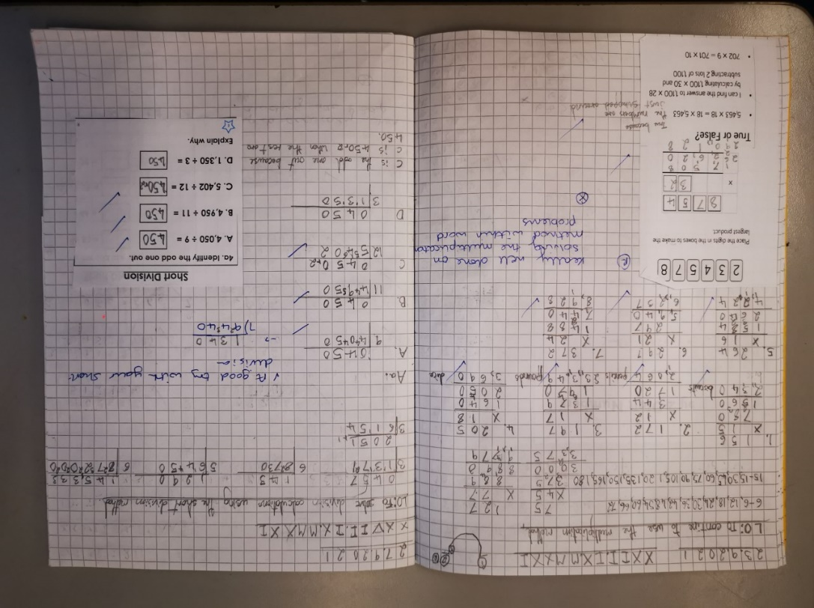
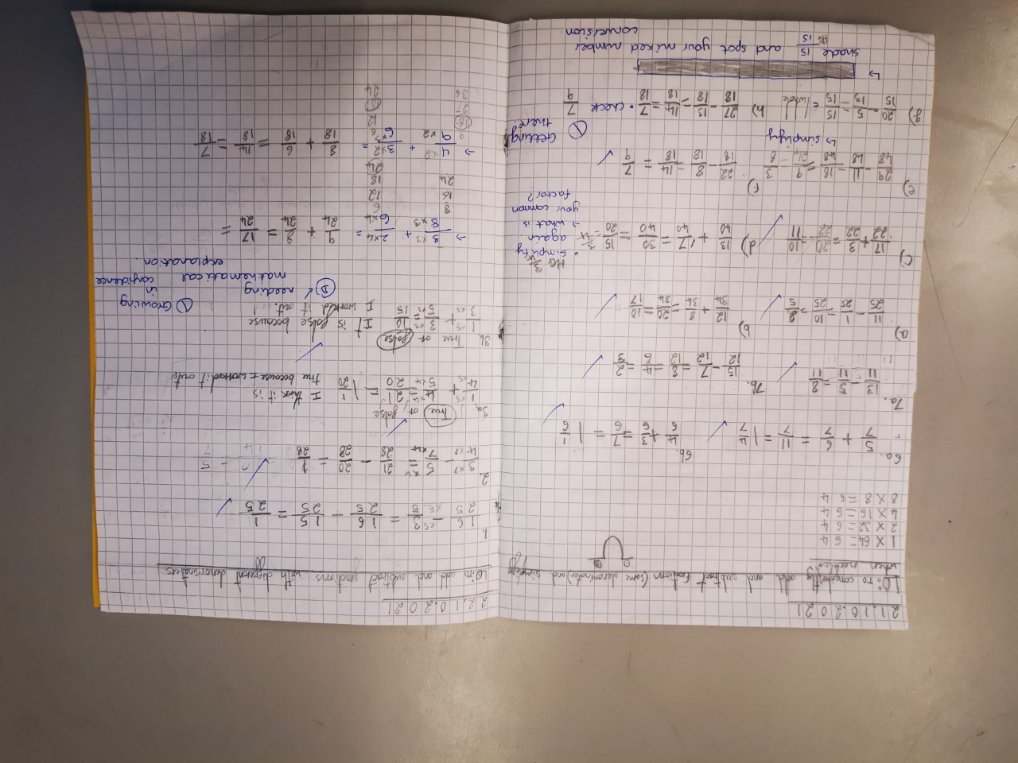
What does Maths look like in Year 6?
Rapid and accurate recall of ALL times tables
Draw, compose and decompose shapes according to given properties, including dimensions, angles and area
Find equivalent fractions, decimals and percentages
Solve problems involving ratio relationships
Solve multi-step word problems
Recognise the place value of each digit in numbers up to 10 million, including decimal fractions
Algebra
To consolidate the formal written methods and use alongside efficient mental strategies
Use common factors and multiples to simplify fractions. To securely use all four operations when calculating with fractions (+ - x ÷)
Working with numbers beyond 6 and 7 digits
Systematic and methodical workings
Draw upon a variety of mental maths strategies to support arithmetic skills

Slide 32

Navigating our GBP website
Click on the picture to access our Maths curriculum page on the Great Binfields website.
We have a wealth of resources on our website available for you to use with your children to support their Maths learning or to guide your own understanding of the Maths curriculum.
Key Areas covered on the Main Maths Page:
Link to the Maths National Curriculum (objectives your child will be learning)
Maths Calculation Policy
Becoming a Mathematician
Maths Dictionary for Parents
Recommended Games and website for Maths at Home
Navigation from GBP homepage:
- Key Information
- Curriculum
- Maths
Notes:
Maths dictionary for parents is really useful!

Slide 33
What will my child be learning?
The link below will take you to the programmes of study for each year group. This shows you what your child will be learning when at school and what a child of that age is expected to achieve by the end of the year (Age Related Expectations).
National Curriculum Programmes of Study for Key Stage 1 and Key Stage 2
Each year group will also re-visit teaching from previous year groups to ensure knowledge is consolidated and secure.

Slide 34
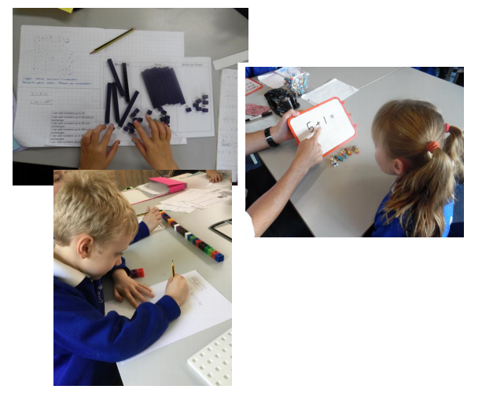


A closer look at the National Curriculum and how these objectives will be taught to my child
Our calculation policy has been written in line with the programmes of study taken from the National Curriculum for Mathematics (2014). It is designed to be challenging, focussing on essential core subject knowledge and skills. This document guides you through the appropriate calculation methods within each year group and the progression of skills throughout the school.
The content of this document is set out in year group blocks under the following headings: addition, subtraction, multiplication and division.
Maths Calculation Policy – Early Years to Year 6

Slide 35


A closer look at the National Curriculum and how these objectives will be taught to my child
Maths Progression of Skills – Years 1 to Year 6

Slide 36

Extra Features
Helpful extras for you to support your child with their Maths learning at home

Slide 37

Maths Workshops for parents
All of our previous Maths information evening resources are also on our website. This contains an abundance of resources based on specific areas parents have requested support with previously.

Slide 38




Modelling our calculation methods
We have created a number of formal calculation method videos to demonstrate how we teach your children at school.
These videos model the formal operations for addition, subtraction, multiplication and division only.

Slide 39
How can you help your child with Maths at home?
Take away their fear.
Reassure and praise whenever possible. Positive mindset…
Let them see you using Maths in your everyday routines – portioning meals between the family, chopping vegetables into halves and quarters etc.
Play with numbers and shapes through games.
Seeing mistakes as an opportunity to learn and using them as a discussion point.
Recognising the importance and value of Maths in our everyday lives e.g. managing money and telling the time.

Slide 40

A quick guide to everyday Maths opportunities for your child
Practise spotting and recognising numbers in the environment. Add/multiply/subtract/divide door numbers, numbers on car registration plates, road signs and at the shop.
Flicking through the TV guide? Ask your child to calculate the length of their favourite programmes. How long is it until the next programme?
Use food packaging to discuss 2D and 3D shapes. What are the properties of these shapes e.g. how many faces, sides, vertices? Flatten the packaging out to find the net of the 3D shape too.
Measuring up for new furniture? Want to make sure the Christmas tree will fit in your living room? These are really good opportunities to encourage your child to see the value of careful measuring skills in everyday life.
Practise telling the time with your child. Can they read both the digital and analogue clock? Can they readily convert between the two and use the 24 hour clock? Can they also recognise Roman Numeral representations of the time too?
Board Games supply endless opportunities for Maths – Snakes and Ladders, Monopoly, Bingo, Connect Four, Battle Ships etc

Slide 41


Websites to support children’s Maths skills
CBeebies have lots of fun and interactive games and activities to help get our younger children excited about Maths
I See Maths – a useful site with a plethora of ideas for fun games that all the family
Primary Games Arena - It is a free website that encourages children to play online maths games linked to their home learning. It breaks the games down into concepts which is really helpful.
Hit the Button – children love this game as it helps to increase confidence through practising times tables and number bonds.
Maths Zone – this site is jam-packed with fun ways to learn more about maths.
BBC Bitesize – lots of information alongside short videos help to make the learning enjoyable and accessible for all children.

