Slide 1

MATHS AT
GREAT BINFIELDS PRIMARY
How to help your child with Times Tables.

Slide 2
Why are Times Tables important?
Times tables are the foundation of mathematical learning and are the building blocks upon which other mathematical thinking is built.
Helping your child to memorise their times tables ensures that working out maths problems become quicker and easier for your child to solve.
Memorising times tables will assist your child when solving, addition, subtraction and division problems – along with multiplication questions.
Times tables begin to unlock the relation that exists between numbers.
They also help to build knowledge of important mathematical concepts such as patterns and sequences, fractions, percentages and even shape.
Successful recall of times tables will increase your child’s confidence in maths exponentially.

Slide 3
Help! How to I help my child learn their Times Tables?
Start small – set a target to learn one set of times table – don’t be overwhelmed by learning them all at once;
  First Step: Learning to count in 2’s
  This allows children to begin to see the pattern that multiplication is repeated addition (KS1)
  Second Step: Beginning the memorisation process
  When beginning to memorise, start with the times tables facts for 1 x 2, 5 x 2 then 10 x 2. Starting with these each time helps build confidence
  Third Step: Building up
  Start building up the memorisation of the times tables, can you spot a relationship between the numbers? 2 x 2 and 4 x 2? Does that make working out 8 x 2 easier to work out/memorise?
  Fourth Step: Practice
  Start by practising them in order, progressing to out of order. Play games to help build fluency and soon your child’s confidence will follow.

Slide 4
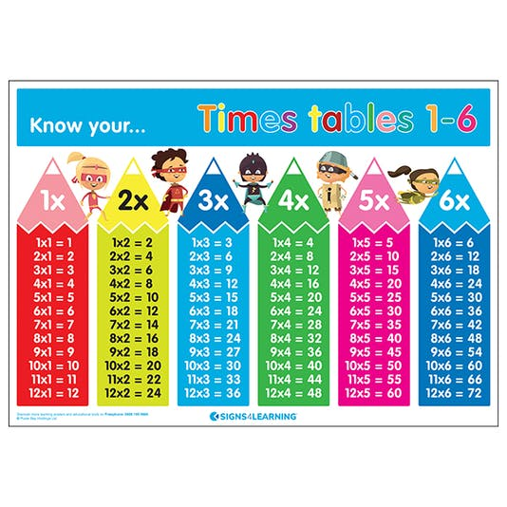

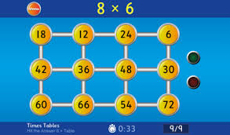
Games and Websites to help my child
Useful links which will provide a good starting point when encouraging your children to practise their times tables can be found on our school Maths page. Every child in KS2 has access to a Times Table Rock Stars account. You will find your child’s username and password in the back of their home school diary. KS1 children have access to a Numbots account which helps to build their understanding of basic number recognition, addition and subtraction.

Slide 5
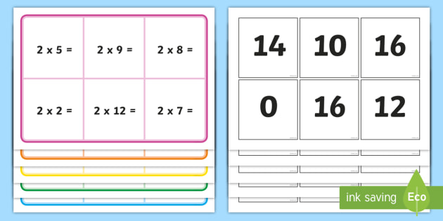
Games to play
Times Tables Bingo
Choose a times table to play (For example 5 times table)
Draw a grid of 6 numbers
Choose 6 multiples from the 5 times tables
The person calling the numbers asks them a times table calculation – (For example 2x5)
Children cross off the answers (10)
The first person to cross off all 6 numbers wins
Play the opposite way around – write down the calculations, caller gives the answers.

Slide 6
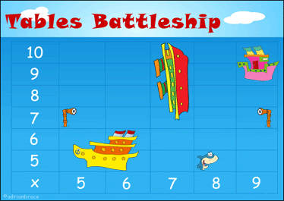
Games
Times Tables Battleships
Set up a grid using any times tables
Plot your ships (agree the size and how many squares they should measure)
Take turns to call out an answer – 25 for your opponent
To work out that is 5 x 5 and a hit

Slide 7
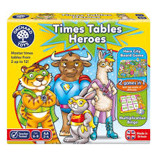
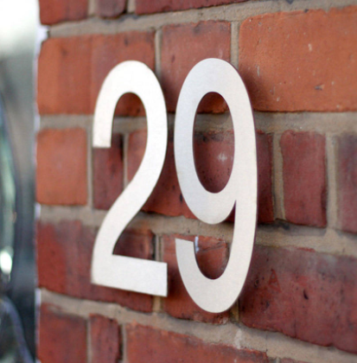
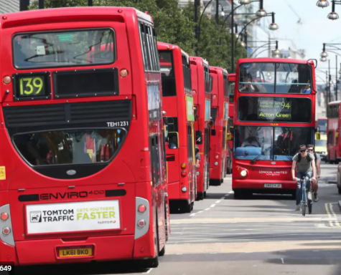
Games
Use numbers on car number plates to solve multiplication calculations
Find numbers in your environment such as on lampposts, house numbers and traffic signs
There are also board games and card games available and many apps also available online

