Slide 1
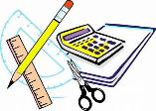

Maths at Great Binfields
Resources that you can use at home to support your child’s maths understanding and learning.

Slide 2

Importance of Resources
Resources can be powerful tools to support sense making, mathematical thinking and reasoning skills.
They help our children to be able to practically engage with new learning and to support their ability to visualise new concepts and knowledge.
At Great Binfields, we apply a CPA approach to Maths learning which embeds the importance of using physical resources to support learning opportunities.
Read on to find out more about this approach.

Slide 3
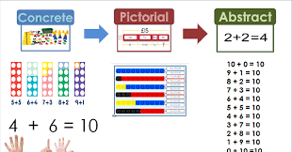

CPA Approach

Slide 4
What is CPA?
C is for concrete. New concepts are introduced through the use of physical objects or practical equipment. These can be physically handled, enabling children to explore different mathematical concepts. These are sometimes referred to as maths manipulatives and can include ordinary household items such as straws or dice, or specific mathematical resources such as dienes or Numicon.
P is for pictorial. Once children are confident with a concept using concrete resources, they progress to pictorial representations. By doing this, they are no longer manipulating the physical resources, but still benefit from the visual support the resources provides.
A is for abstract. Once children have a secure understanding of the concept through the use of concrete resources and visual images, they are then able to move on to the abstract stage. Here, children are using symbols to solve problems. To be able to access this stage effectively, children need access to the previous two stages alongside it.

Slide 5

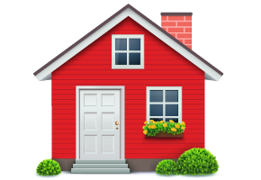
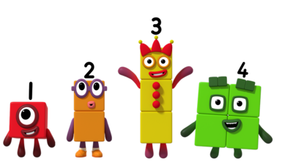
Resources you can use at home
Notes:
Maths dictionary for parents is really useful!

Slide 6
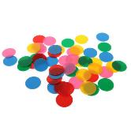
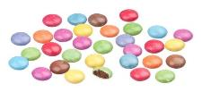
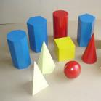
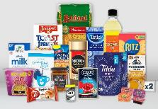
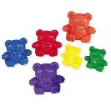
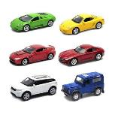
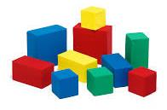

Alternatives to maths resources
Counters or you could use…… Smarties
3D shapes or you could use…… groceries
Counting Bears or you could use…… anything you have a lot of!
Notes:
Maths dictionary for parents is really useful!

Slide 7
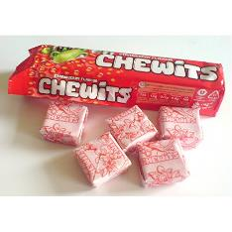
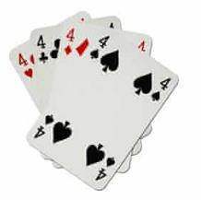
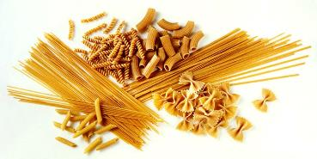
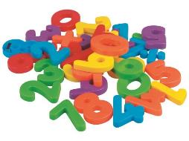
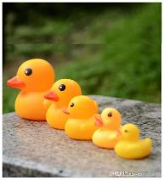
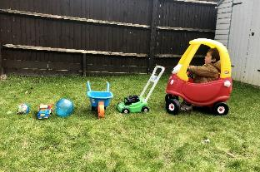
You can use anything you have around the house
Cards for number
recognition and counting
Chewits for counting
Pasta for counting
Toys to put in size order
Magnetic numbers for
number recognition
Notes:
Maths dictionary for parents is really useful!

Slide 8
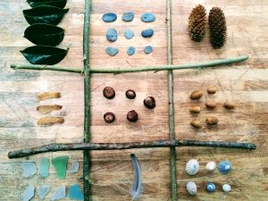
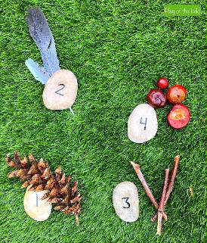
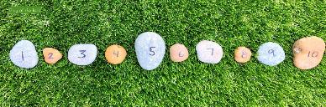
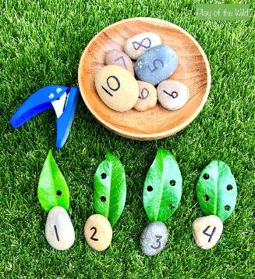
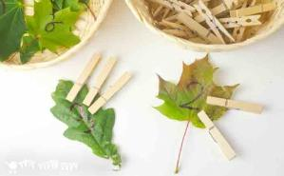
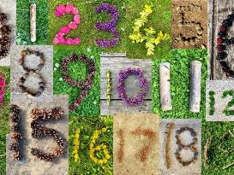
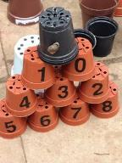
Don’t Forget Outside
Notes:
Maths dictionary for parents is really useful!

Slide 9
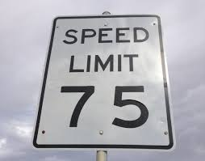
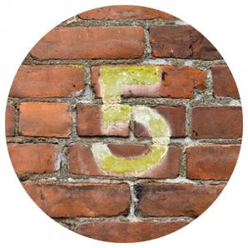
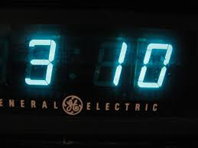
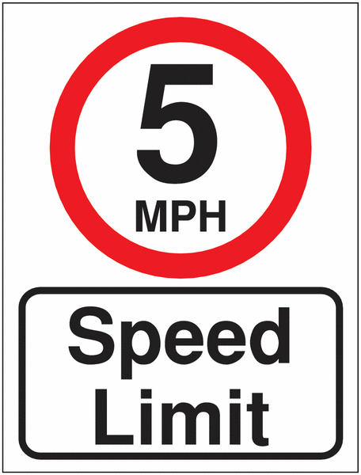
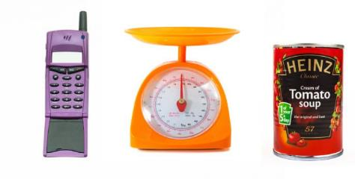
Numbers are all around us!
Notes:
Maths dictionary for parents is really useful!

Slide 10

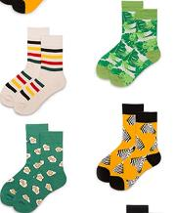


Counting in 2s and 10s
Numicon or you could use…… socks
Numicon or you could use…… gloves
Notes:
Maths dictionary for parents is really useful!

Slide 11
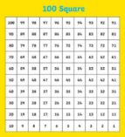
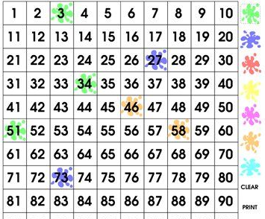
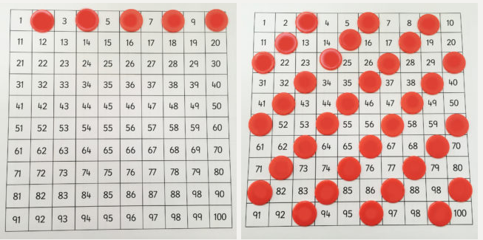
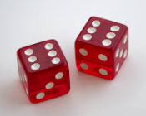
Numbers
100 Square or you could use 100 square splat online game
Games you could play:
Cover Up: Cover up one or more squares using counters. The child has to guess which numbers are hidden under the counter/s.
Patterns: Cover the multiples of 2, 3, 5 and 10 etc (one multiple at a time). Use the patterns to predict which numbers will be in the sequence.
Dice or you could use an Online Dice
Games you could play:
Use dice to help your child recognise numbers at speed.
Knock Out: Each player chooses a “knock out number” – either 6, 7, 8, or 9. More than one player can choose the same number. Players take turns throwing both dice, once each turn. Add the number of both dice for the score. If a player throws a 6, 7, 8 or 9, they are knocked out of the game until the next round.

Slide 12
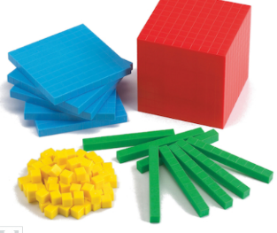

Addition/ Subtraction using sweets instead of dienes
When first teaching children about the concepts of addition and subtraction, we use dienes to help represent the maths behind the calculation. Instead of a tens and ones resource, you could use sweets (such as Chewits). A whole pack of Chewits represent the tens and individual Chewits are the ones. E.g. 18 = 1 tens and 8 ones

Slide 13
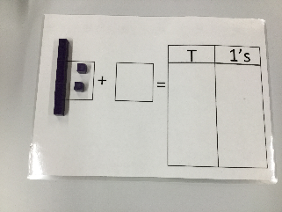

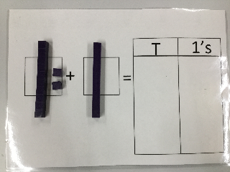
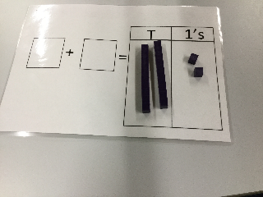
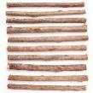
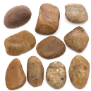
An example of an addition word problem being solved using dienes. This could be solved using sweets (e.g. Chewits)
Big skeleton goes to the shop to buy cakes. He buys 12 chocolate cakes and 10 cream cakes. How many does he buy altogether?
You could also use sticks as tens and stones as ones.

Slide 14
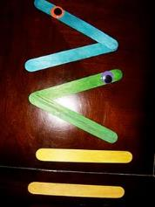
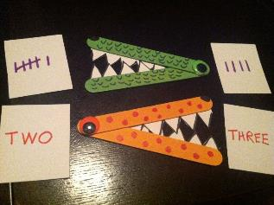
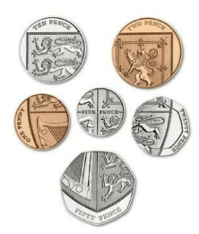
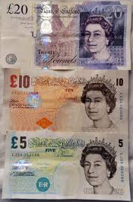
For greater or less than you could use…
For money work or problems you could use your own coins/ notes.

Slide 15
Key Stage 2 Ideas
The resources previously mentioned can be adapted to support children in Key Stage 2 (Years 3-6). The challenge may be presented through the questions you asked when using these resources.
These next slides show some other examples that are more specific to children in Key Stage 2.

Slide 16
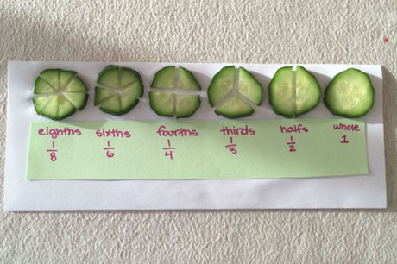
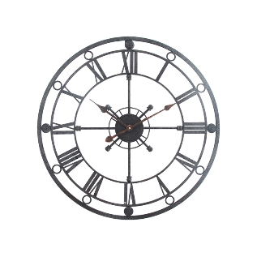
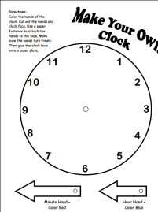
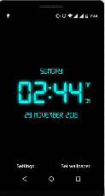
Key Stage 2 Ideas
Using food to practically support with the understanding of fractions.
Make your own analogue clock to tell the time to the minute.
Use any digital device to practise converting analogue to digital using the 24 hour clock.
Practise your roman numerals by drawing them on your own clock face.

Slide 17
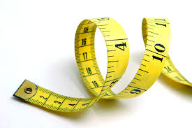
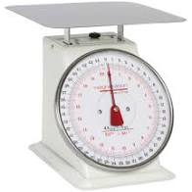



Key Stage 2 Ideas
Using any measuring equipment
that you may have around the house to practise reading a variety of scales.

Slide 18



Key Stage 2 Ideas
Food packaging around the home
Can be used for spotting numbers, adding numbers together and working out and reading percentages.

Slide 19




Key Stage 2 Ideas
Packaging can be used to support with understanding 3D shapes and their nets.

