Slide 1
Relationships and Sex Education (RSE)

Slide 2
What is Relationships and Sex
Education?
Relationships and sex Education (RSE) is learning about:
The emotional, social and physical aspects of growing up
It should equip children and young people with the information, skills and values to have safe, fulfilling and enjoyable relationships and to take responsibility for their sexual health and well-being.
Relationships, human sexuality and sexual health

Slide 3



Updated Guidance
In Focus: Key Principles
Knowledge and Understanding
Attitudes and Values
Skills

Slide 4
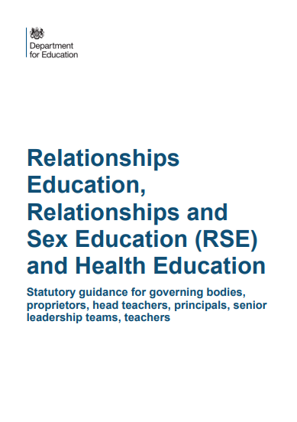
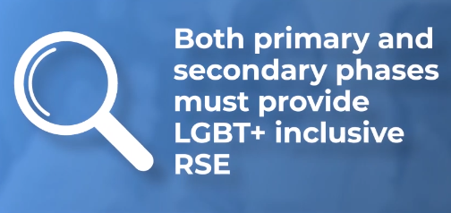
Statutory Guidance
Relationships and Sex Education has now been made statutory by the Government.
Relationships Education: Statutory consists of the following elements at primary level:
Families and people who care for me
Caring friendships
Respectful relationships
Being safe
Sex Education (non-statutory)
Parents have the right to withdraw their child from this area of RSE Education although we do recommend that all children experience this education as part of their personal development.
At primary level, all schools must teach about different family types, which can include LGBT families.

Slide 5
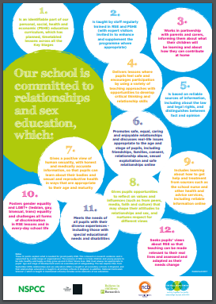
Great RSE?
What should it look like?
Completely age related
Co-produced with young people
Inclusive and critical
Rights based
Safe and ethical
Creative and curious
Holistic and interdisciplinary

Slide 6
RSE at GBP
We want our pupils to grow up healthy, happy and safe. RSE is designed to equip your child with knowledge and make informed decisions about their wellbeing, health and relationships as well as preparing them for a successful adult life.
The world today for young people looks very different from the way it did 20 years ago when this curriculum was last updated – these changes bring the content into the 21st century, so that it is relevant for your child.
The delivery of RSE is not new to GBP and we are continuously developing the teaching and learning of this subject area.
We are flexible in its content and deliver content which is completely age appropriate and sensitive to the needs and religious backgrounds of all pupils.

Slide 7
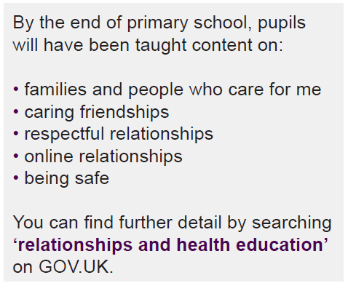
Relationships Education
Relationships Education will put in place the building blocks needed for positive and safe relationships, including with family, friends and online.
Your child will be taught what a relationship is, what friendship is, what family means and who can support them. In an age-appropriate way, we will cover how to treat each other with kindness, consideration and respect.

Slide 8
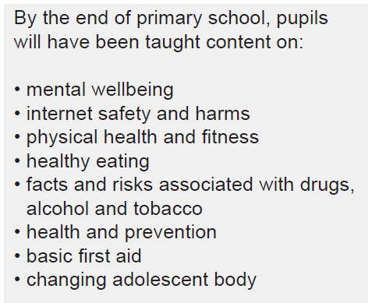
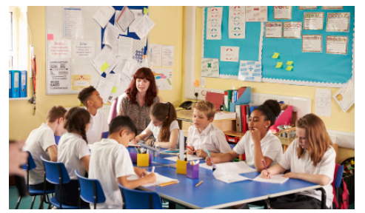
Health Education
Health education aims to give your child the information they need to make good decisions about their own health and wellbeing, to recognise issues in themselves and others, and to seek support as early as possible when issues arise.

Slide 9
Your rights as a parent…
The important lessons you teach your child about healthy relationships, looking after themselves and staying safe, are respected and valued under this new curriculum. Teaching at school will compliment and reinforce the lessons you teach your child as they grow up.
You can express your opinion, and this will help us decide when and how to cover the content of the statutory guidance.
We will ensure out teaching reflects the age and religious background of our pupils.

Slide 10
Parents’ right to withdraw
Parents cannot withdraw their children from Relationships Education as it is statutory. It is important that all pupils receive this content, covering topics such as friendships and how to stay safe.
However, parents do have the right to withdraw their children from the non-statutory components of Sex Education within RSE.
Alternative work will be given to pupils who are withdrawn from Sex Education and they will be removed from the lesson.

Slide 11
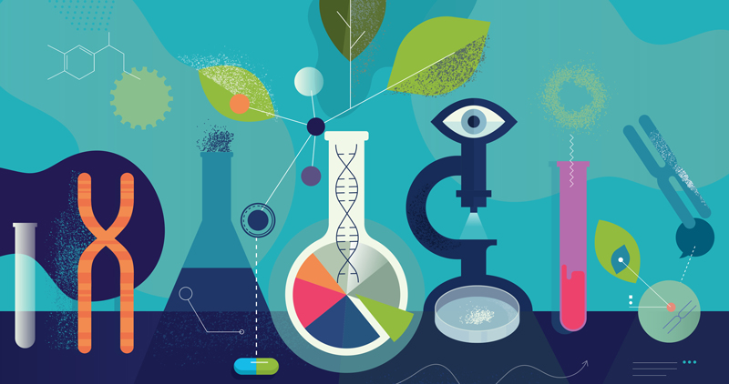
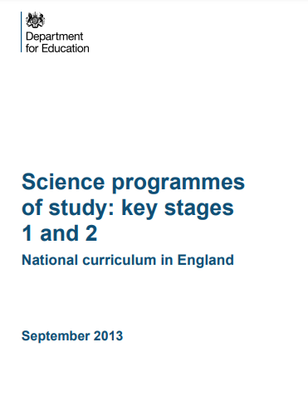
Parents’ right to withdraw:
The Science Curriculum
The science curriculum in all maintained schools also includes content on human development, including reproduction and human development (puberty), which maintained schools are required to teach.
There is no right to withdraw from the content on human development.

Slide 12
Under the National Curriculum, the basics of Sex Education fall within the science curriculum. The statutory content requires maintained schools to teach children about human development, including puberty, and reproduction. Please see the DfE Science Programme of Study below which includes specific content for each year group.
In Key Stage 1, pupils will:
Be introduced to the process of reproduction and growth in animals. They should be introduced to the concepts of reproduction and growth, but not how reproduction occurs.
Key Stage 2, pupils will:
Be taught about different types of reproduction, including sexual and asexual reproduction in plants and sexual reproduction in animals. Pupils should draw a timeline to indicate stages in the growth and development of humans. They should learn about the changes experienced in puberty.

Slide 13
What do we use to teach RSE?
We use ‘Jigsaw’ for the delivery of our RSE Curriculum.
Objectives linked to RSE are clearly mapped out on our PSHE curriculum map.

Slide 14
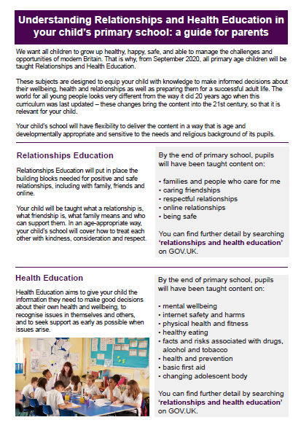
Our RSE Policy
Our updated Relationships and Sex Education Policy
From September 2020
Our policy is available on our school website and paper copies can be made available upon request.
Please also see the short guide for parents which can be located on our school website.

