Slide 1


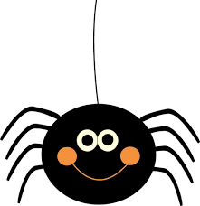
Nursery Rhymes & Songs
Twinkle twinkle little star
How I wonder what you are
Up above the world so high
Like a diamond in the sky
Twinkle twinkle little star
How I wonder what you are
Hickory dickory dock
The mouse ran up the clock
The clock struck one
The mouse ran down
Hickory dickory dock
Hickory dickory dock
The mouse ran up the clock
The clock struck two
The mouse went boo
Hickory dickory dock
Hickory dickory dock
The mouse ran up the clock
The clock struck three
The mouse went wee
Hickory dickory dock
Zoom zoom zoom
We’re going to the moon
Zoom zoom zoom
We’ll be there very soon
5, 4, 3, 2, 1
Blast off!
Incy wincy spider
Climbed up the water spout
Down came the rain
And washed poor incy out
Out came the sun
And dried up all the rain
So incy wincy spider
Climbed up the spout again

Slide 2
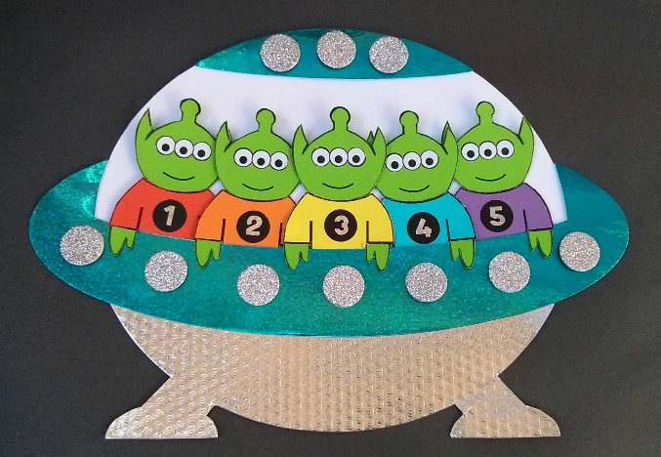


Five little men in a flying saucer
Flew round the world one day
They looked left and right
but they didn’t like the sight
So one man flew away
Repeat with four, three, two little men in a flying saucer…
One little man in a flying saucer
Flew round the world one day
He looked left and right
but he didn’t like the sight
So one man flew away
Ring a ring o’ roses
A pocketful of posies
A-tishoo, a-tishoo
We all fall down
The cows are in the meadow
Eating buttercups
A-tishoo, a-tishoo
We all jump up
A—B—C—D—E—F—G
H—I—J—K, L-M-N-O-P
Q—R—S, T—U—V
W—X, Y and Z
Now I know my ABC
Next time won't you sing with me?
One, two, three, four, five
Once I caught a fish alive
Six, seven, eight, nine, ten
Then I let it go again
Why did you let it go?
Because it bit my finger so
Which finger did it bite?
This little finger on my right

Slide 3
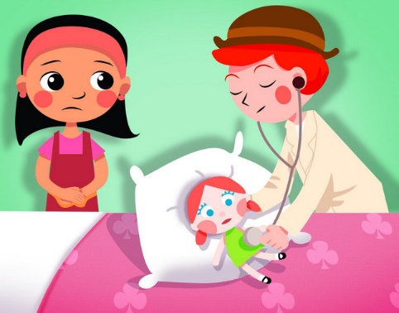
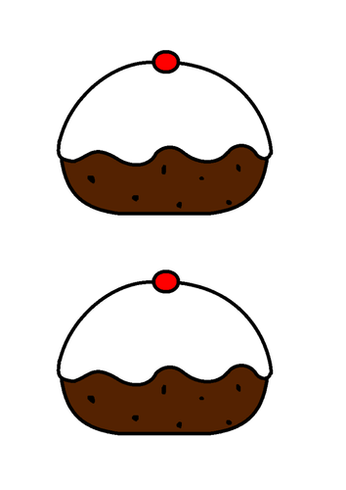
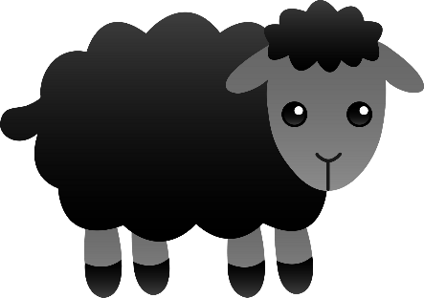
Five currant buns in a baker's shop
Big and round with a cherry on the top
Along came a boy with a penny one day
Bought a currant bun and took it away
Repeat for four, three two, one currant bun…
Miss Polly had a dolly
Who was sick, sick, sick
She called for the doctor
To come quick, quick, quick
The doctor came
With his bag and his hat
And he knocked on the door
With a rat-a-tat-tat
He looked at the dolly
And he shook his head
And he said “Miss Polly
Put her straight to bed”
He wrote out a paper
For a pill, pill, pill
“I’ll be back in the morning
With a bill, bill, bill”
Baa Baa Black Sheep
Have you any wool?
Yes sir, yes sir
Three bags full
One for the master and one for the dame
And one for the little boy who lives down the lane
Baa Baa Black Sheep
Have you any wool?
Yes sir, yes sir
Three bags full
Thank-you said the master and thank-you said the dame
And thank-you said the little boy who lives down the lane

Slide 4
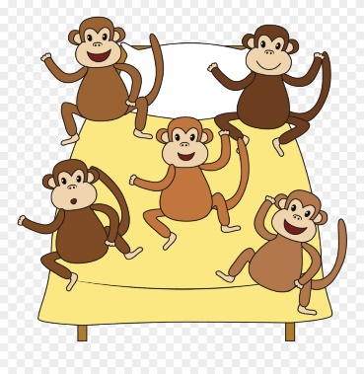
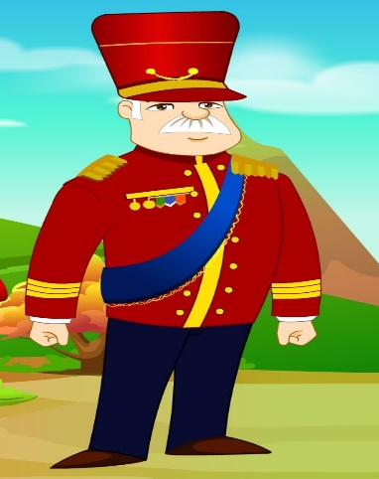

Five little monkeys jumping on the bed
One fell off and bumped his head
Mummy called the doctor
and the doctor said
no more monkeys jumping on the bed
Repeat for four, three, two monkeys
One little monkey jumping on the bed
He fell off and bumped his head
Mummy called the doctor
And the doctor said
Put those monkeys straight to bed
Wind the bobbin up
Wind the bobbin up
Pull, pull, clap, clap, clap
Wind it back again
Wind it back again
Pull, pull, clap, clap, clap
Point to the ceiling
Point to the floor
Point to the window
Point to the door
Clap your hands together, one, two, three
Put your hands upon your knee
I’m a little teapot
Short and stout
Here’s my handle
Here’s my spout
When I get all steamed up
Hear me shout
Tip me over and pour me out
Oh, the grand old Duke of York
He had ten thousand men
He marched them up to the top of the hill
And he marched them down again
And when they were up, they were up
And when they were down, they were down
And when they were only half-way up
They were neither up nor down

