Slide 1
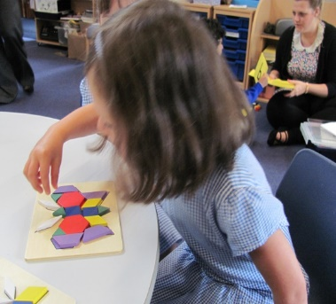
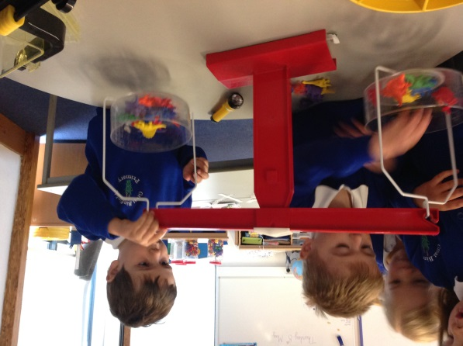
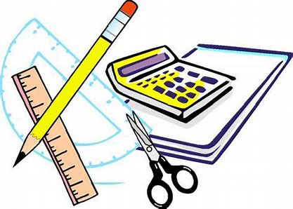
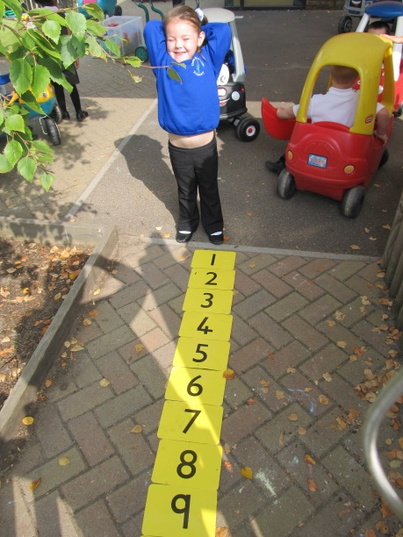
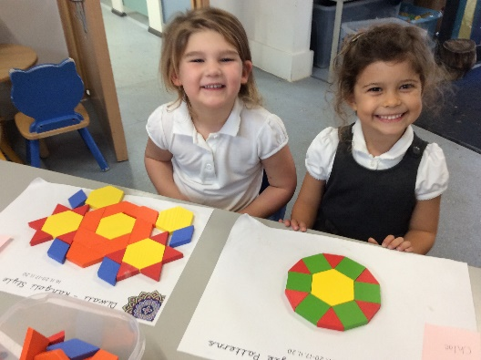

Maths in Year R at Great Binfields
This presentation aims to guide you through the resources which are currently available on our website and also to recap how you can help your child at home with their Maths. Please use this presentation as a signposting tool to help you navigate our existing resources.

Slide 2
Why is maths so important?
Maths is everywhere in the world around them.
Children will need to be able to use maths in everyday life.
Maths enables children to think logically and become good problem solvers.
Therefore:
It is vital to lay secure foundations in early mathematics.
We want children to engage with all areas of mathematics.
We must give children the tools to help them to develop a better understanding of the mathematical world in which they live.

Slide 3
Building Positive Attitudes
Before children can learn maths, they first need to believe in their own ability .
You are your child’s first role model for learning. If they hear you talk about being bad at maths, then they will think it is ok not to try. Ask yourself whether you would confidently say “oh I’m no good at reading” in front of your child. If not, then why would you do it for maths?
If you engage with your child in a supportive, relaxed atmosphere, your child will enjoy exploring the world of mathematics.
Don’t let your own experiences, if bad, pass onto your child.

Slide 4
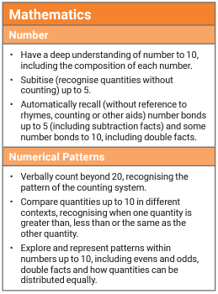

At the end of the year children are measured against Early Learning Goals. The maths Early Learning Goals are:
Although shape and measures are not assessed as part of the Early Learning Goals, they are still part of our maths curriculum. We will work with the children to learn about properties of shapes, copy and create simple repeating pattern, understand how to measure time, size, weight and length.

Slide 5
How do we help children become confident mathematicians?
Children are given clear purposes and context for mathematics that are real in life and in play.
First hand experiences both indoors and outdoors e.g. creating cafes, car washes, shows that require tickets.
Adults modelling how to be a mathematician through whole class teaching and small group work.
Maths rich environment.

Slide 6
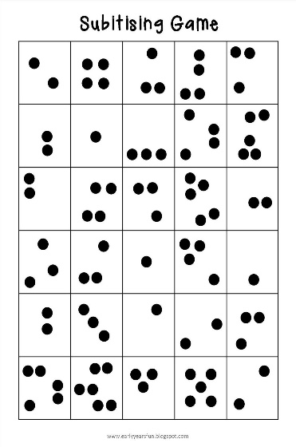
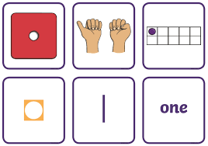
Subitising.
Subitising is rapid, accurate and confident judgement of numbers for small amounts. To help children become confident mathematicians we help them recognise a small amount without counting. For example being able to know that you have rolled 5 on a dice just by looking at the spots.

Slide 7
Counting.
When children first begin to count, they learn important mathematical ideas:
One-to-one correspondence (one number for one object)
Stable order (we count 1,2,3,4,... not 1,2,7,5,...)
Cardinality (the last number counted tells how many)
When children learn to count they like to touch, point to and move objects as they say the number aloud – provide loads of opportunities for this and encourage them to do so. You absolutely cannot do enough counting so the more times you count in a day the better.

Slide 8
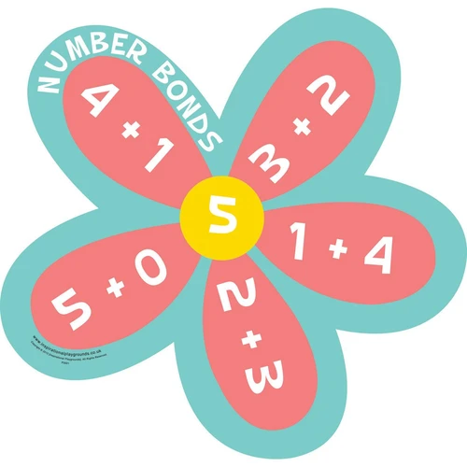
Number Bonds
Number bonds are pair of numbers that add together to make another larger number.
We concentrate on number bonds to five and then progress onto ten.
Number bonds will support children to recognise patterns and solve other calculations as they move to other Key Stages, so if 7 + 3 = 10, this knowledge can be used to support the sum 17 + 3 and 70 + 30.
By the end of the year we would expect the children to be able to recall number bond facts up to 5 mentally.

Slide 9
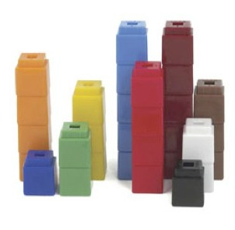
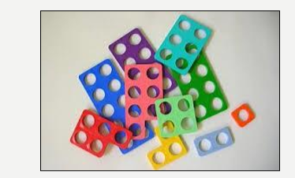
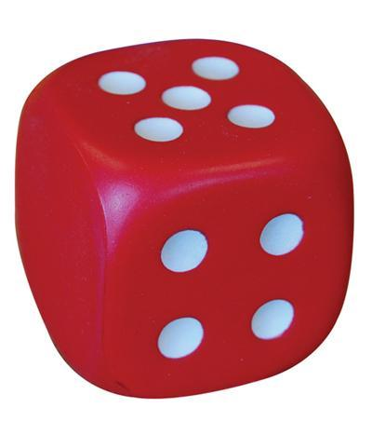
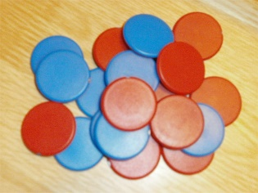
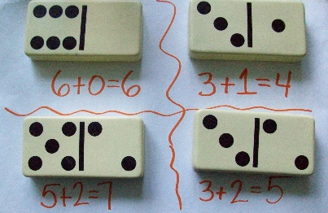
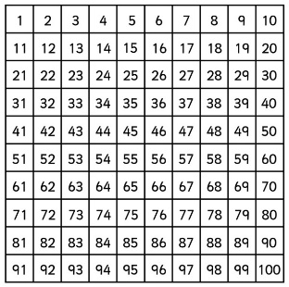
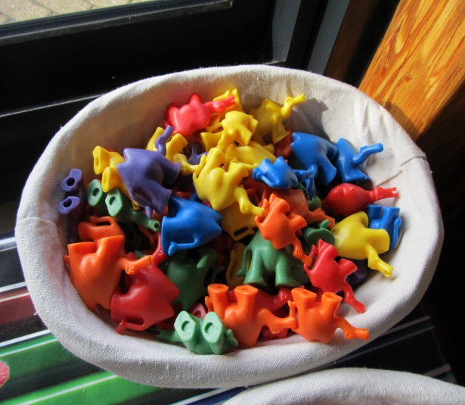

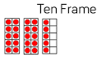
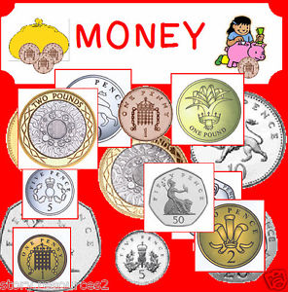
Concrete and pictorial resources
The children use a variety of resources to develop number recognition and problem solving skills. Here are just a few examples of the resources we use at school. Many of the best maths resources are things that are around the children every day e.g. conkers, using socks to count in twos, buttons.
Notes:
Julie – Interactive teaching programs

Slide 10
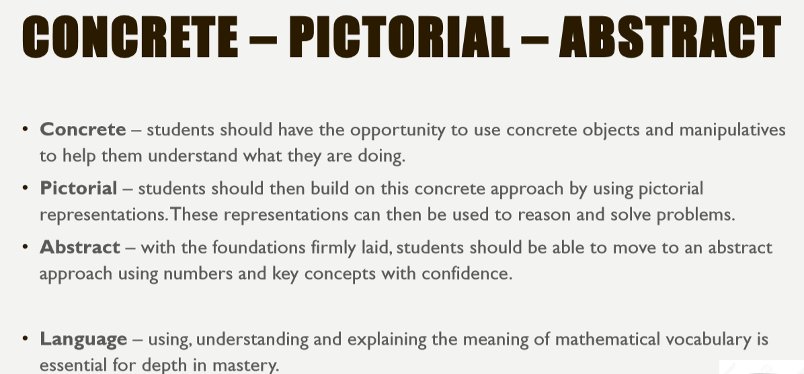

Slide 11
What if my child is very confident with number already will this hold them back?
You may feel that your child can already count to 10 and therefore understands everything there is to know about counting to 10. But have you considered:
they may just know the numbers by rote?
they may not have grasped the 5ness of 5. i.e. they may not understand the numbers within numbers that 5 is made up of 3 and 2, 4 and 1?
they may not be aware of the patterns and relationships between numbers?

Slide 12
How you can support your child at home.
Identify numbers in our environment – on doors, car registration plates, telephone numbers and price tickets.
Children always benefit from plenty of counting practice and singing number rhymes.
Sorting into sets – e.g. sorting cutlery before it is put away
Sorting socks/buttons/toys
Laying places at the table and counting the places and the cutlery

Slide 13
Using mathematical language when looking at books, e.g. how many people can you see in the picture?
Water play with a variety of different sized containers.
Helping you weigh ingredients when cooking.
Handling money, e.g. sorting coins.
Learning positional language through hearing it used as often as possible – ‘Can you put the cups IN the cupboard?’
Number rhymes and finger games.
Playing games which involve counting e.g. snakes and ladders.
Play a number version of I Spy. For example, “I spy something that has the number five on it,” or “I spy something in this room that there are three of.

Slide 14
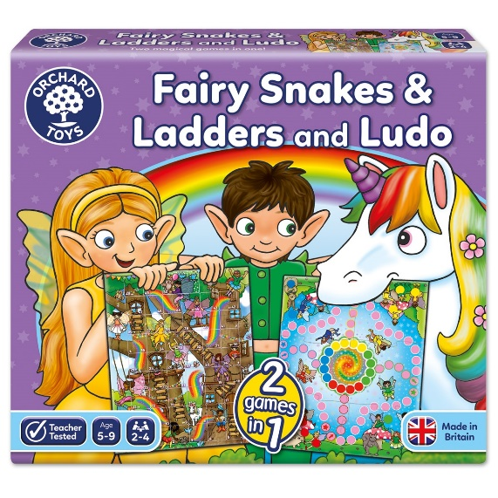
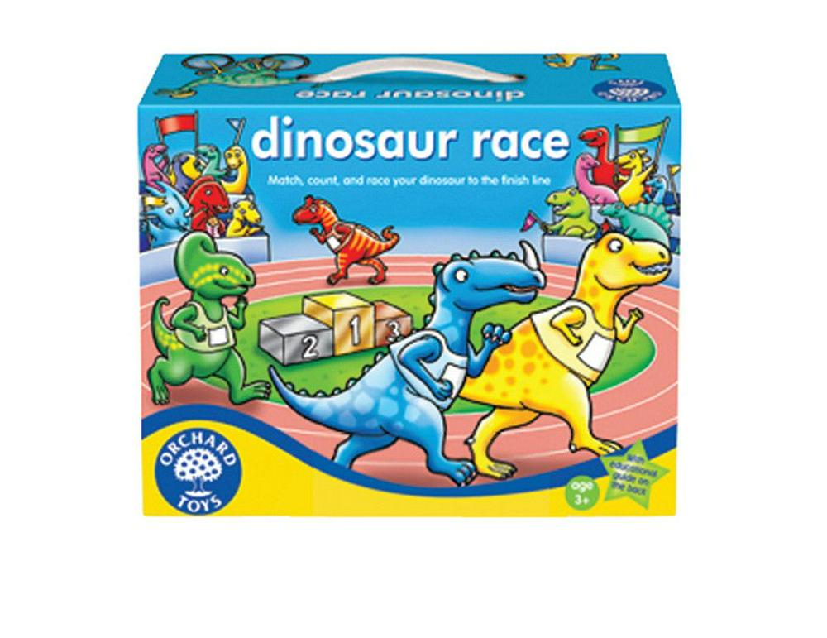
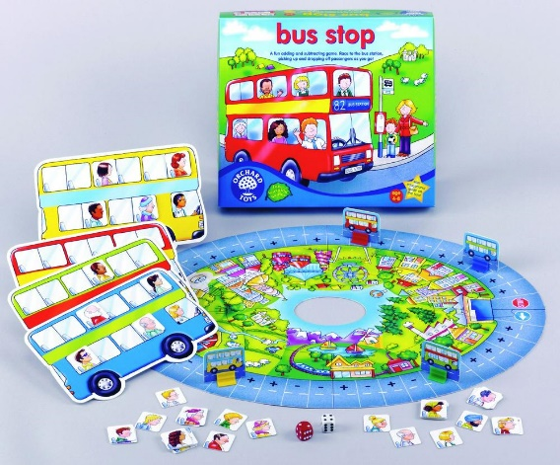
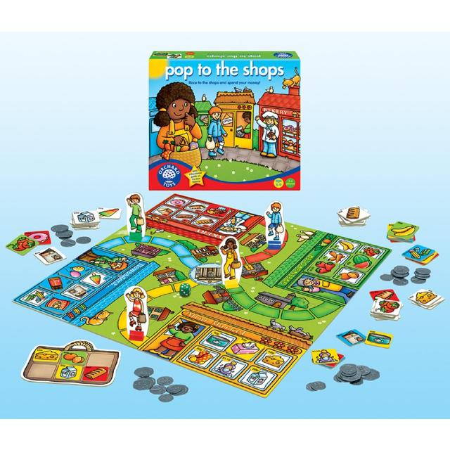
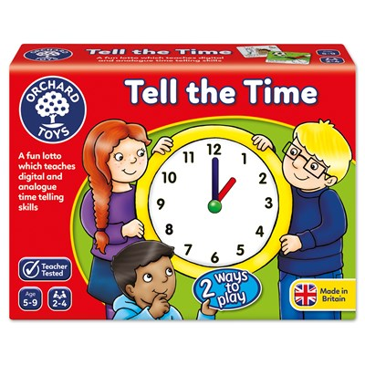
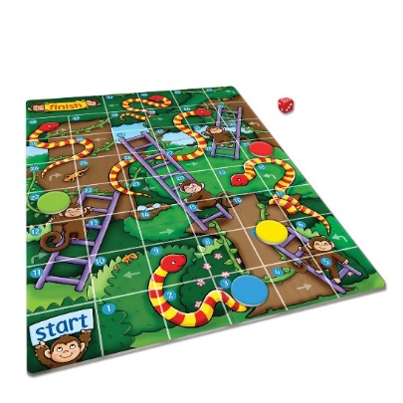
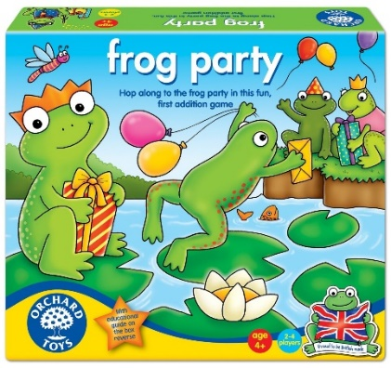
“Board games boost early maths skills” https://www.theguardian.com/education/2008/mar/25/schools.uk3

Slide 15
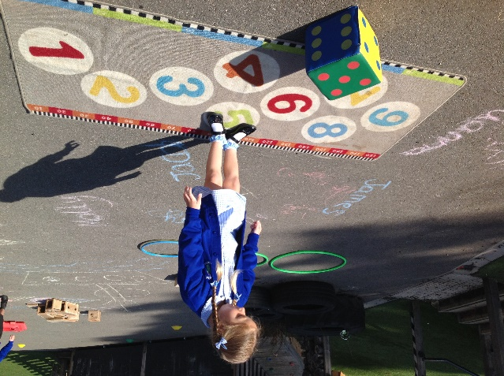
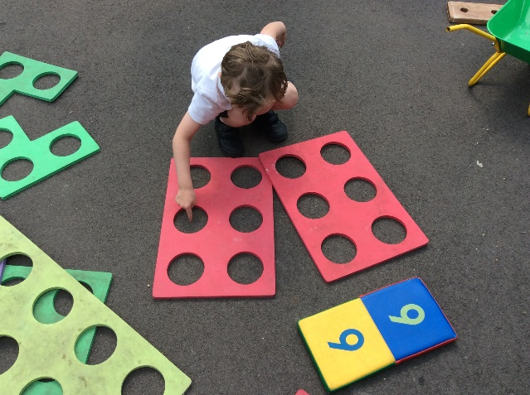
We hope that you have found this presentation useful. If you have any questions regarding maths in the early years at Great Binfields, then please come and speak to us in person or email the admin office.

