Slide 1
SEND Coffee Session
Dyslexia

Slide 2
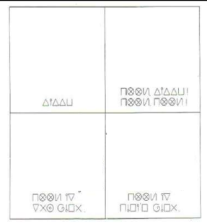

Slide 3
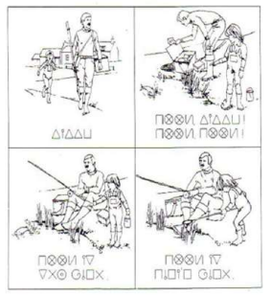

Slide 4
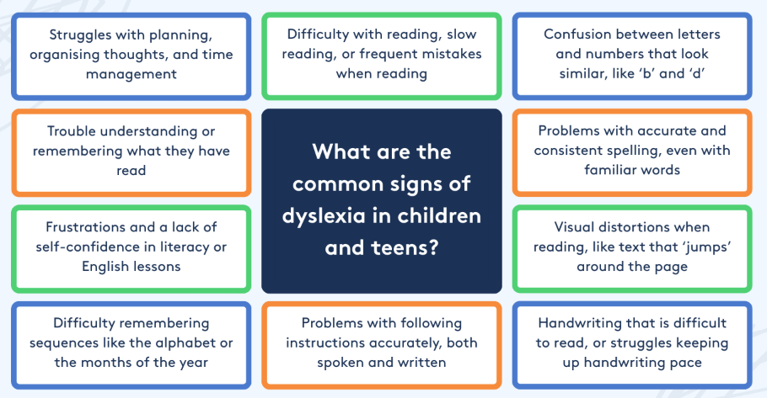

Slide 5
What is Dyslexia and Myths associated with it.
https://www.youtube.com/watch?v=BOn4DWBNdOU
https://www.nessy.com/en-gb/dyslexia-explained/understanding-dyslexia/dyslexia-myths

Slide 6
Label – good or bad?
Positives
Feeling understood
Feeling more able to celebrate strengths and have a hopeful view of the future
Positive associations in research* and popular media
Creativity, Problem-solving, Imagination *findings are inconsistent
Things to remember -
A label of dyslexia does not tell you the specifics of what a child is finding difficult
Research evidence does not support specific interventions that are more beneficial for children with a dyslexia label (compared to other children with literacy difficulties) • Which is a good thing! We can apply the same strategies and support to all those finding literacy learning hard.

Slide 7
Support in school
Literacy interventions
Multi-sensory Learning
Task break downs
Technology (spellchecker, text to speech software, speech to text software)
Reading bookmarks
Pre-learning / over learning – ask about class books
Repetition
Verbal active recall - ask the child to state what you have asked them to do.
Reduce working memory load.
Extra time for tests
Limit copying from the board
Using Mnemonic spelling strategies
Having someone read for the child or scribe for the child.
Reduced spellings per week.
RNIB Bookshare - https://www.rnibbookshare.org/about/information-for-parents

Slide 8
How to support at home
Use reading materials that your child finds interesting e.g. comics.
Read aloud to your child.
Playing games with word sounds.
Audio books
Visuals for organisation and promoting independence.
Establish clear routines.
Time for processing – audio dyslexia
Remind your child that they have many skills that are important, not focus just on what they find difficult.
Help your child find strategies that work for them e.g. colour coding, post its, having set spaces for things.
Remind your child that dyslexia is not a sign of intelligence.

Slide 9
Useful links
Nessy - https://www.nessy.com/en-gb/dyslexia-explained/understanding-dyslexia
Helen Arkell - https://helenarkell.org.uk/about-dyslexia/information-and-advice/parents/supporting-your-dyslexic-child/
Borrow Box - https://www.borrowbox.com/
Barrington Stoke Books - https://collins.co.uk/pages/barrington-stoke?gad_source=1&gad_campaignid=18144540891&gbraid=0AAAAADn5sx77vR_hy1p8OmTwxwmJ7PGw2&gclid=EAIaIQobChMI6tDcw-W6kwMVR5BQBh3bBRvfEAAYASAAEgL_ZPD_BwE
British Dyslexia association - https://www.bdadyslexia.org.uk/

