Slide 1

Expectations for Year 4
What to expect this year….
Learning together, achieving forever.
Notes:
E

Slide 2
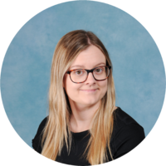
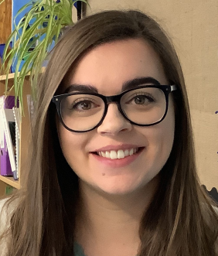
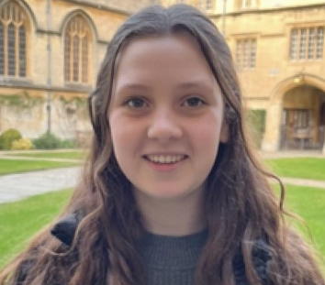
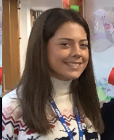
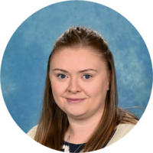
Meet the staff team.
Mrs Franklin
Miss Murrells
Miss Chave
Miss Howard
Teachers
LSAs
The team very much work as a cohort unit so your child will work with a range of adults. We pride ourselves on being an approachable and friendly staff team, so please do contact us as you need!
Mrs Russell
Mrs Ivasyuk
Learning together, achieving forever.
Notes:
Emma

Slide 3
Year 4 Highlights:
Swimming – January (Monday morning)
Viking Dress up Day – Anglo Saxons and Vikings
Ufton Court Residential – 27th to 29th January
Basing House trip – Tudors
Coding unit – Micro:bit
Lots of exciting learning too!
Whilst we will send out reminders of key events, please do refer to our termly dates letter and school calendar found on our website. You can also subscribe to this so you never miss a thing!
Learning together, achieving forever.
Notes:
Phoebe

Slide 4
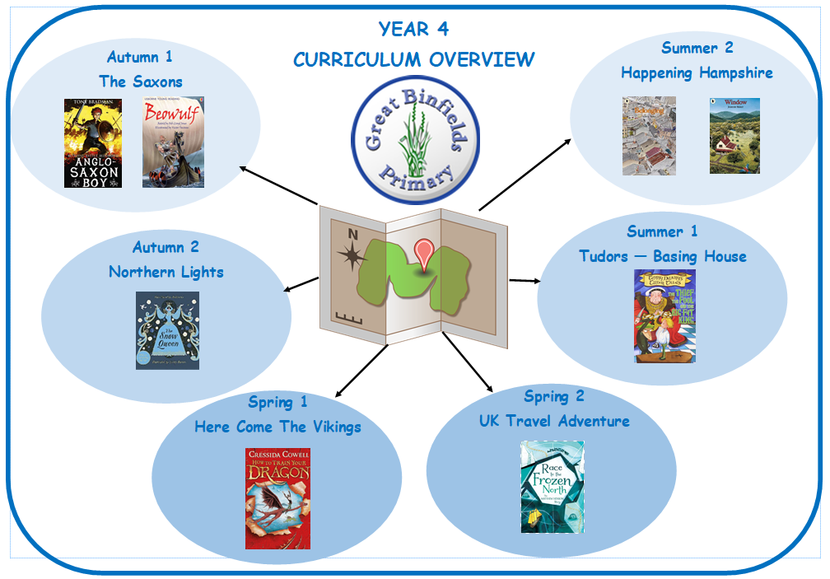
Topics in Year 4
Autumn Term 1 – Saxons
A highlight of this topic includes an Anglo Saxon day
and making a digestion demonstration.
Autumn Term 2 – Northern Lights
A highlight of this topic includes studying a Norwegian
city and creating Northern Lights art.
Spring Term 1 – Vikings
A highlight of this topic includes our Ufton Court Residential.
Spring Term 2 – UK Travel Adventure
A highlight of this topic includes planning a trip around the UK, selecting and researching landmarks to visit.
Summer Term 1 – Basing House and the Tudors
A highlight of this topic includes making clay Tudor roses.
Summer Term 2 – Happening Hampshire
A highlight of this topic includes writing to our local councillor about suggestions for improving our local area.
Learning together, achieving forever.
Notes:
P

Slide 5
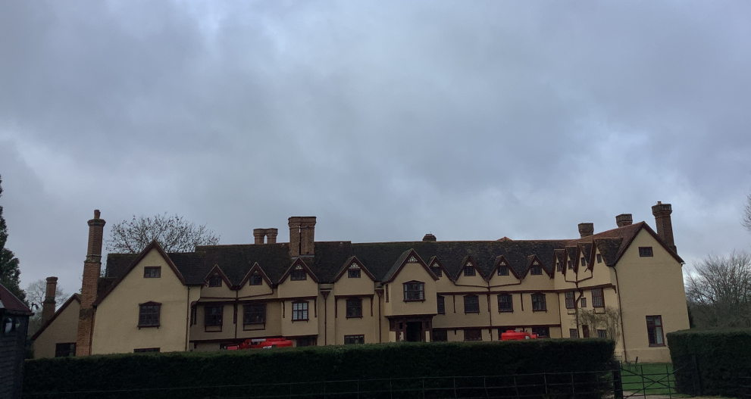

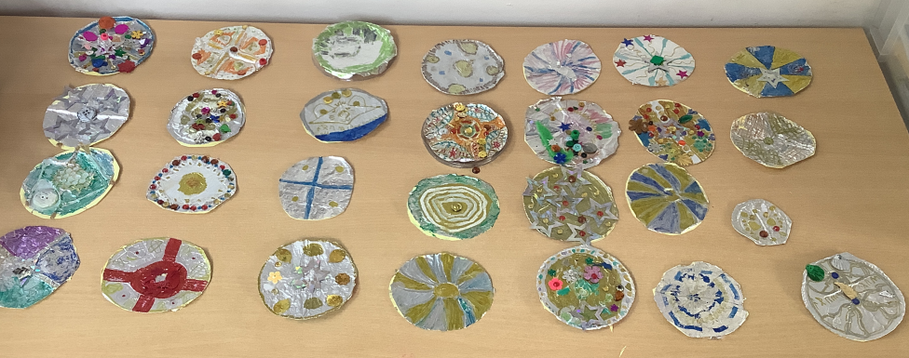
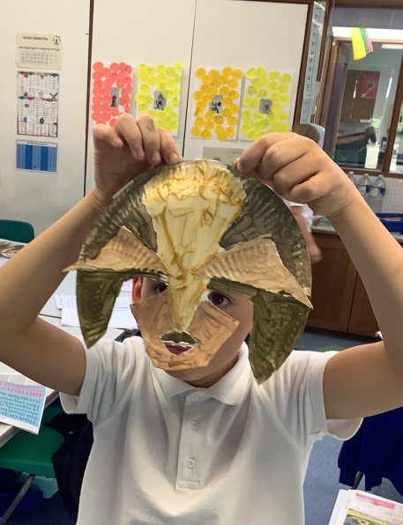
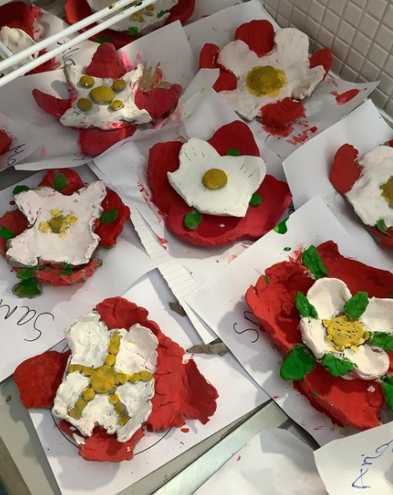
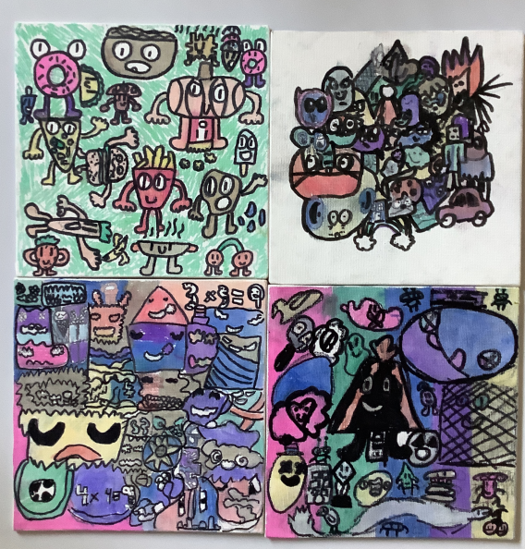
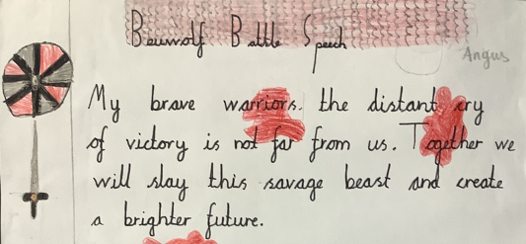
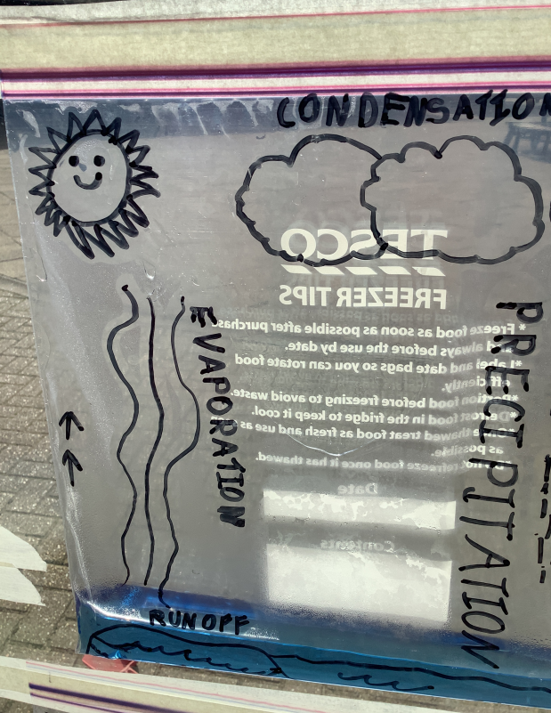

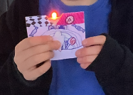
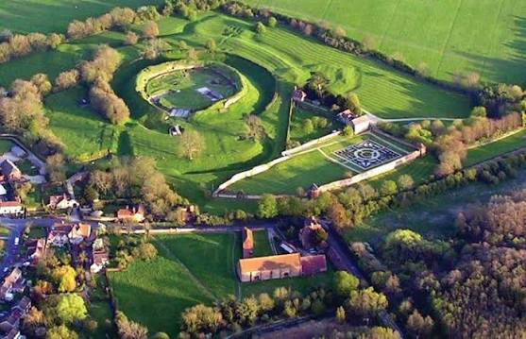
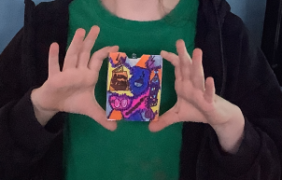
Notes:
Phoebe

Slide 6
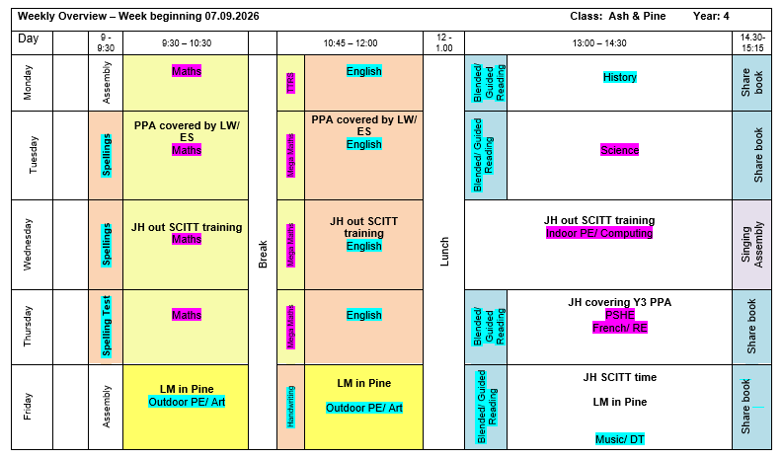
A typical week in Year 4
PE days:
Indoor PE - Wednesday afternoon
Outdoor PE – Friday morning
Notes:
Emma

Slide 7
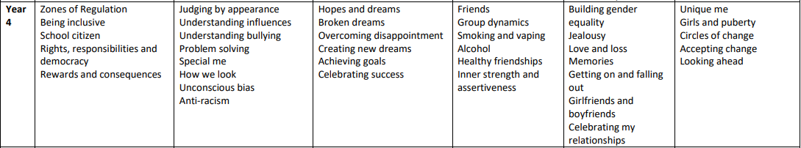
PSHE
https://www.greatbinfields.co.uk/pshe-including-rse-and-citizenship
Please visit our website for our PSHE and RSE policies and more information on how each are taught.
Notes:
Emma

Slide 8
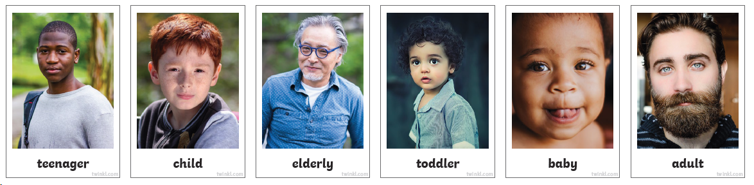

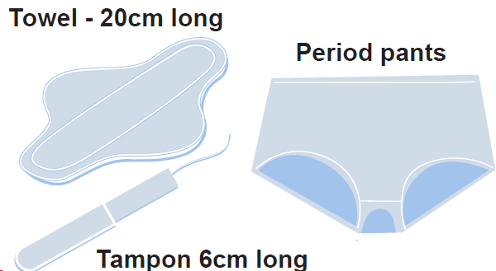
The government has updated RSE guidance for September 2026 onwards and our curriculum has been adapted to be in line with this.
Here is an example of an RSE lesson resource used within our year group:
We also have an RSE parent consultation survey which can be found on our Key Information page. The survey is available to complete at any point, with no end date – responses will be reviewed periodically, and taken into account when the policy is reviewed each year.
Notes:
E

Slide 9
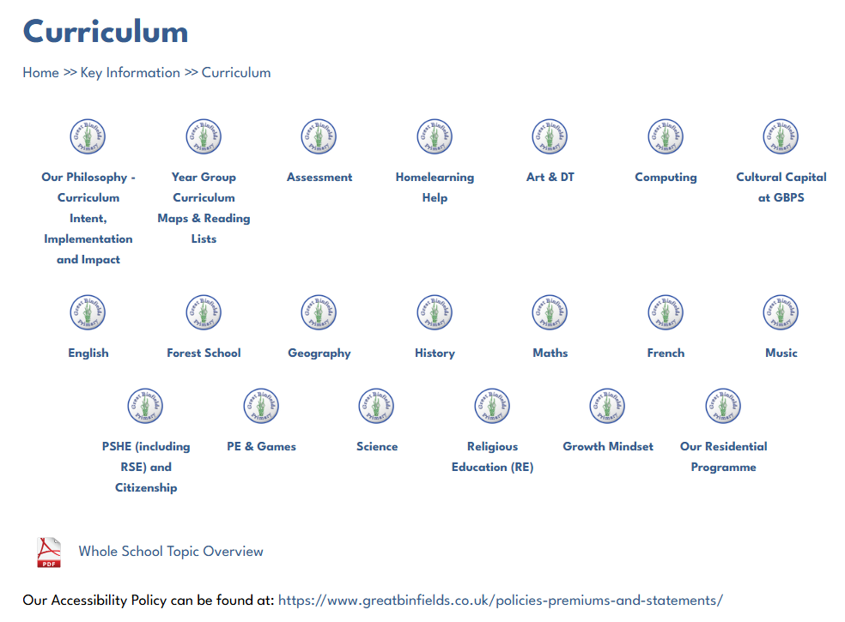
Curriculum pages on our website
https://www.greatbinfields.co.uk/curriculum/
Each area of the curriculum has a dedicated information page on our school website. These pages are kept up to date by our Subject Leads. These pages outline the long term plan for that area across the school. For example, you can see what your child will be learning in Science during their school year, how this progresses from KS1 to KS2 and which objectives we are assessing your children against.
Notes:
Phoebe

Slide 10
Whole School Highlights –
PSHE Days – half termly events, each with different theme based on PSHE learning
Topic visitors and trips
Geography fieldwork
Creativity Week
Sports Day
Half termly House Point Reward Time – a thank you for following the school’s values and Behaviour Code
Learning together, achieving forever.
Notes:
Emma

Slide 11
General Information
Settling in – usual transition and PSHE element
Approachable staff team
Children must not bring in any unnecessary equipment. They are permitted to bring with them a small rucksack (KS2 only)/bookbag only (KS1) containing their lunchbox (if they do not have a school lunch)/healthy break time snack (*), clearly named water bottle and coat
Healthy Snack only - We ask that children in Key Stage 2 bring a healthy playtime snack if they would like one - fruit and vegetables only please. Sweets, crisps and chocolate are not permitted. Please do not pack playtime snacks in your child’s lunch box. These should be kept separately.
Stationery equipment and pencil cases, etc. are provided by school. Please do not send your children in with these. Thank you.
Belongings – please ensure all belongings are named and that your children understand it is their responsibility to look after them. (Lost property in the entrance hall)
No toys / teddies are permitted. Keep them safe for home use.
Year group costs – a letter regarding this has been emailed out
Learning together, achieving forever.
Notes:
Phoebe

Slide 12


https://www.greatbinfields.co.uk/
We will regularly post updates on the latest news page (front page) as the year group enjoys special events.
Each half term, we will post a round up of the topic including pictures of your children learning in action! This will be n the ‘class page’ section of the website (under red ‘children’ tab then ‘class pages’)
The monthly school newsletter is also published on the ‘latest news’ section. This will keep you up to date with school events.
Notes:
Emma

Slide 13


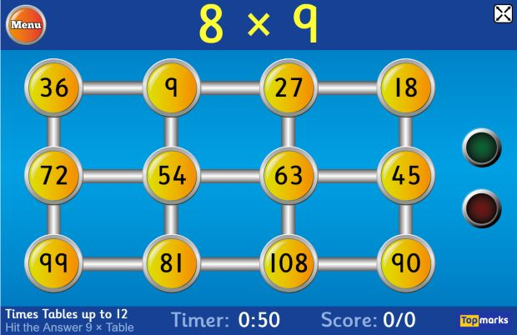

Times tables/Number bonds
Notes:
Phoebe until reading

Slide 14


Maths
We will be using MathSeeds (KS1)
Used for lessons and some home learning activities
Guided learning journey
All children will be given a log in
All parents will get information and a guide on how to use this.
We will be using Mathletics (KS2)
Used for lessons and some home learning activities
Guided online resource giving children access to activities to help Maths learning (fluency, problem solving and reasoning)
All children will be given a log in
All parents will get information and a guide on how to use this.
‘How can I support at home?’
Play games
Number bond practise
Times table practise
Pattern spotting in Maths all around you

Slide 15

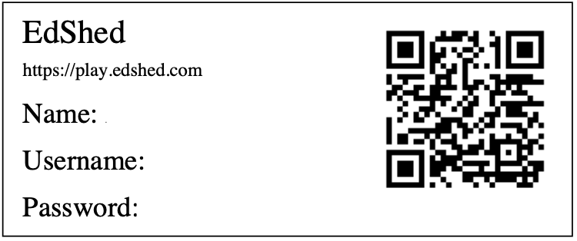
Spellings
The children in KS2 use a programme called ‘Spelling Shed’ to learn their spellings.
The children in KS1 also use Spelling Shed alongside their Monster Phonics.
Spelling Shed is full of many interactive games and activities. Spelling Shed's approach to spelling involves the relationship between sounds and written symbols as well as using morphology to help spell through meaning.
Every Friday, the children are set an activity on Spelling Shed to complete at home. They are tested on the words they have been focusing on in school on the following Thursday.
Reminder - if the children don’t complete the quiz online, it looks like they haven’t completed their home learning.
The children have their own Spelling Shed log in details in their Home School Diary.

Slide 16
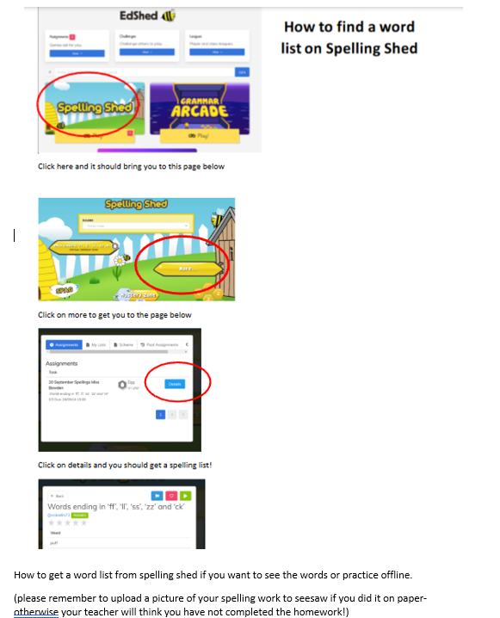

Slide 17
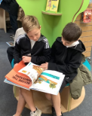
Reading
As your child moves through the book bands, we encourage them to begin really thinking about the books they are interested in and enjoy. They will be encouraged to try and explore a range of texts, promoting a strong and varied reading diet.
Whilst the children will have general reminders to change their books, independence is promoted in KS2 and we find most children are able to effectively manage this themselves, finding the balance between giving enough time to a book but also updating it regularly.
Diaries should be in school every day, so they can be stamped if your child reads 1-1, in a Blended Reading session or in a Guided Reading session. However, diaries are not checked by staff every day so please do not send communication to teachers via diaries.
Remember the expectation is to read to an adult 5 x per week and for this to be recorded in their home school log.
Notes:
Information

Slide 18
Our Home School Log
This book is to travel to and from school every day.
We expect all children to read at least 5 times a week at home. You will need to sign to indicate they have done this. We hope that your child and you as parents find it a useful tool to record your child’s reading achievements.
This book will last for the whole school year and is provided free of charge, however if your child loses their home school book there is a cost of £4.00 to replace it. Please contact the admin office if you need a new diary.
Learning together, achieving forever.
Notes:
Emma on general home learning

Slide 19
Normal Home Learning Expectations (this will be different for each year group)
Our Home Learning Policy can be found on our school website in the Key Information section.
We recognise and value the contribution that learning in the home environment can make to our children’s education. All Home Learning is linked to learning done in class. This may consist of activities to consolidate and re-enforce what has been learnt in a lesson, or investigation work linked to a topic.
The expectation for this year group is: 45 - 60 minutes a week in addition to reading.
Instead of the weekly tasks set, there will be a maximum of one home learning project (with at least 2 weeks given to complete) in every year group per half term. These tasks are more research and project based but provide stimulating and relevant open-ended tasks for those children who may manage to complete their set homework very quickly.
Home learning will be posted on Seesaw on a Friday, to be returned via Seesaw by the following Thursday.
We believe that the support of parents and carers is essential for children to make the most of their home learning opportunities. There are many ways in which parents can help their children, for example, by: encouraging and supporting them; playing games with them; practicing times tables, number bonds and telling the time; practicing the children’s phonic patterns and spellings they receive; listening to children read 5 times per week and providing opportunities for real life experience; talking, shopping, using money, cooking, letter writing etc
Learning together, achieving forever.

Slide 20

As children move up through the school, they will become more and more proficient at using Seesaw for their Home Learning but also for in-school learning opportunities.
Your child may have an activity on their account that says “In school activity – no home action required”. This means they will be completing the task in school and will not need to complete it at home. This does however provide a good talking point of what your child has been doing in their learning time!
As children progress into KS2, they will have increased independence when it comes to accessing their Home Learning.
On each Home Learning activity set, there will be capacity to indicate whether the activity was completed independently or with support.
Seesaw is a really creative way for children to showcase their learning, we would encourage them to make use of these tools as they feel more confident.

Slide 21
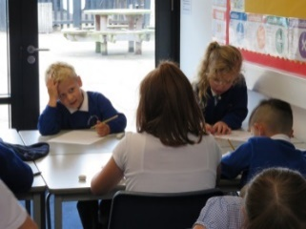
Some further guidance about Home Learning
Pupils are expected to complete tasks given in the time allocated.
Staff will provide feedback to each piece of Home Learning. This may be in the written or audio form.
Children who do not do their homework: It is the responsibility of all class teachers to see who has completed the home learning on the day that it is due to be returned. If unforeseen circumstances have arisen and made it impossible for the child to do the home learning set, please notify the class teacher of this.
If a child does not complete their Home Learning twice the class teacher will contact the child’s parents to discuss what support can be put in place.
If this continues for three consecutive weeks, the Deputy Headteacher will be informed and will contact parents to ascertain the possible reasons why.
If homelearning is handed in late – it may well be that the teacher will not mark it until the following week due to other working commitments.
All of this information can be found in our Home Learning Policy.

Slide 22

Computing and e-safety
A reminder for you: Our Safer Internet Day for our children is in the Spring term – further details to follow.
E-safety is planned into our curriculum in both Computing and as part of our PSHE/Jigsaw learning.
We also have lots of information on e-safety on our website in the Children’s section and will signpost you accordingly.
Our E-safety lead (Deputy Headteacher Mrs Holdsworth) is informed of all e-safety concerns in school and keeps track of emerging patterns.
Learning together, achieving forever.
Notes:
Phoebe

Slide 23
Continuous and end of year assessment for our year group
We continually assess our children throughout the day, week, term so that we know we are providing them with a curriculum they can access and rightfully deserve. This is called formative assessment.
We use a system in school to record your children’s progress throughout the year. Our Leadership Team monitor this system regularly to ensure all pupils are adequately challenged and supported. In addition to this, Pupil Progress Meetings are held where class teachers and the Leadership team meet to discuss how individuals, specific groups or cohorts have been targeted, supported and challenged in the form of various interventions so that all children in our school have the best possible chance of meeting their end of year expectations as set out by the Government.
We report how your child/ren are doing in their ongoing and end of year assessments during our Autumn and Spring Parents’ Meetings and of course in their end of year Achievement Report which is sent home in July.
Please do contact us if you have any questions of concerns regarding your child’s curriculum progress.
Assessment information is also fed back to our Governing Body, our Local Authority and in the case of some year groups, the Government for statistical analysis.
Learning together, achieving forever.
Notes:
Emma

Slide 24
School Uniform Expectations
We take great pride in our uniform and it is important that all children and parents support us in ensuring that children have the correct uniform at all times. Wearing a school uniform helps to promote unity and team spirit among our pupils.
PLEASE REFER TO OUR RECENTLY REVISED GUIDANCE WHICH CAN BE FOUND ON OUR WEBSITE https://www.greatbinfields.co.uk/school-uniform/
Children wear a blue logoed school cardigan or sweatshirt (no fleeces inside), white polo shirt*, grey skirt or grey trousers for girls, and grey trousers for boys.
In the summer boys can wear grey shorts and girls can wear a dress, either blue/white stripe or gingham.
We ask that sensible, robust, black shoes are worn, and not trainers.
To avoid unnecessary cost, please ensure all uniform is clearly labelled with your child’s name.
Learning together, achieving forever.
Notes:
Phoebe until end of PE kit

Slide 25
Clothing Grants
If you have difficulty providing your child with essential items of clothing or footwear, a limited amount of financial assistance may be available through Pupil Premium Funding depending on your income.
We also have lots of second-hand uniform (check out our FOGB page)
Further advice is available from our school office.
Learning together, achieving forever.

Slide 26
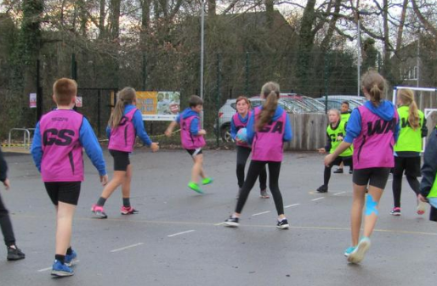
PE Kit Expectations
All children need to come into school wearing a complete P.E. / Games kit on their PE days. Your child needs:
To remove earrings before they come into school and if hair is long, it needs to be tied up. If earrings are worn, they will need to use cover tape
To wear plain blue or black shorts underneath jogging bottoms/leggings for indoor PE. Children must have shorts on for health and safety (friction on wall bars – less slippy!)
To wear their plain house coloured T-shirt (these are available from FOGB PTA)
To wear sensible trainers for the whole day
Everything should still be clearly named
It is your family’s responsibility to ensure they wear their kit in school on the right days as PE/Games is a statutory part of our curriculum

Slide 27


Our relational approach
We are firm believers of connection before correction
We place relationships at the heart of all we do
We are proud to be an accredited bronze level ATA (Attachment and Trauma Aware) School.
We move through a system of: verbal warning, RP (reflection points), RF (reflection form).
Notes:
Emma until ZOR

Slide 28
If a child receives a reflection form, this is usually completed by a member of the Senior Leadership Team (Miss Dillon – HT or Mrs Holdsworth – DHT/Behaviour Lead) or the SENDCO (Miss Khan). We encourage the child to reflect on their choices and think about how they could have handled it differently. We link this to our zones of regulation and we consider ‘natural consequences’ to ‘repair damage’.
Parents/carers are notified by the Admin team via e-mail if their child is bringing a reflection form home with them. This is to keep you informed about the events of the day. Please sign to acknowledge receipt of it. There is also the option to speak to someone further about the incident, if necessary.
We adopt a model of ‘restorative justice’ between pupils where appropriate and ask them to consider each other’s viewpoints.
Notes:
E

Slide 29

Zones of regulation
Our Behaviour Code is underpinned by Zones of regulation. This helps enable the children to label their emotions, how their bodies may have been feeling and possible reasons for why they may have felt this way. We also encourage the children to reflect on their behaviour choices and think about how they could have acted differently. We refer to the restoration process as ‘repairing damage’ and this may be in the form of an apology to someone, picking something up from the floor or mending something which has become broken as a result of their actions.
Notes:
E

Slide 30
Rewards at GBP for fulfilling responsibilities and for trying to be the very best version of themselves
Golden Trail Treat – whole class team effort – once completed they vote for a safe trail treat, e.g. in class biscuit decorating, craft, pebble painting, etc.
Pupil of the Week – awarded to 1 child from each class, each week during Friday’s celebration assembly.
Home Notes from Miss Dillon (HT) or Mrs Holdsworth (DHT) – awarded for exceptional effort.
Values certificates and rainbow pin badges – for following the school’s values.
House points & House point reward time for the winning house each half term. Children stay in the same team throughout their time at our school. They collect house points for following the school’s values and Behaviour Code throughout the school day, including playtimes.
Learning together, achieving forever.
Notes:
Phoebe

Slide 31
Sharing your children’s out of school achievements
If your child has accomplished something special out of school, please do encourage them to speak to us and they can share this with their classmates or, if a particularly special moment, the rest of our school during our Friday assemblies.
We regularly have children sharing their sporting/dance achievements, their work for charity etc. and also their musical achievements too. We love seeing our children live out the Great Binfields values.
Notes:
Phoebe

Slide 32
Safeguarding Responsibilities
Everyone in our school community has a responsibility to safeguard our children.
Our school’s DSL(*)s are: Miss Dillon (Lead), Mrs Holdsworth (Deputy Headteacher) and Miss Khan (SENCo). All of our staff are safeguarding trained.
Please contact school to speak to our DSL or one of our DDSLs if you have any safeguarding concerns.
We have lots of safeguarding information on our school website.
(*) (D)DSL = (Deputy) Designated Safeguarding Lead
Notes:
Emma

Slide 33
Any Questions?

Slide 34

Thank you for attending this meeting – your support is very much appreciated and we look forward to working together with your children.

